Slide 1
Chapter 14
Forging the National Economy, 1790–1860
PART 2

Slide 2
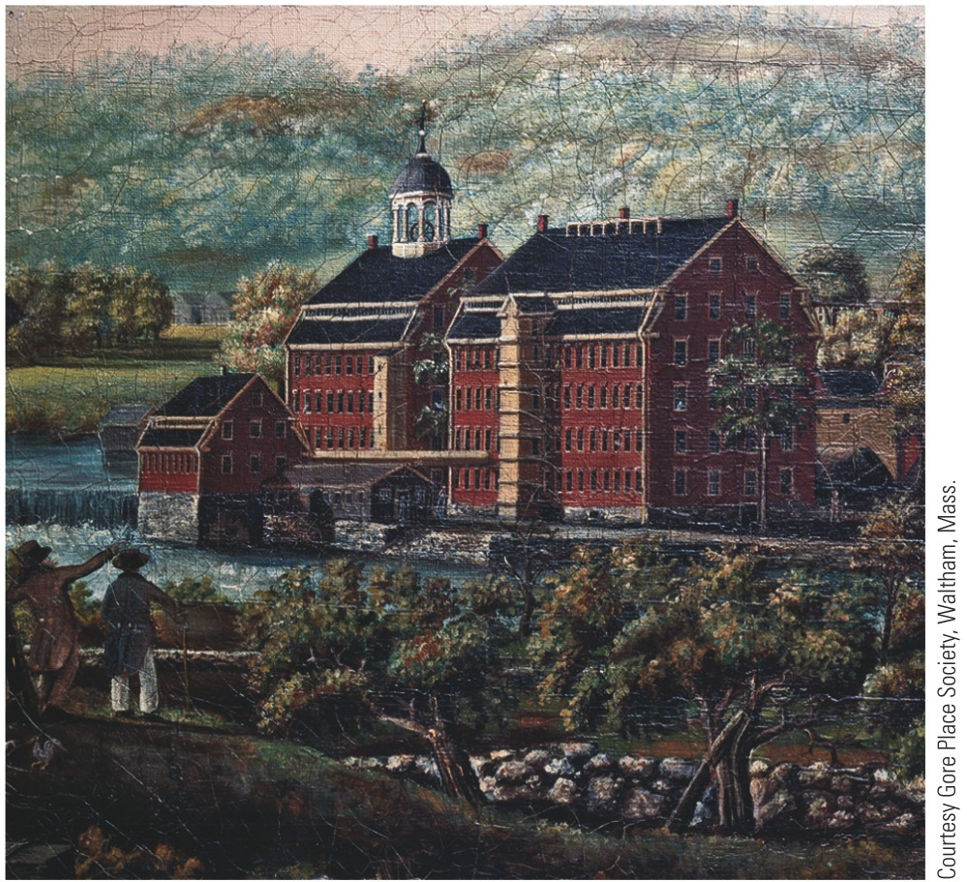
p290
Notes:
Francis Cabot Lowell’s Mill, Waltham, Massachusetts, 1826, and Cotton Industry; Carding,
Drawing, and Roving; Engraving, 1835 Built in 1814, Lowell’s mill (left) was a marvel of
manufacturing efficiency. It combined all phases of production, including spinning and weaving,
under one roof. The mill’s labor force (right) was composed primarily of young women from the
local farming communities.

Slide 3
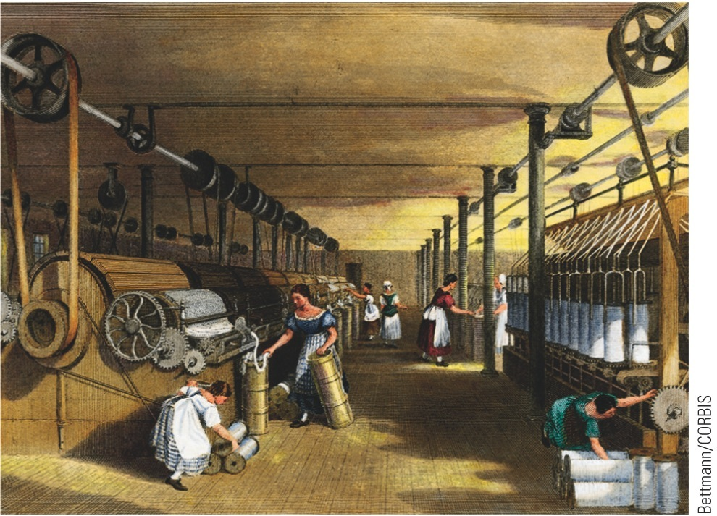
p290
Notes:
Francis Cabot Lowell’s Mill, Waltham, Massachusetts, 1826, and Cotton Industry; Carding,
Drawing, and Roving; Engraving, 1835 Built in 1814, Lowell’s mill (left) was a marvel of
manufacturing efficiency. It combined all phases of production, including spinning and weaving,
under one roof. The mill’s labor force (right) was composed primarily of young women from the
local farming communities.

Slide 4
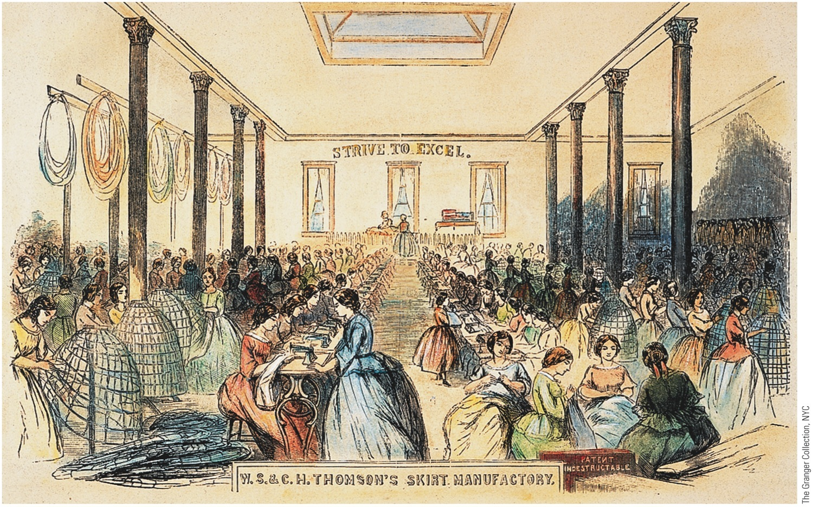
p295
Notes:
The Sewing Floor of Thompson’s Skirt Factory, 1859 The burgeoning textile industry provided
employment for thousands of women in antebellum America—and also produced the clothes that
women wore. This view of a New York City shop in 1859 illustrates the transition from hand-sewing
(on the right) to machine-stitching (on the left). It also vividly illustrates the contrast between the kinds
of “sewing circles” in which women had traditionally sought companionship to the impersonal mass production
line of the modern manufacturing plant. Note especially the stark exhortation on the
wall: “Strive to Excel.”

Slide 5
Women and the Economy
Factory jobs still unusual for women:
Few opportunities to be economically self-supporting (mainly nursing, domestic services, and teaching)
Teaching profession became “feminized” as men left for other opportunities

Slide 6
Women and the Economy
Other “opportunities” in household service:
One white family in ten employed poor white, immigrant, or black women
10% of white women worked outside home
20% of all women employed at some time before marriage
Vast majority of working women single
Upon marriage, left job to become wives and mothers, without wages

Slide 7
What was the “Cult of Domesticity”?

Slide 8
Women and the Economy
Cult of domesticity:
Widespread cultural creed that glorified customary functions of homemaker
Women's changing roles:
Industrial Revolution changed life in home of nineteenth-century: traditional “women's sphere”
Love, not parental “arrangement” determined choice of spouse—yet parents retained power of veto
Families grew smaller

Slide 9
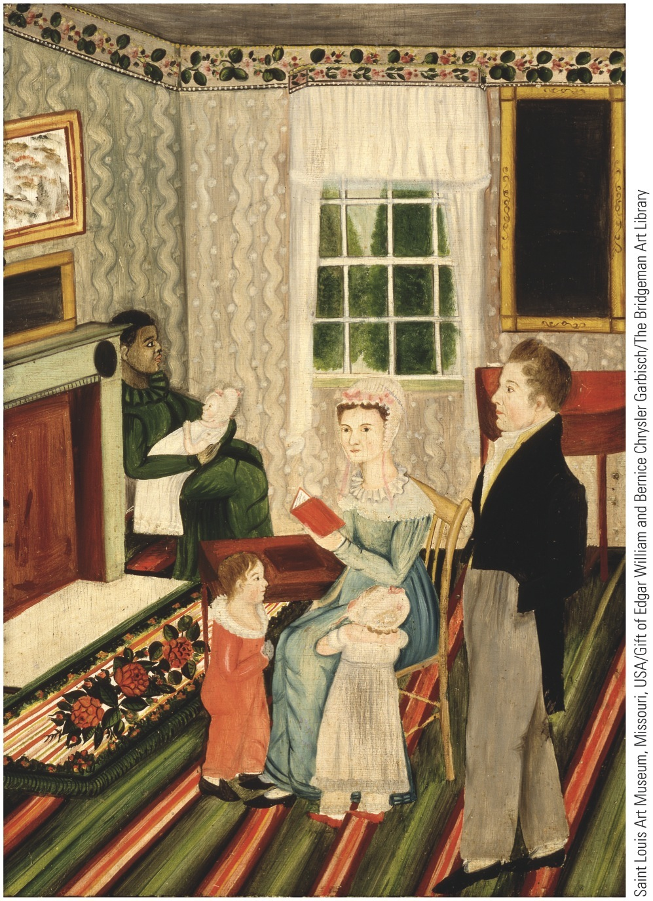
p296
Notes:
York, Pennsylvania, Family with Negro Servant, ca.
1828 This portrait of a Pennsylvania family presents
a somewhat idealized picture of the home as the
woman’s sphere. The wife and mother sits at the
center of activity; while she reads to the children,
the husband and father stands by somewhat superfluously.
A black servant cares for an infant in the corner,
suggesting the prosperous status of this household.

Slide 10
Western Farmers Reap a Revolution in the Fields
Flourishing farms changed face of West:
Trans-Allegheny region—esp. Ohio-Indiana-Illinois tier—fast becoming nation's breadbasket
Before long, would become granary to world
Pioneer families cleared the forests
Then planted corn fields
Yellow grain amazingly versatile

Slide 11
Western Farmers Reap a Revolution in the Fields
Most western products first moved by Ohio-Mississippi Rivers
Inventions helped farmers:
John Deere in 1837 produced a steel plow that broke stubborn soil:
Light enough to be pulled by horses, rather than oxen
1830 Cyrus McCormick invented mechanical mower-reaper
Could do work of 5 men with sickles and scythes
To western farmers what cotton gin was to South

Slide 12
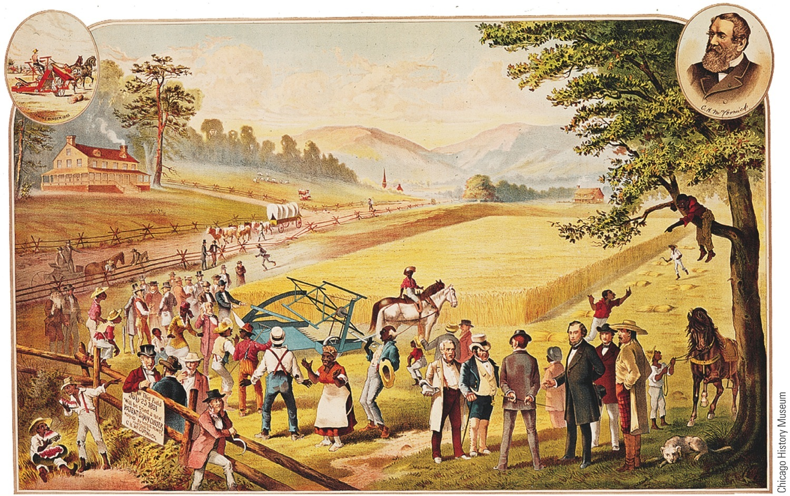
p297
Notes:
McCormick’s Miraculous Reaper This illustration shows an early test of Cyrus
McCormick’s mechanical reaper near his home in Virginia in 1831. The reaper was
best suited, however, to the horizonless fields of wheat on the rolling prairies of the
Midwest. By the 1850s McCormick’s Chicago factory was cranking out more than
twenty thousand reapers a year for midwestern farmers.

Slide 13
Western Farmers Reap a Revolution in the Fields
McCormick reaper:
Made ambitious capitalists out of humble plowmen
Subsistence farming gave way to large-scale food production
Specialized, cash-crop agriculture came to dominate trans-Allegheny West
With it followed mounting indebtedness
Wanted more land and more machinery
Dreamed of new markets in mushrooming factory towns of East or across Atlantic
However, still landlocked—needed transportation revolution

Slide 14
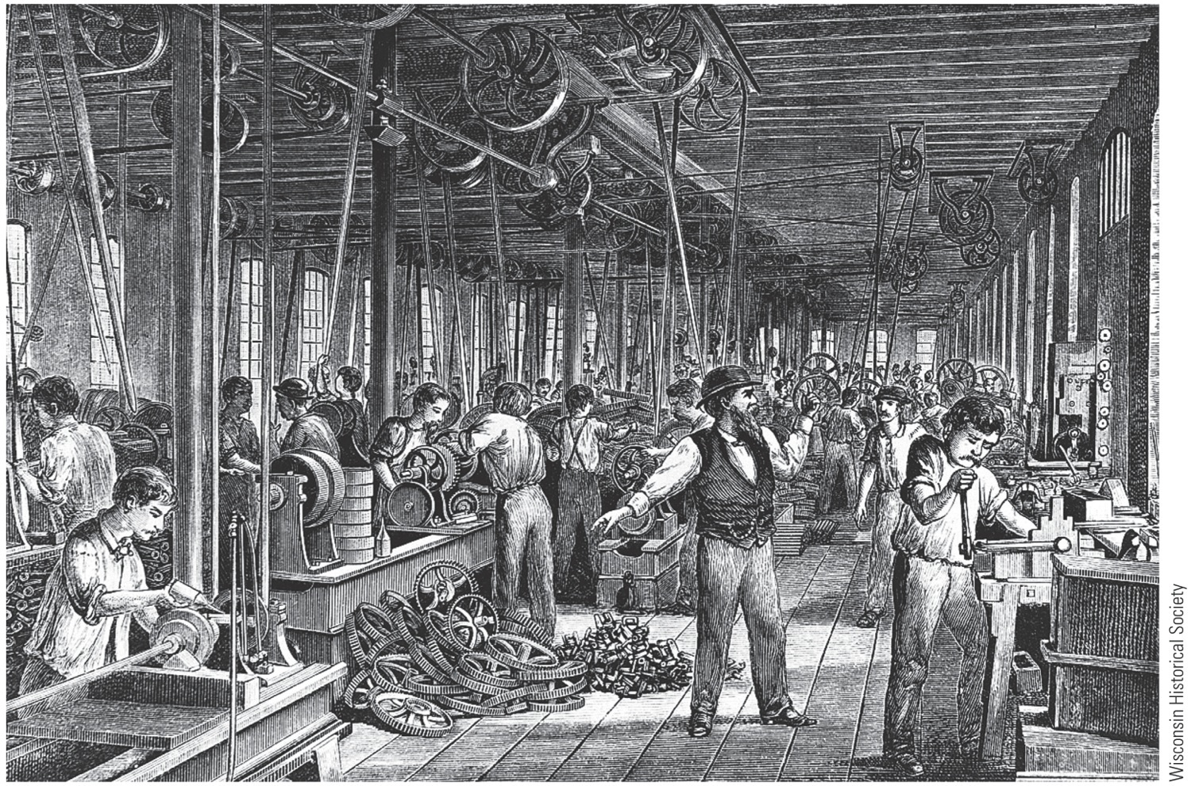
McCormick Reaper Works, 1850s Contrast this hectic scene of “mass production”
with the simple workplace depicted in “The Wheelwright’s Shop” on p. 293.
p298

Slide 15
Highways and Steamboats
In 1789, when Constitution launched, primitive methods of travel still dominated:
Waterborne travel slow, uncertain, often dangerous
Stagecoaches and wagons lurched over bone-shaking roads
Cheap, efficient transportation increasingly needed
In 1790s, private company completed profitable Lancaster Turnpike in Pennsylvania, running 62 miles from Philadelphia to Lancaster

Slide 16
Highways and Steamboats
As driver approached tollgate, they confronted barrier of sharp pikes, which were turned aside when toll paid (hence, turnpike)
Western road building, always expensive, encountered many obstacles:
Noisy states' righters opposed federal aid to local projects
Eastern states protested against being bled of populations by westward-reaching arteries
Westerners scored key triumph in 1811 when federal government started construction of National Road—known as Cumberland Road

Slide 17
Highways and Steamboats
Robert Fulton started steamboat craze:
Installed powerful steam engine on Clermont:
In 1807, it went from New York City up Hudson River to Albany—150 miles in 32 hours
Success of steamboat was sensational
Fulton changed all of America's navigable streams into two-way arteries, doubling carrying capacity
(1820): 60 steamboats on Mississippi and tributaries
(1860): 1,000

Slide 18
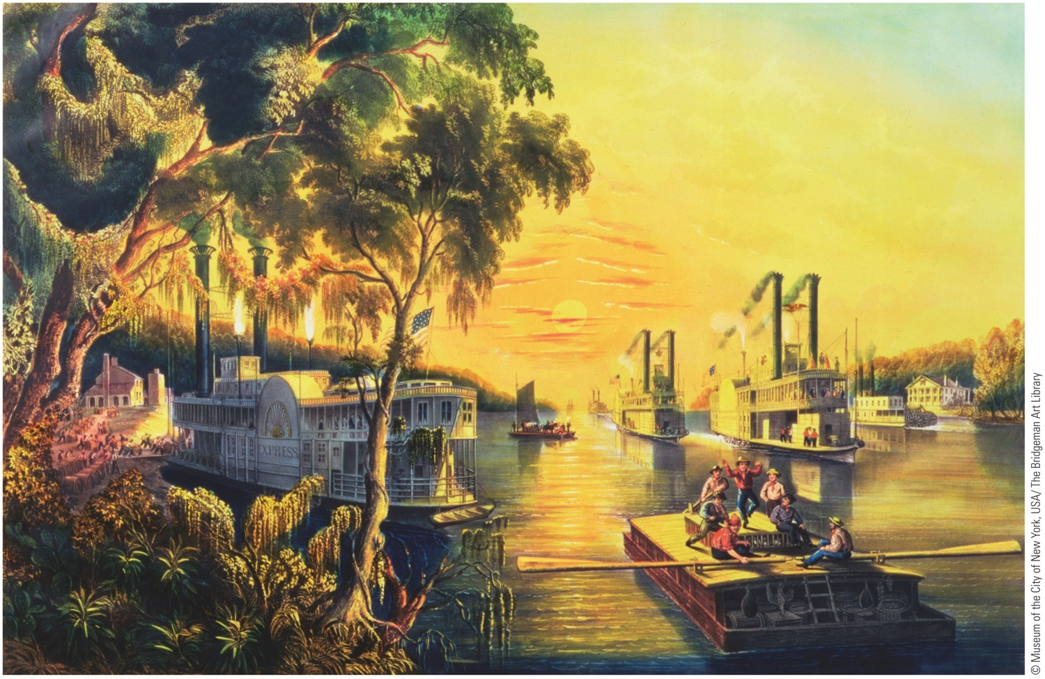
p299
Notes:
Mississippi in Time of Peace, by Mrs. Frances Flora Bond Palmer, 1865 By the mid-nineteenth
century, steamboats had made the Mississippi a bustling river highway—as it remains today.

Slide 19
“Clinton's Big Ditch” in New York
Canal-cutting craze paralleled boom in turnpikes and steamboats:
New Yorkers, denied federal aid by states' righters, funded Erie Canal themselves to link Great Lakes with Hudson River
Driving leadership of Governor DeWitt Clinton
Project called “Clinton's Big Ditch” or “Governor's Gutter”

Slide 20
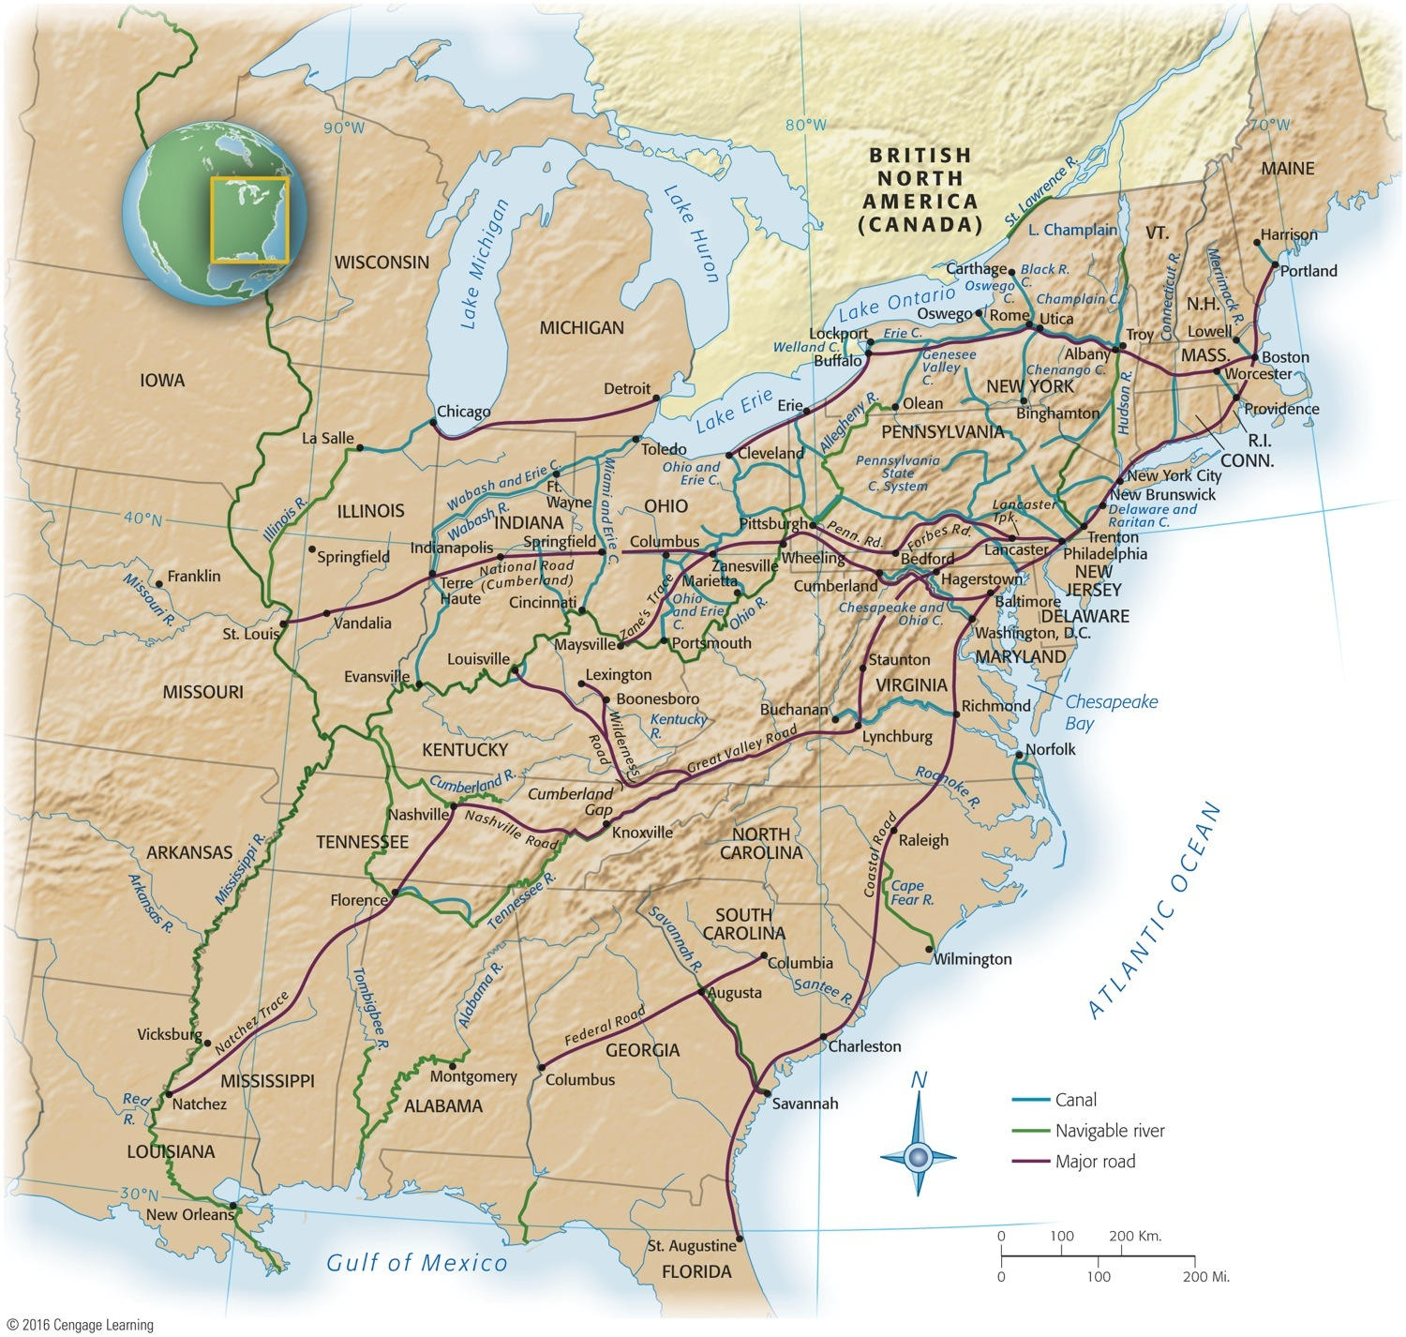
Map 14-2 p300
Notes:
Map 14.2 Major Rivers, Roads, and Canals, 1825–1860 © 2016 Cengage Learning

Slide 21
“Clinton's Big Ditch” in New York
Begun in 1817, canal stretched 363 miles from Buffalo on Lake Erie, to Hudson River, onto New York harbor
Shipping sped up as cost/time dropped significantly
Other economic ripples
Value of land along route skyrocketed and new cities, Rochester and Syracuse, blossomed
New profitability of farming in Old Northwest—Ohio, Michigan, Indiana, Illinois attracted European immigrants
Cleveland, Detroit, and Chicago grew in size

Slide 22
The Iron Horse
Development of railroad:
Fast, reliable, cheaper than canals to construct, and not frozen over in winter
Able to go anywhere—it defied terrain and weather
First railroad appeared in 1828 and new lines spread swiftly
Faced strong opposition from canal builders
Other obstacles:
Brakes so feeble that engineers might miss station
Arrivals and departures were conjectural
Differences in gauge required passengers to make frequent changes of trains

Slide 23
The Iron Horse
Improvements came:
Gauges gradually became standard
Safety devices adopted
Pullman “sleeping palace” introduced in 1859
America at long last bound together with braces of iron, later to be made of steel

Slide 24
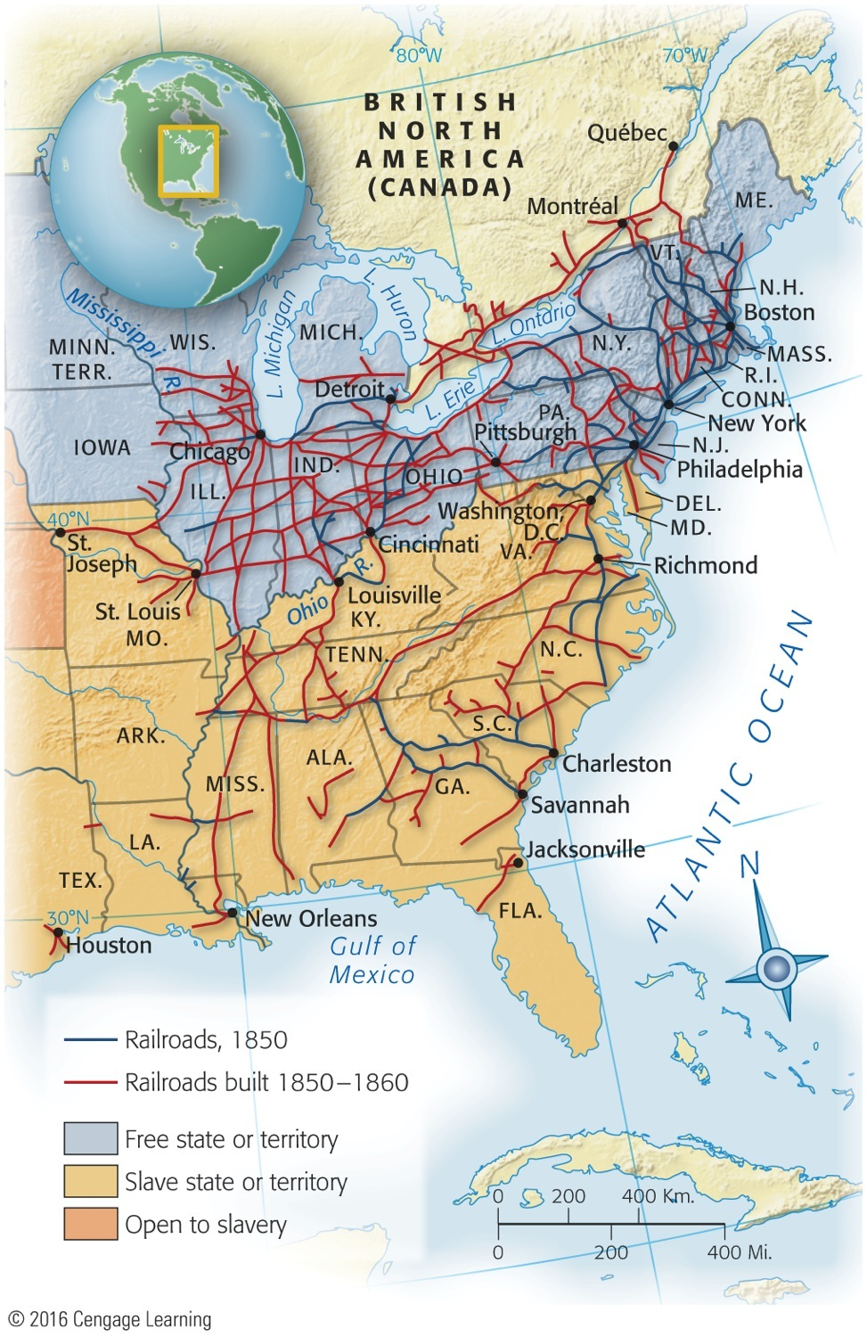
Map 14-3 p301
Notes:
Map 14.3 The Railroad Revolution Note the explosion
of new railroad construction in the 1850s and its heavy
concentration in the North. © 2016 Cengage Learning

Slide 25
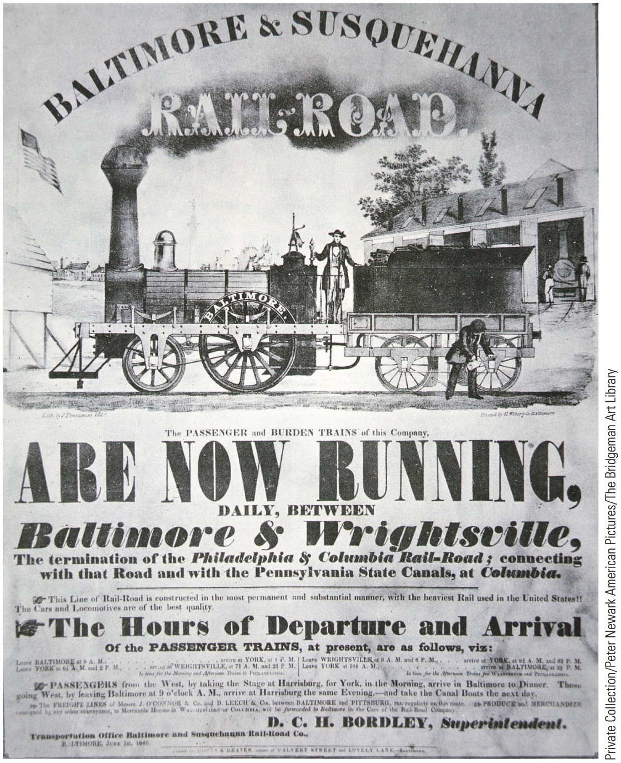
p302
Notes:
Poster-Timetable for Baltimore & Susquehanna
Railroad, 1840 Advertising the Baltimore & Susquehanna’s
train schedule alone was not sufficient to get
passengers to their destinations. A typical trip often
entailed coordinating legs on other railroad lines,
stagecoaches, and canal boats.

Slide 26
Cables, Clippers, and Pony Riders
Other forms of transportation and communication linked United States and world:
Cyrus Field in 1858:
Called “the greatest wire-puller in history,” stretched a cable from Newfoundland to Ireland
A heavier cable in 1866 permanently linked American and European continents
Donald McKay developed new clipper ships
Sacrificed cargo space for speed
Their hour of glory was relatively brief

Slide 27
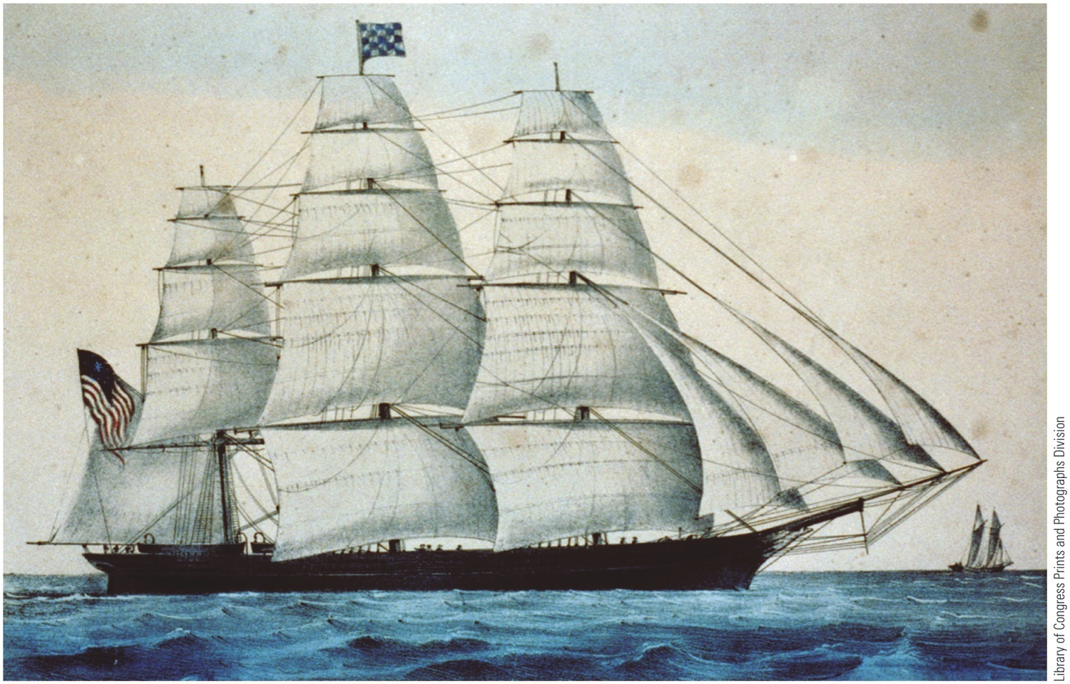
p302
Notes:
Poster-Timetable for Baltimore & Susquehanna
Railroad, 1840 Advertising the Baltimore & Susquehanna’s
train schedule alone was not sufficient to get
passengers to their destinations. A typical trip often
entailed coordinating legs on other railroad lines,
stagecoaches, and canal boats.

Slide 28
Cables, Clippers, and Pony Riders
Eve of Civil War, British steamers won race for maritime ascendancy:
Steadier, roomier, more reliable – thus more profitable
Stagecoaches:
Immortalized by Mark Twain's Roughing It
Their dusty tracks stretched from banks of muddy Missouri River clear to California (see Map 14.4)
Pony Express (1860):
Carried mail speedily the 2,000 miles from St. Joseph, Missouri to Sacramento, California; ten day trip
Lasted only 18 months

Slide 29
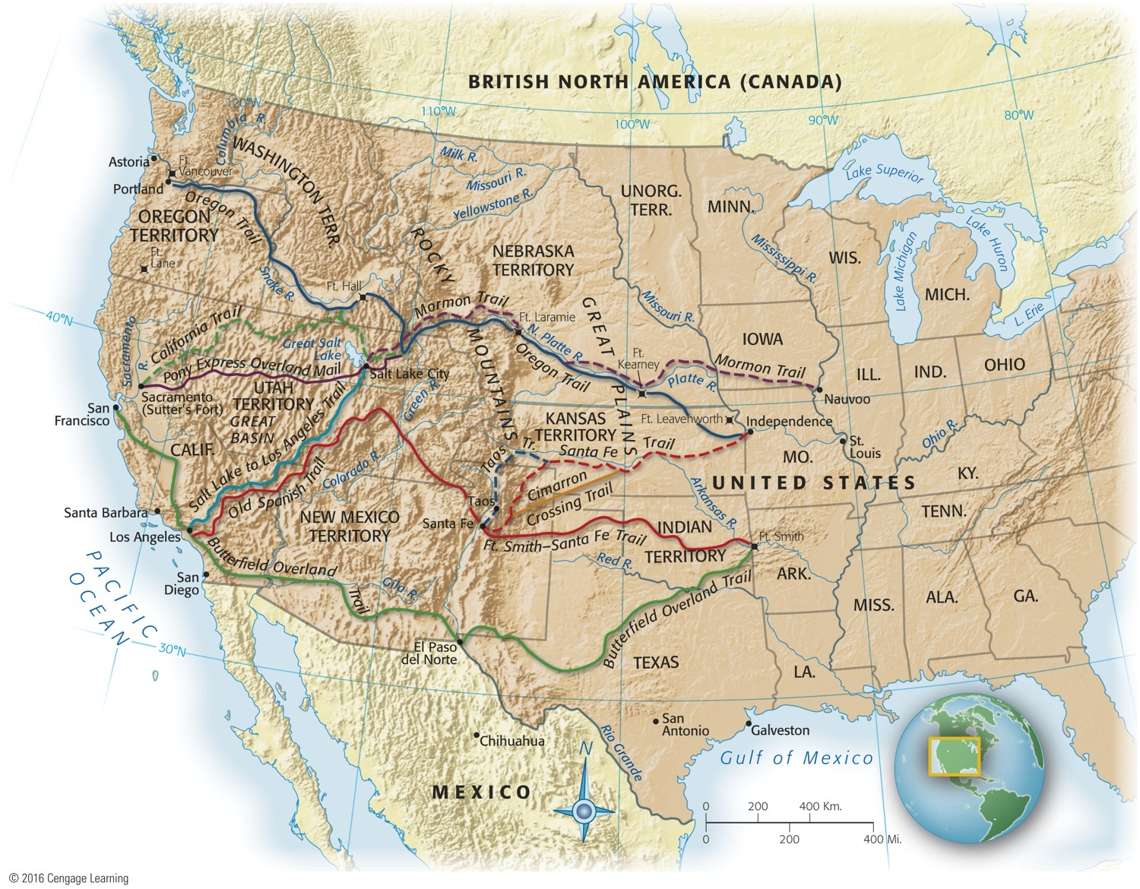
Map 14-4 p303
Notes:
Map 14.4 Main Routes West Before the Civil War Mark Twain described his stagecoach trip to
California in the 1860s in Roughing It: “We began to get into country, now, threaded here and there with
little streams. These had high, steep banks on each side, and every time we flew down one bank and
scrambled up the other, our party inside got mixed somewhat. First we would all be down in a pile at the
forward end of the stage, . . . and in a second we would shoot to the other end, and stand on our heads.
And . . . as the dust rose from the tumult, we would all sneeze in chorus, and the majority of us would
grumble, and probably say some hasty thing, like: ‘Take your elbow out of my ribs!—can’t you
quit crowding?’” © 2016 Cengage Learning

Slide 30
Cables, Clippers, and Pony Riders
Express riders unhorsed by Morse's clacking keys
Began messages to California in 1861
Swift ships and fleet ponies ushered out a dying technology of wind and muscle
In future, machines would dominate

Slide 31
The Transport Web Binds the Union
Transportation revolution:
Stimulated by desire of East to tap West
Western rivers drained southward to cotton belt
Steamboats reversed flow by bringing finished goods to West and helped bind West and South together
Three decades before Civil War, canals and railroads from East tied seaboard with blossoming heartland
Impressive grid of “internal improvements” established
By 1860, a truly continental economy had emerged

Slide 32
The Transportation Web Binds the Union
Division of labor applied on a national level
Each region specialized in particular type of economic activity
South raised cotton
West grew grain and livestock
East made machines and textiles
Economic pattern had fateful political and military implications:
Many southerners regarded Mississippi as a chain linking upper valley states to southern Cotton Kingdom
They believed some or all of these states would secede with them or be strangled

Slide 33
The Transportation Web Binds the Union
They overlooked man-made links that bound upper Mississippi Valley to East
Southern rebels would not only have to
fight Northern armies
Also tight bonds of interdependent continental economy
Economically, two northerly sections were conjoined twins

Slide 34
The Market Revolution

Slide 35
The Market Revolution
Market Revolution:
Transformed subsistence economy of scattered farms and tiny workshops into national network of industry and commerce
Greater mechanization and robust market-oriented economy raised new legal questions:
How tightly should patents protect inventions?
Should government regulate monopolies?
Who should own technologies and networks?
Chief Justice John Marshall's Court protected contract rights by requiring states to grant irrevocable charters

Slide 36
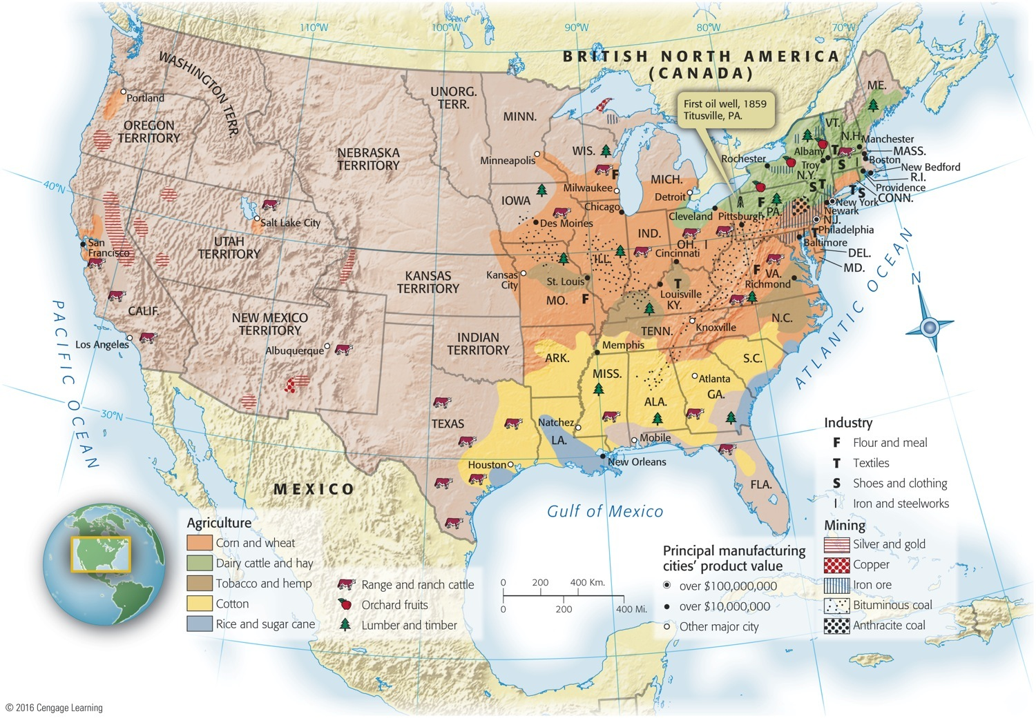
Map 14-5 p305
Notes:
Map 14.5 Industry and Agriculture, 1860 Still a nation of farmers on the eve of the Civil War,
Americans had nevertheless made an impressive start on their own Industrial Revolution, especially
in the Northeast. © 2016 Cengage Learning

Slide 37
The Market Revolution
Monopolies easily developed and new companies found it difficult to break into markets
Chief Justice Roger Taney argued “rights of the community” outweighed exclusive corporate rights:
His decision encouraged greater competition
So did passage of more liberal state incorporation laws
Self-sufficient households of earlier were transformed:
Now families scattered to work for wages in factories
Or planted just a few crops for sale at market
Used money to buy goods made by strangers in far-off factories

Slide 38
The Market Revolution
Store-bought products replaced homemade products
Changed division of labor and status in household
Traditional women's work rendered superfluous and devalued
Home grew into place of refuge from world of work that increasingly became special and separate sphere of women
Revolutionary advances in manufacturing and transportation brought increased prosperity:
Widened gulf between rich and poor

Slide 39
The Market Revolution
Cities bred greatest extremes of economic inequality:
Unskilled workers fared worst; “drifted” from city to city
These workers accounted for up to ½ the population of new industrial centers
Were forgotten men and women of American history
Many myths about “social mobility:”
Mobility did exist in industrializing America
Rags-to riches success stories relatively few
American did provide more “opportunity” than elsewhere
Millions of immigrants headed for New World shores
General prosperity defused potential class conflict

Slide 40
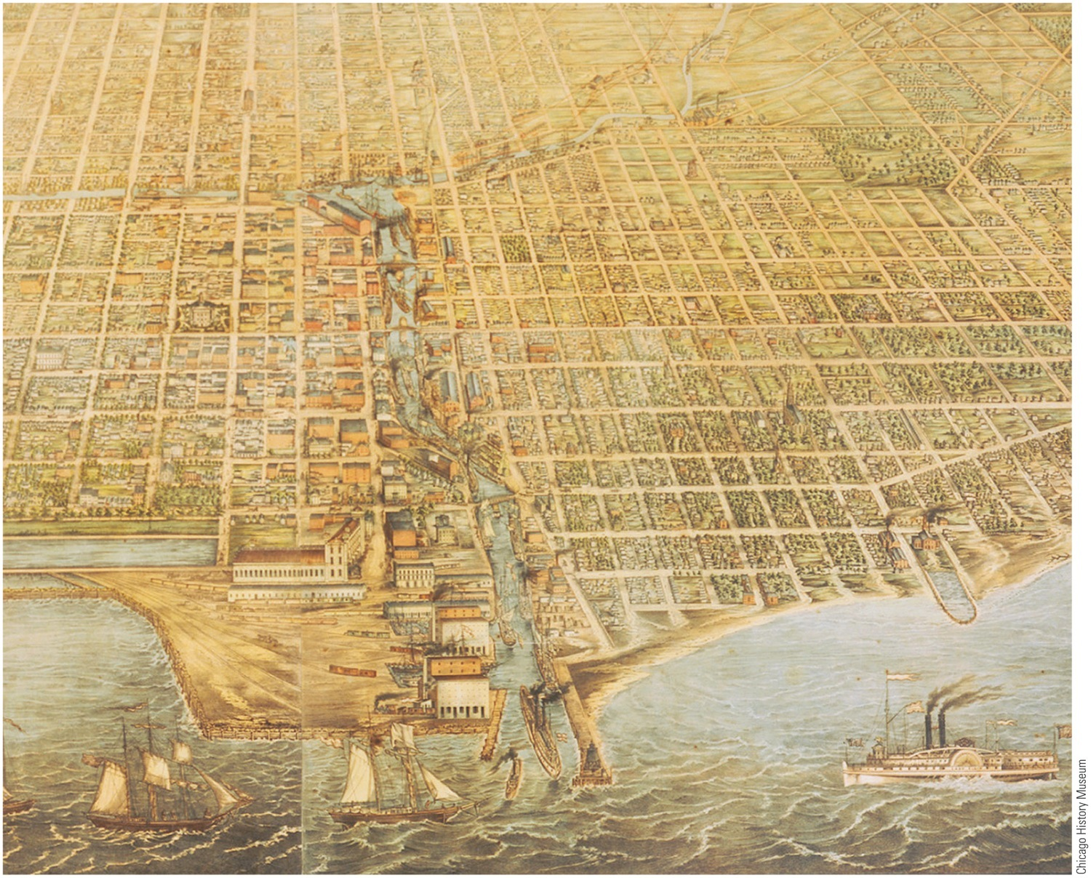
p306
Notes:
Chicago, 1857 A modest village of a few hundred souls in the 1830s, Chicago was a teeming
metropolis just two decades later—one of the fastest-growing cities in the world. A food and
livestock processing center and transportation hub, it served the vast farming area of the western
plains, a remarkably productive agricultural region and breadbasket to the world.

Slide 41
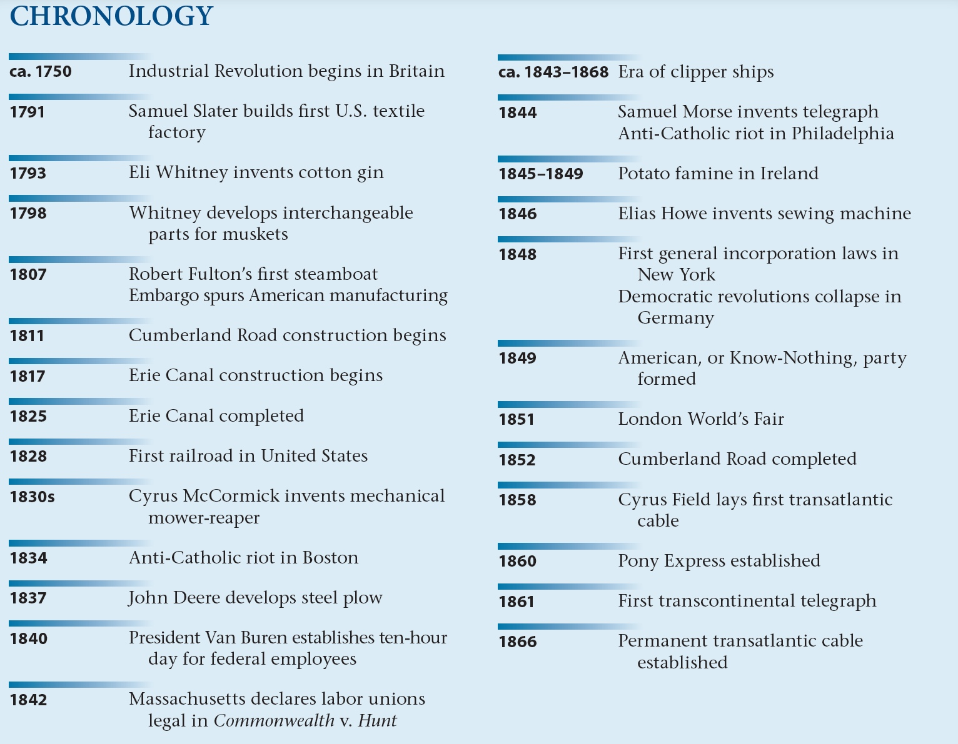
p305

