Slide 1
Chapter 14
Forging the National Economy, 1790–1860

Slide 2
The Westward Movement
Rise of Andrew Jackson, first president from beyond Appalachians, exemplified movement west
Late 1850s:
Half of Americans under age of 30
By 1840 “demographic center” of population map had crossed Alleghenies (see Map 14.1)
By 1860, it had crossed Ohio River

Slide 3
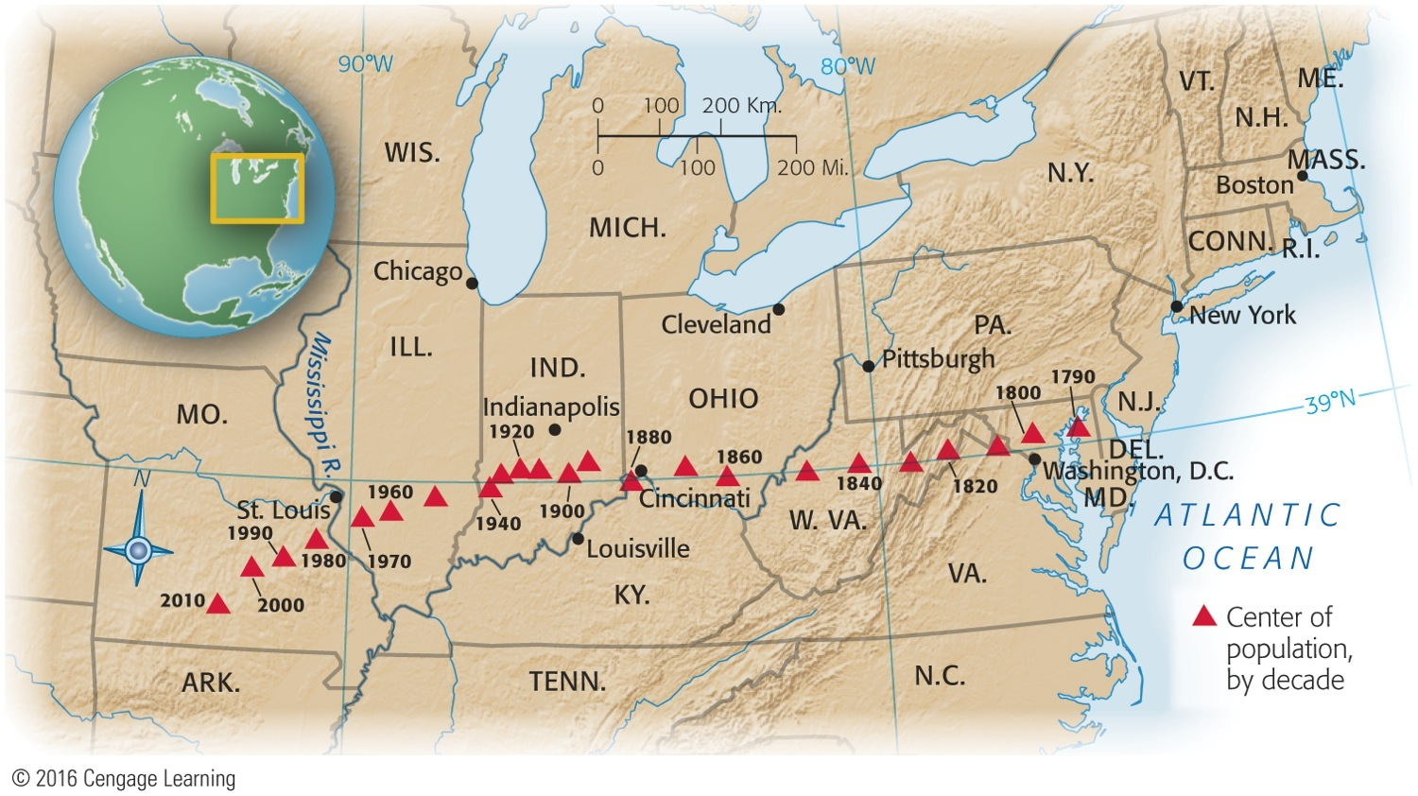
Map 14-1 p279
Notes:
Map 14.1 Westward Movement of Center of Population, 1790–2010 The triangles
indicate the points at which a map of the United States weighted for the population of
the country in a given year would balance. Note the remarkable equilibrium of the north south
pull from 1790 to about 1940, and the strong spurt west and south thereafter. The
1980 census revealed that the nation’s center of population had at last moved west of the
Mississippi River. The map also shows the slowing of the westward movement between
1890 and 1940—the period of heaviest immigration from Europe, which ended up mainly
in East Coast cities. © 2016 Cengage Learning

Slide 4
The Westward Movement
Life across Ohio River:
Downright grim for most pioneer families
Suffered diseases, depression, and premature death
Unbearable loneliness, especially for women
Breakdowns and madness were frequent
Frontier life could be tough and crude for men as well
Pioneers relied upon neighbors for help and upon government for internal improvements.

Slide 5
Shaping the Western Landscape
Westward movement molded physical environment:
By 1820s trappers active in vast Rocky Mountain region
Beaver all but disappeared from region
Buffalo were also almost annihilated
On California coast, traders sought sea-otter pelts, driving them to point of near-extinction
Some have called this aggressive, heedless exploitation of West's natural bounty ecological imperialism.

Slide 6
Shaping the Western Landscape
America had pristine, natural beauty, unspoiled by human hands
This national mystique inspired literature, painting, and a powerful conservation movement:
George Catlin, painter and student of Native American life, was among the first to advocate preservation of nature as deliberate national policy
Proposed creation of a national park in 1830s:
Started with Yellowstone Park in 1872

Slide 7
The March of the Millions
As American people moved West, they multiplied at an amazing rate:
By midcentury, population doubled every twenty-five years
By 1860, thirteen colonies had more than doubled in numbers; 33 stars graced flag
U.S.A. was fourth most populous nation in western world: exceeded by Russia, France, and Austria

Slide 8
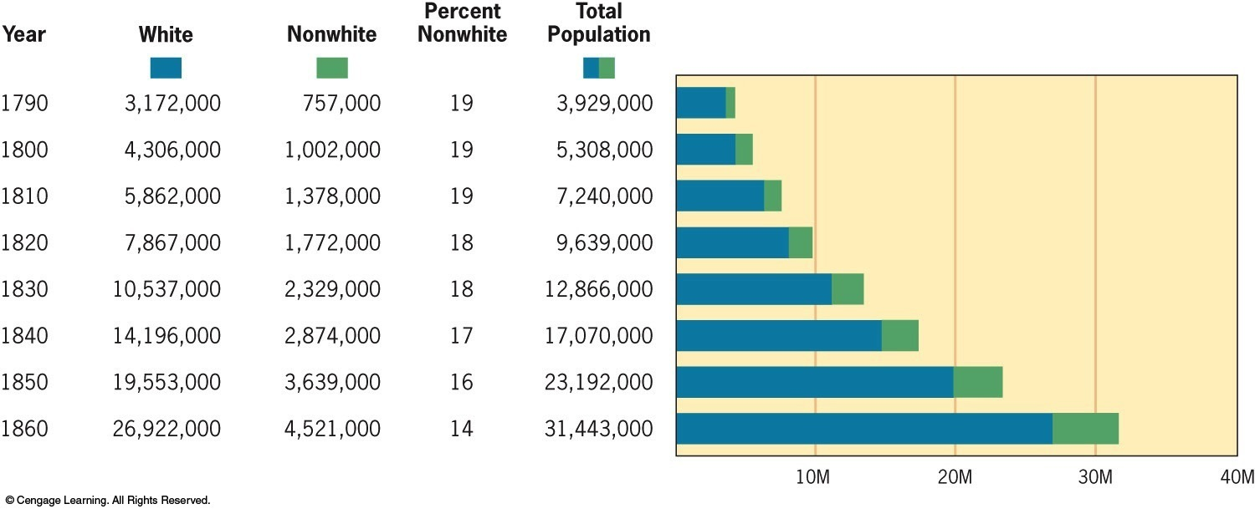
Figure 14-1 p281
Notes:
Figure 14.1 Population Increase, Including Slaves and Indians, 1790–1860 Increasing European
immigration and the closing of the slave trade gradually “whitened” the population beginning in 1820.
This trend continued into the early twentieth century. © 2016 Cengage Learning

Slide 9
The March of the Millions
Urban growth continued explosively:
1790 only two American cities that could boast populations of 20,000—Philadelphia, New York
1860 there were 43 and 300 claimed over 5,000
New York was metropolis; New Orleans, “Queen of the South;” and Chicago, swaggering lord of Midwest

Slide 10
The March of the Millions
Over-rapid urbanization brought undesirable by-products:
Smelly slums, inadequate policing, impure water, foul sewage, ravenous rats, and improper garbage disposal
Boston (1823) pioneered sewer system
New York (1842) abandoned wells and cisterns for piped-in water supply, thus eliminating breeding place for disease-carrying mosquitoes

Slide 11
The March of the Millions
High birthrate accounted for biggest increase in population, but immigration also helped:
By 1830s immigration was 60,000 a year
Influx tripled in 1840s and then quadrupled in the 1850s
During 1840s and 1850s, >1.5 million Irish, and nearly as many Germans came

Slide 12
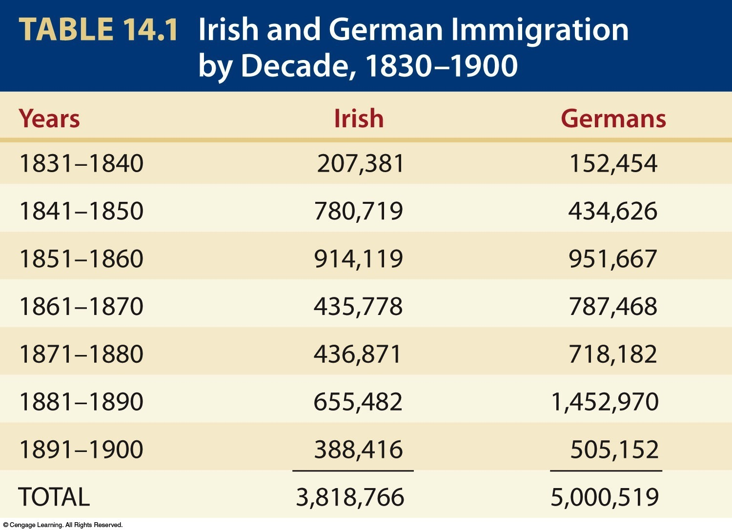
Table 14-1 p281

Slide 13
The March of the Millions
Why did they come?
Because Europe seemed to be running out of room, had “surplus people”
Majority headed for “land of freedom and opportunity”
New transoceanic steamships allowed immigrants to move speedily and cheaply
United States received far more diverse array of immigrants than other countries
U.S.A. received immigrants from dozens of different nations

Slide 14
The Emerald Isle Moves West: Irish Immigration
Ireland was devastated in mid-1840s:
2 million died as result of potato famine
Tens of thousands fled Land of Famine for Land of Plenty in “Black Forties”
Ireland's great export has been population

Slide 15
The Emerald Isle Moves West: Irish Immigration
Many swarmed into seaboard cities (e.g., Boston)
New York City became largest Irish city in world
Irish did not receive red-carpet treatment
Friendless “famine Irish” forced to fend for themselves:
Ancient Order of Hibernians, semisecret society founded in Ireland to fight rapacious landlords, served in America as benevolent society, ailing downtrodden
Helped spawn Molly Maguires, shadowy Irish miners' union that rocked Pennsylvania coal districts in 1860s and 1870s

Slide 16
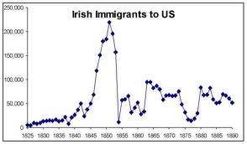

Slide 17
The Emerald Isle Moves West
Irish conditions in America:
Tended to remain in low-skill occupations
Gradually improved their lot, usually by acquiring modest amounts of property
Education of children was often cut short
Property ownership counted as a grand “success”
Politics attracted Gaelic newcomers
Gained control of powerful city machines, esp. New York's Tammany Hall, and reaped patronage rewards

Slide 18
The Emerald Isle Moves West
Politicians tried to cultivate Irish vote:
Nearly two million arrived between 1830 and 1860—and politicians glimpsed political gold in those potential voters, esp. in politically potent state of New York
Because Irish hatred of England remained strong, politicians won support with anti-British remarks

Slide 19
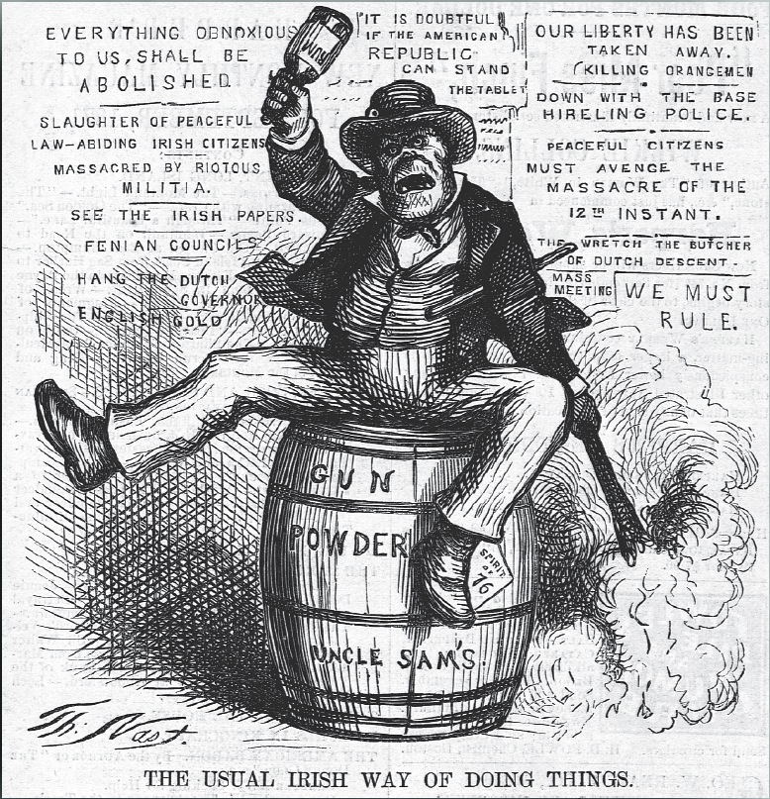
American View of the Irish Immigrant

Slide 20
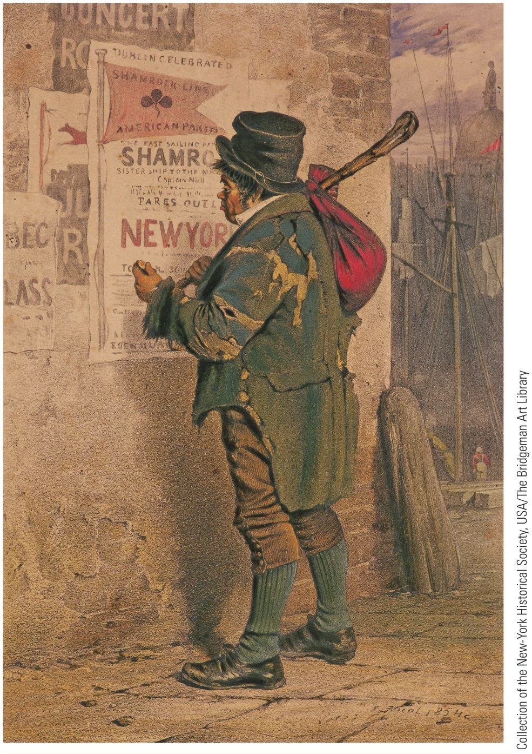
p284
Notes:
Outward Bound, the Quay at Dublin, 1854 Thousands
fled famine in Ireland by coming to America in
the 1840s and 1850s.

Slide 21
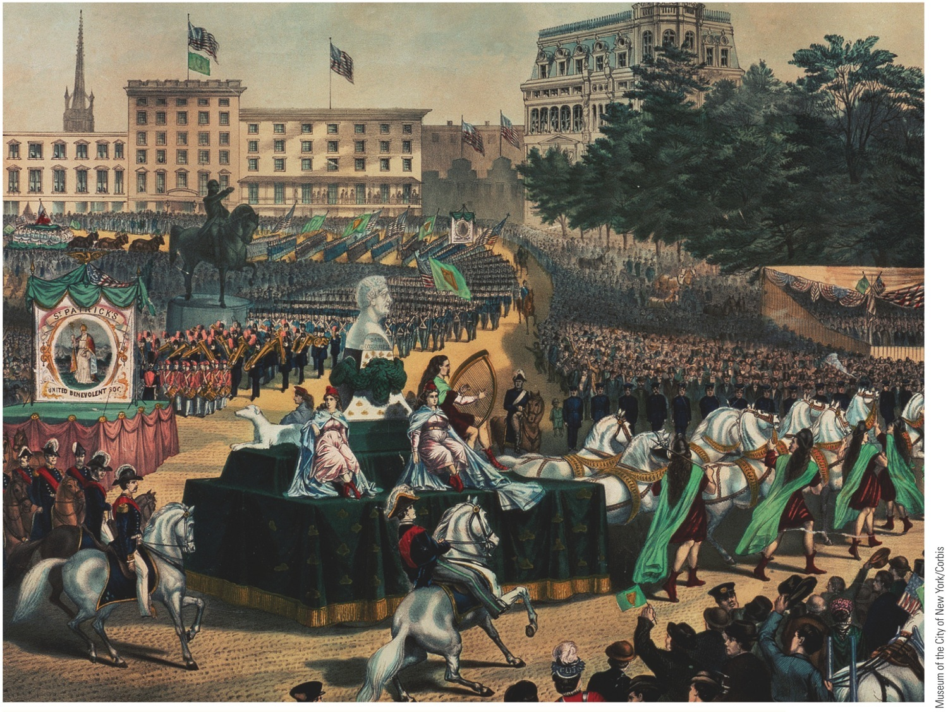
p285
Notes:
St. Patrick’s Day Parade in America, Union Square, ca. 1870 This painting shows a St. Patrick’s Day
parade in New York City. The religious festival was celebrated with greater fanfare in America than in
Ireland itself, as Irish immigrants used it to boost their ethnic solidarity and assert their distinctive
identity in their adopted country.

Slide 22
The German Forty-Eighters
Influx of refugees from Germany b/t 1830 and 1860 hardly less spectacular than from Ireland:
>1.5 Germans stepped onto American soil
Bulk were uprooted farmers
Some were liberal political refugees
Germany's loss was America's gain: Carl Schurz became relentless foe of slavery and public corruption

Slide 23
The German Forty-Eighters
Germans:
Possessed modest amount of materials goods
Most pushed to lush lands of Middle West, notably Wisconsin for farming
Formed influential body of voters wooed by politicians
Less potent politically than Irish since were more widely scattered

Slide 24
The German Forty-Eighters
German influence in shaping American life:
Conestoga wagon, Kentucky rifle, and Christmas tree all German contributions
Supported public schools, including Kindergarten (children's garden)
Promoted music and arts
Relentless enemies of slavery

Slide 25
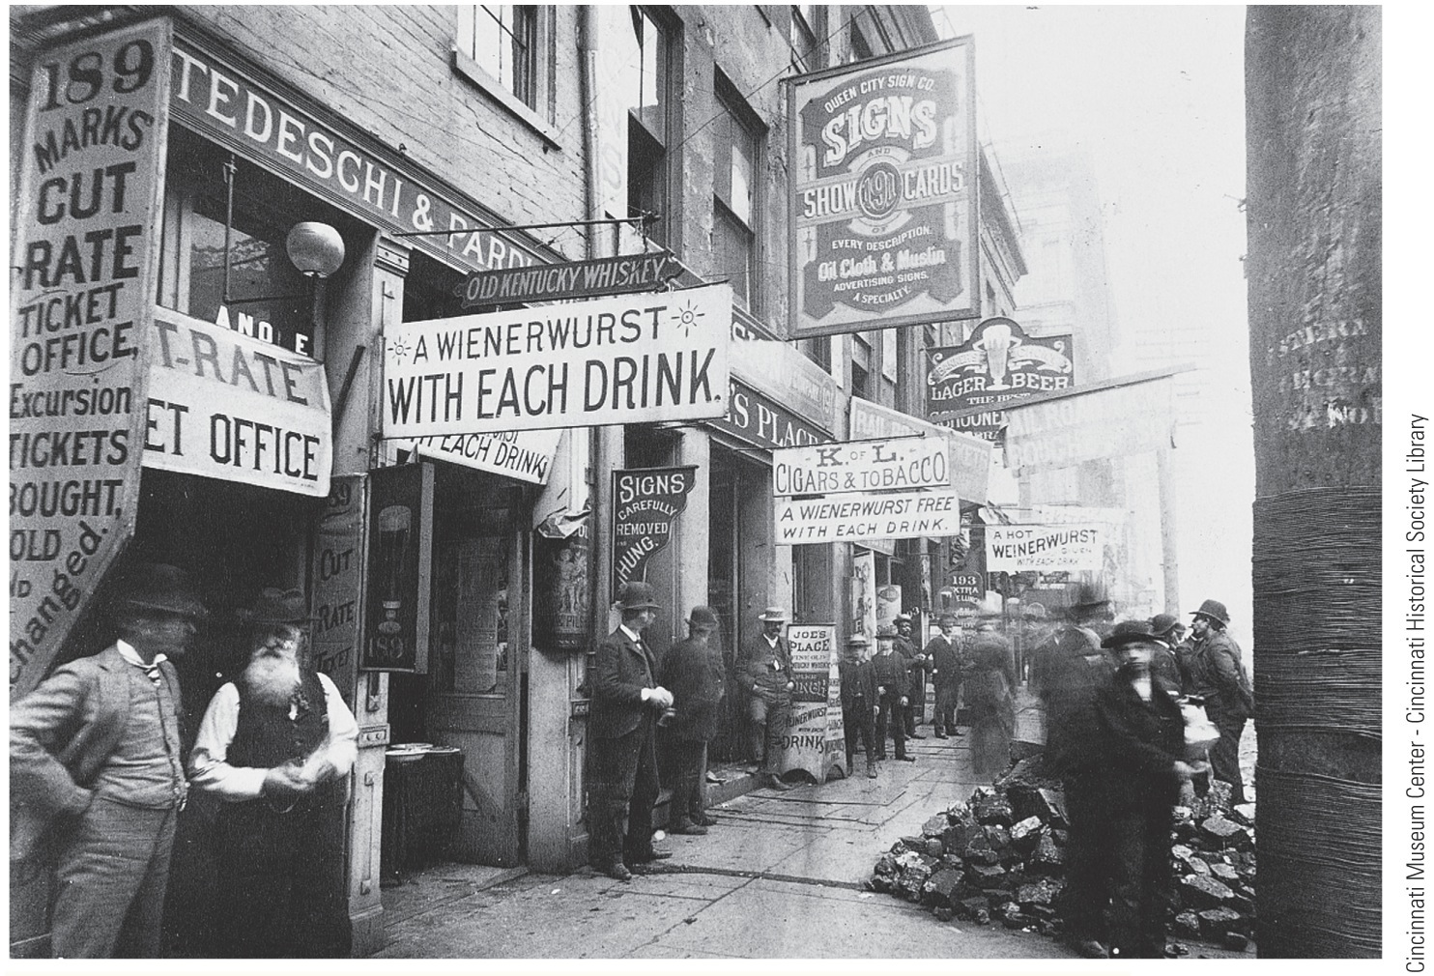
p288
Notes:
“Little Germany” Cincinnati’s “Over-the-Rhine” district in 1887.

Slide 26
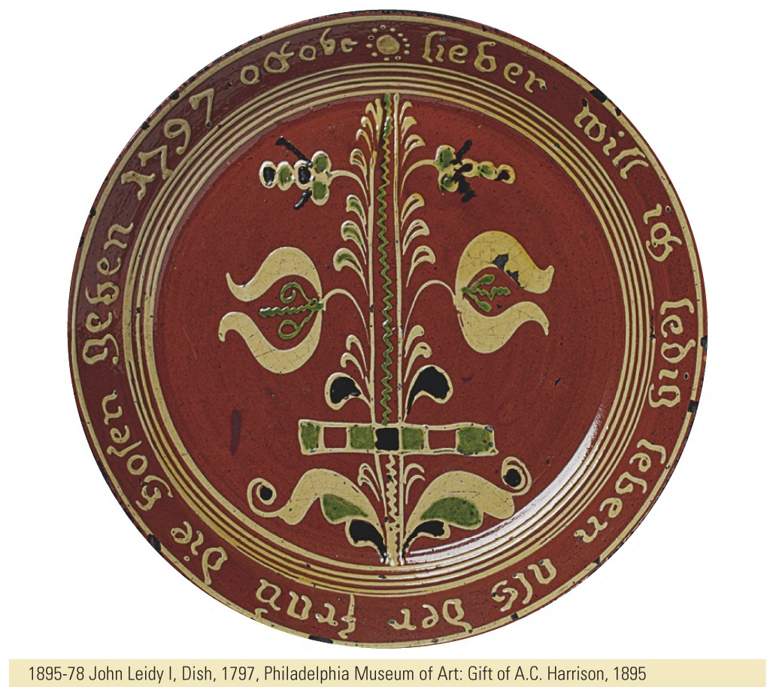
p289
Notes:
Marriage Plate, Bucks County, Pennsylvania, ca.
1806 The Germans who settled the “Pennsylvania
Dutch” communities in the eighteenth century preserved
ancient traditions of handicraft and art, as exemplified by
this whimsical “marriage plate” made by a sixteen-year old
potter named John Leidy. The inscription reads,
“Rather would I single live than the wife the breeches
[trousers] give.”
1895-78 John Leidy I, Dish, 1797, Philadelphia Museum of Art: Gift of A.C. Harrison, 1895

Slide 27
The German Forty-Eighters
Sometimes dubbed “damned Dutchmen” and regarded with suspicion:
Seeking to preserve language and customs, they settled in compact “colonies” aloof from surrounding communities
Accustomed to “Continental Sunday,” they made merry on Sunday
Their Old World drinking habits further spurred advocates of temperance

Slide 28
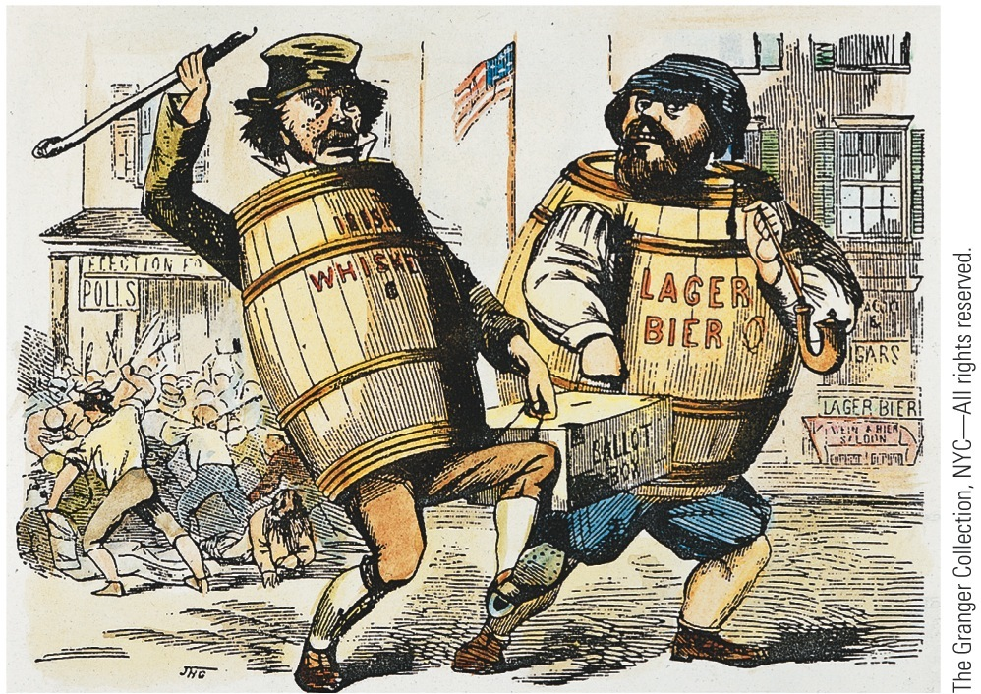
p286
Notes:
Crooked Voting A bitter “nativist” cartoon charging
Irish and German immigrants with “stealing” elections.

Slide 29
Flare-ups of Antiforeignism
Influx of immigrants in 1840s and 1850s inflamed prejudices of American “nativists:”
Feared immigrants would outbreed, outvote, and overwhelm “native” stock
Also took jobs from “native” Americans
As Roman Catholics were regarded by many old-line Americans as following a “foreign” church

Slide 30
Flare-ups of Antiforeignism
Roman Catholics on the move:
To avoid Protestant indoctrination in public schools, began in 1840s to construct separate Catholic educational system:
Expensive, revealed strength of religious commitment
With Irish and German influx, Catholics became large religious group:
In 1840 ranked fifth behind Baptists, Methodists, Presbyterians and Congregationalists

Slide 31
Flare-ups of Antiforeignism
Know-Nothing Party—organized by “nativists” for political action:
Agitated for rigid restriction on immigration and naturalization
Agitated for laws authorizing deportation of alien paupers

Slide 32
Flare-ups of Antiforeignism
Occasional mass violence against Catholics:
Burned churches and schools
Some killed and wounded in days of fighting
Immigrants made U.S.A. one of most ethnically and racially diverse societies in world.
Not surprising that cultural clashes occurred.

Slide 33
Flare-ups of Antiforeignism
American economy:
Attracted immigrants and ensured them share of wealth without jeopardizing wealth of others
Immigrants helped fuel economic expansion
Immigrants and American economy needed each other
Together they helped bring Industrial Revolution

Slide 34
Industrialization

Slide 35
Creeping Mechanization
British inventors in 1750s perfected series of machines for mass production of textiles:
Harnessed steam to usher in modern factory system of Industrial Revolution
Spectacular transformation in agricultural production
As well as methods of transportation and communication

Slide 36
Creeping Mechanization
Factory system slowly spread from Britain, “the world's workshop”.
Why was America slow to industrialize?
Land was cheap
Labor was scarce
Money for capital investment was scarce

Slide 37
Whitney Ends the Fiber Famine
Samuel Slater— “Father of Factory System”
After memorizing plans for machinery, he escaped to America
Won backing of capitalist Moses Brown
Reconstructed essential apparatus in 1791
Thus put together 1st efficient machinery for spinning cotton thread in America
Problem was accessing cotton fiber
Eli Whitney's cotton gin solved problem

Slide 38
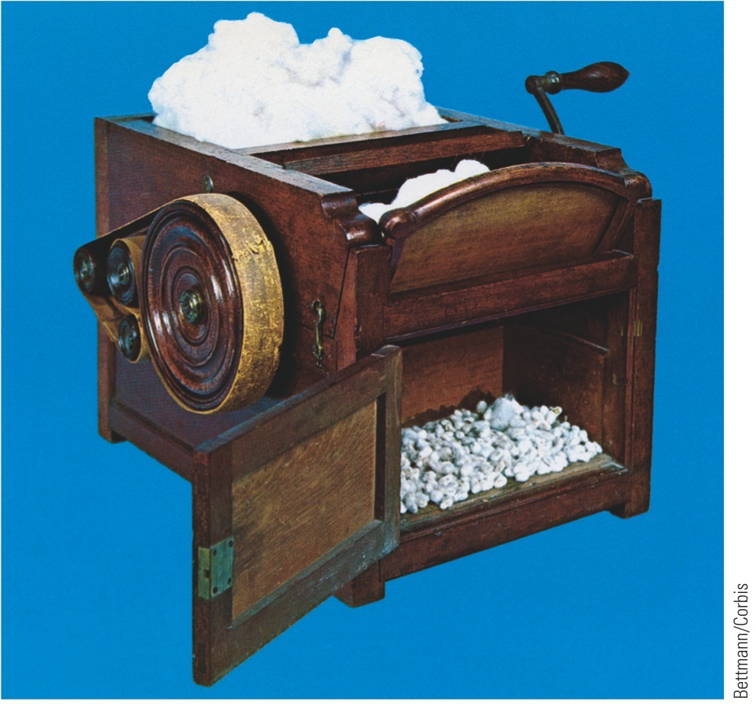
p291
Notes:
The Growth in Cotton Production and Consumption Whitney’s gin (left) made possible the mass
cultivation of upland, or short-stable, cotton, which was unprofitable to raise when its seeds had to
be laboriously removed by hand. As cotton production pushed farther south and west, taking slavery
with it, it provisioned a growing northern textile industry. Calico, or patterned cotton cloth, was hand produced
by wood-block printing with colored dyes, as shown here at right. The availability of plentiful,
cheap cloth vastly expanded women’s wardrobes.

Slide 39
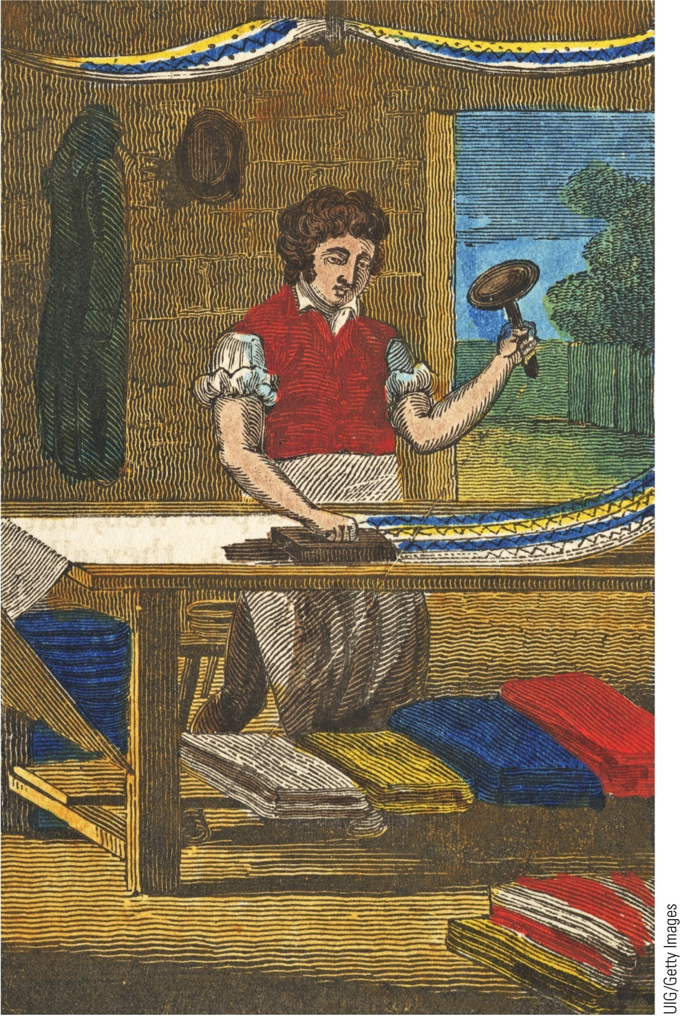
p291
Notes:
The Growth in Cotton Production and Consumption Whitney’s gin (left) made possible the mass
cultivation of upland, or short-stable, cotton, which was unprofitable to raise when its seeds had to
be laboriously removed by hand. As cotton production pushed farther south and west, taking slavery
with it, it provisioned a growing northern textile industry. Calico, or patterned cotton cloth, was hand produced
by wood-block printing with colored dyes, as shown here at right. The availability of plentiful,
cheap cloth vastly expanded women’s wardrobes.

Slide 40
Whitney Ends the Fiber Famine
Momentous effects of cotton gin:
Planters cleared more and more land for cotton
Cotton Kingdom pushed westward
Insatiable demand for cotton riveted chains of slavery more tightly on southern blacks
Yankee machines put out avalanches of textiles
America's Industrial Revolution first blossomed in cotton textiles

Slide 41
Whitney Ends the Fiber Famine
Factories 1st flourished in New England, then branched out to NY, NJ, Pennsylvania
The South:
Increasingly wedded to growing cotton
Little manufacturing
Capital invested in slaves
Local consumers for most part desperately poor

Slide 42
Whitney Ends the Fiber Famine
New England favored as industrial center because:
Stony soil made farming difficult and manufacturing attractive
Dense population provided labor and markets
Seaports provided easy import of raw materials and export of finished products
Rivers provided abundant water power
By 1860, >400 million pounds of southern cotton poured into mills, mostly in New England

Slide 43
Marvels in Manufacturing
As factory system flourished, it embraced other industries.
Contribution of Whitney's interchangeable parts to manufacture of firearms:
Basis of mass-production, assembly-line methods
Gave North the factories that ensured military preponderance over South
Ironically Whitney, by perfecting cotton gin, gave slavery renewed lease on life

Slide 44
Marvels in Manufacturing (cont.)
Sewing machine:
Invented by Elias Howe in 1846
Perfected by Isaac Singer
Strong boost to northern industrialization
Foundation of ready-made clothing
Moved sewing from private homes to factory

Slide 45
Marvels in Manufacturing
Each new invention stimulated still more imaginative inventions:
Decade ending in 1800: only 306 patents registered
Decade ending in 1860: 28,000 patents registered

Slide 46
Marvels in Manufacturing
Key changes in form and legal status of business organizations:
Principle of limited liability aided concentration of capital
Boston Associates created by 15 Boston families
Laws of “free incorporation” meant businessmen could create corporations without applying for individual charters from legislature

Slide 47
Marvels in Manufacturing
Samuel F. B. Morse:
Invented telegraph
Secured $30,000 from Congress to experiment with “talking wires”
In 1844, strung a wire 40 miles from Washington to Baltimore and tapped out historic message, “What hath God wrought?”

Slide 48
Marvels in Manufacturing
By time of London World's Fair in 1851:
American products were prominent among world's commercial wonders
Fairgoers crowded into Crystal Palace to see
McCormick's reaper
Morse's telegraph
Colt's firearms
Charles Goodyear's vulcanized rubber goods

Slide 49
Workers and “Wage Slaves”
Factory system created acute labor problem.
Manufacturing had been done in home:
Master craftsman and apprentice worked together
Industrial Revolution submerged personal association into impersonal ownership of factories in “spindle cities” surrounded by hovels of “wage slaves.”

Slide 50
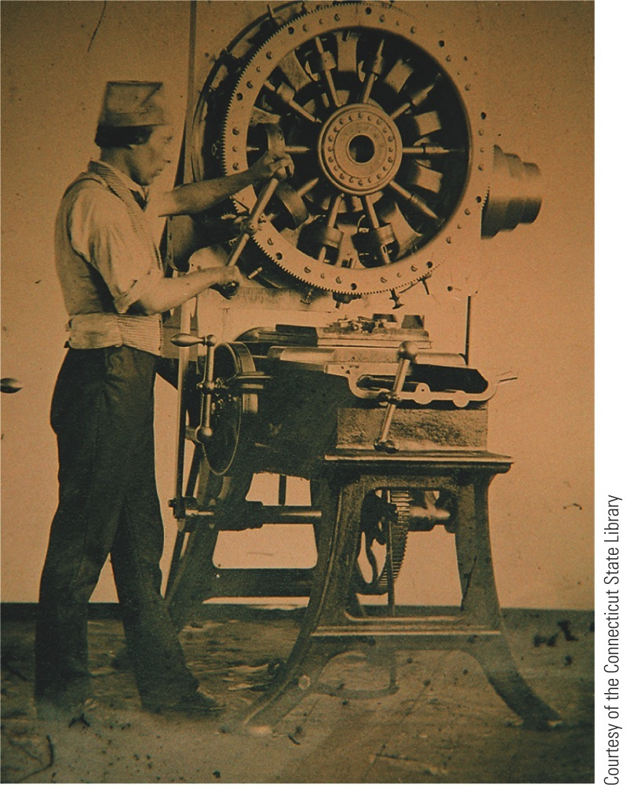
p293
Notes:
Coexistence of the Craftsman’s Shop and the Factory, 1860 These two images recorded workers
laboring in very different kinds of work places in the same year. The painting, “The Wheelwright’s
Shop,” by Edwin Tryon Billings (right), captures the survival of a small-scale, intimate shop producing
hand-made wheels for carts and carriages. The daguerreotype (left) shows an operator working the
Lock Frame Jigging Machine in Samuel Colt’s state-of-the-art Hartford, Connecticut, gun factory. As
different as they were, both jobs required skill and focus.

Slide 51
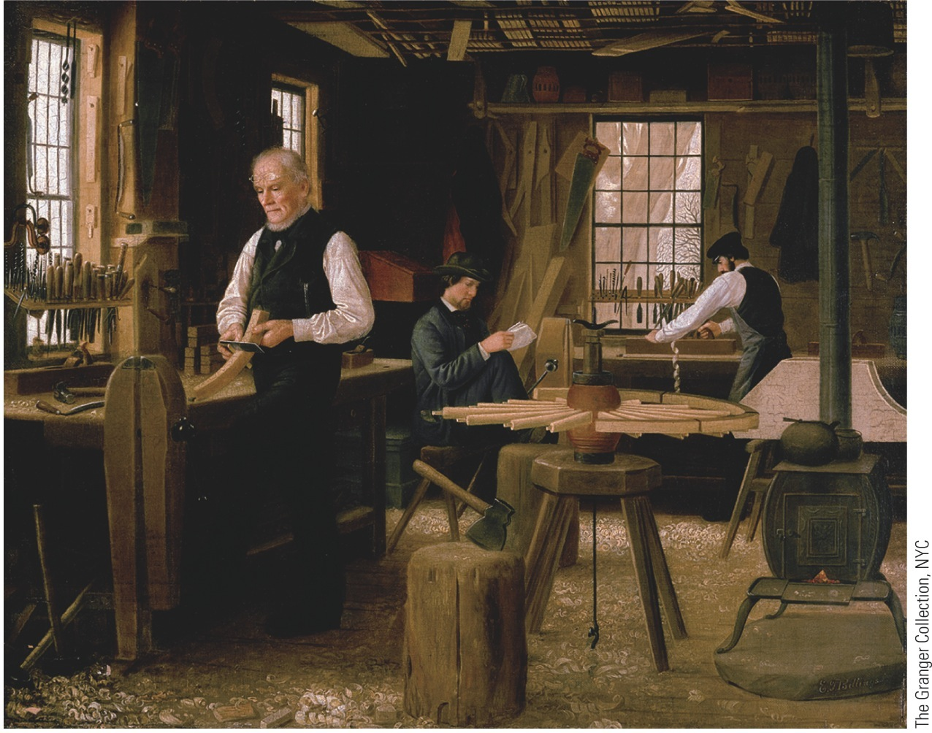
p293
Notes:
Coexistence of the Craftsman’s Shop and the Factory, 1860 These two images recorded workers
laboring in very different kinds of work places in the same year. The painting, “The Wheelwright’s
Shop,” by Edwin Tryon Billings (right), captures the survival of a small-scale, intimate shop producing
hand-made wheels for carts and carriages. The daguerreotype (left) shows an operator working the
Lock Frame Jigging Machine in Samuel Colt’s state-of-the-art Hartford, Connecticut, gun factory. As
different as they were, both jobs required skill and focus.

Slide 52
Workers and “Wage Slaves”
Workers' conditions:
Hours long, wages low
Meals skimpy and hastily gulped
Workers toiled in unsanitary buildings (poorly ventilated, lighted, heated)
Forbidden to form unions to raise wages
Only 24 recorded strikes before 1835

Slide 53
Workers and “Wage Slaves”
Exploitation of child labor:
In 1820, many of nation's industrial toilers were children under ten
Victims of factory, children were mentally blighted, emotionally starved, physically stunted, and brutally whipped in special “whipping rooms”
Slater's mill of 1791: first machine tenders were seven boys and two girls, all under 12

Slide 54
Workers and “Wage Slaves”
Lot of adult wage workers in 1820s-1830s:
Many states granted laboring man the vote
Strove to lightened burden through workingmen's parties
Many workers gave loyalty to Democratic Party of Andrew Jackson
Besides 10-hour day, higher wages, and tolerable working conditions, workers demanded public education and end to imprisonment for debt

Slide 55
Workers and “Wage Slaves”
Employers fought 10-hour day:
Argued reduced hours would lessen production, increase costs, and demoralize workers
Laborers would have so much leisure time that Devil would lead them to mischief
In 1840 President Van Buren established ten-hour day for federal employees on public works
In later years many states began reducing hours of working people

Slide 56
Workers and “Wage Slaves”
Day laborers tried to improve their lot:
Strongest weapon was strikes
Dozens of strikes erupted in 1830s and 1840s
Sought higher wages, ten-hour days, and goals such as right to smoke on job
Workers lost more strikes than they won
Employers imported strike-breakers
Labor raised voice against immigrants

Slide 57
Workers and “Wage Slaves”
Labor's effort to organize:
Some 300,000 trade unionists by 1830
Declined as result of severe depression, 1837
Won promising legal victory in 1842 in Commonwealth v. Hunt
Mass. Supreme Court ruled unions not illegal conspiracies, provided methods were “honorable and peaceful”
Case did not legalize right to strike

Slide 58
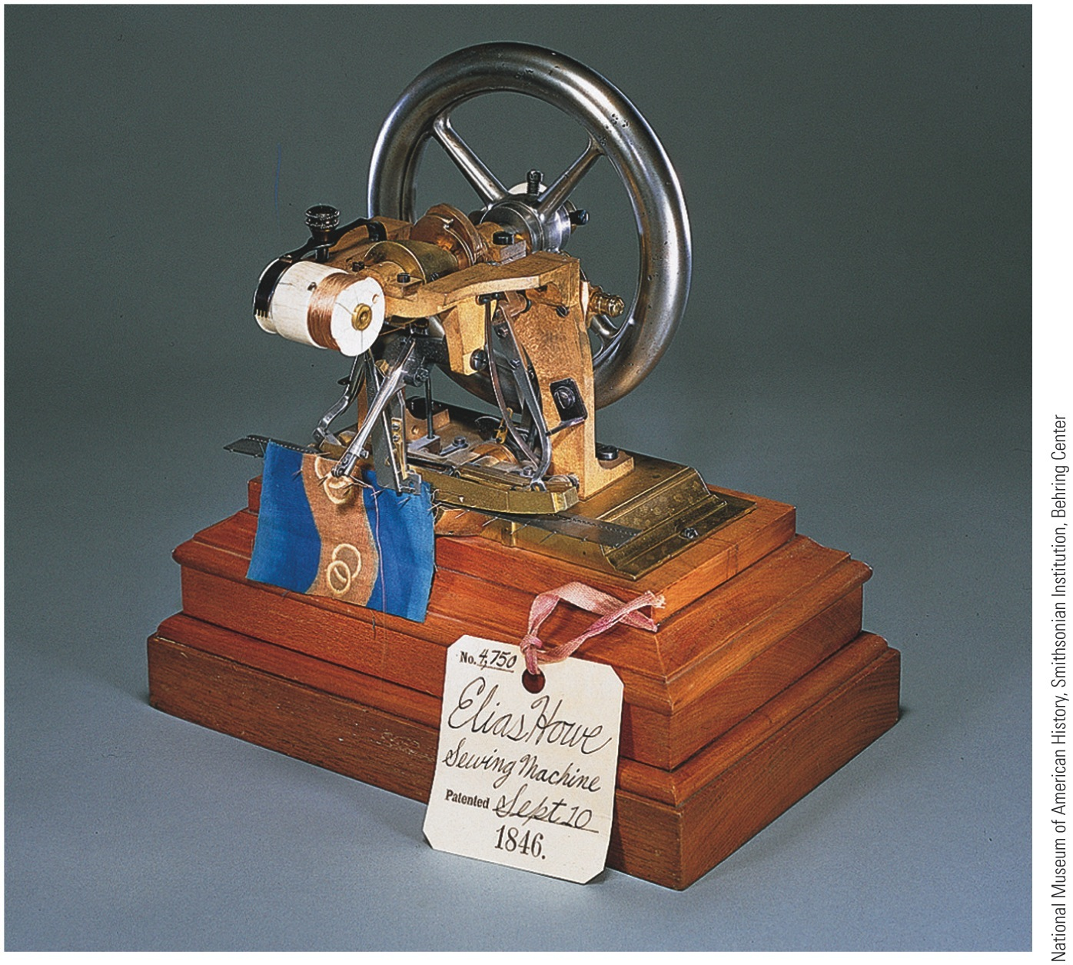
p294

Slide 59
Women and the Economy
Women became part of factory production:
Factories undermined work of women in homes
Factories offered work to those displayed
Factory jobs promised greater economic independence for women
And means to buy manufactured products of new market economy

Slide 60
Women and the Economy
“Factory girls” toiled 6 days a week, 12 to 13 hours “from dark to dark”
Textile mill at Lowell, Mass.:
Workers mostly New England farm girls
Supervised on and off job by watchful matrons
Escorted to church from company boardinghouses
Forbidden to form unions
Few outlets to protest grueling working conditions

