Slide 1
American Life in the 17th Century, and the Great Awakening

Slide 2
The Unhealthy Chesapeake
Life Expectancy
Starvation, Indians, and diseases cut 10 years off of life expectancy
Most immigrants were single men in early 20s
50% of people born in MD and VA didn’t live to 20
Men outnumber women by 6-1
Not many eligible women
Most couples lost a partner within 7 years
Birth rate lower than mortality rate until end of 17th century

Slide 3
Tobacco Economy
Tobacco
Soil quickly exhausted
People move west looking for land
1700 – 40 million pounds/year shipped
Laborers
Impractical
Families – death rates too high
Indians – death rates too high
Slaves – cost too much
Surplus of laborers in England
Leads to indentured servitude

Slide 4
Indentured Servants
Work for nothing in exchange for passage to colonies
Promised “freedom dues” when contract up
Few barrels of corn
Suit of clothing
Small piece of land
VA and MD – headright system
Pay for passage of laborers, receive 50 acres of land
1700 – 100000 indentured servants
¾ of all European immigrants to Chesapeake
Land becomes scarce
Land removed from freedom dues

Slide 5
Bacon’s Rebellion
Poor Freemen
Frustrated
No land, no women
Moved west
Denied right to vote by VA assembly
Nathaniel Bacon
Ex indentured servant
Leads 1000 Virginians in revolt in 1676

Slide 6
Bacon’s Rebellion
William Berkeley – governor of VA
Refuses to stop Indian attacks in west
Has monopoly on fur trade with Indians
Bacon and other ex servants revolt
Indians defeated
Jamestown captured and burned
Bacon dies of disease
Revolt ends

Slide 7
Consequences of Rebellion
Underscores growing class conflict in colonies
Poor farmers vs. plantation owners
Indentured servitude dies
Freed servants are dangerous
Wages rising in England
English poor less willing to risk life in America
Who will replace them as labor?

Slide 8
Mercantilism
Philosophy of mercantilism:
there is only a set amount of wealth in the world
the only way for a country to obtain more wealth is to Export (sell) more than they Import (buy) which creates a “Favorable balance of trade”
Having colonies is important because they provide raw materials & markets.

Slide 9
Mercantilist System
Colonies exist as a market for England’s goods and a supplier of raw materials
All trade with other nations needs to go through the home-country.*
Mercantilism helped create trade patterns such as the triangular trade in the North Atlantic, in which raw materials were imported to the metropolis and then processed and redistributed to other colonies.
*Navigation Acts- All colonial trade must go thru England. English ships with English crews.

Slide 10
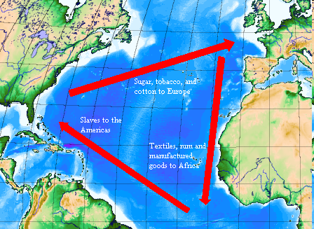
Triangular Trade
Middle
Passage

Slide 11
Triangular Trade
Trade between Europe, the Americas, and Africa was interdependent.
Europe traded manufactured goods with Africa in order to obtain slaves.
The slaves were then sent to North and South America to work on plantations in European colonies.
The crops grown in the Americas were sent to Europe where they were processed into manufactured goods.

Slide 12
The Atlantic Slave Trade

Slide 13
Colonial Slavery
Africans
1600s – most slaves brought to South America and West Indies
Most slaves arrive in colonies after 1700
Slave Trade
1698 – Royal African Company loses monopoly on carrying slaves to colonies
American merchants get involved
Increased supply of slaves lowers prices
Most slaves come from west coast of Africa
1700-1750 – tens of thousands of slaves arrive

Slide 14
The slave trade
Slaves captured from interior Africa by African coastal tribes
Traded to European or American merchants for goods
Textiles, alcohol, weapons
Branded and bound
Packed like sardines on slave ships for “middle passage”
Death rates on slave ships as high as 20%
Survivors auctioned at slave markets

Slide 15
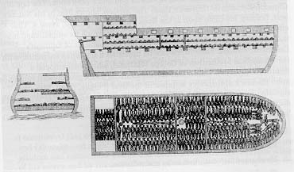
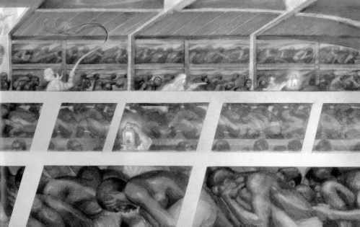
The Middle Passage

Slide 16
The Middle Passage
The Middle Passage was the middle leg of the triangular trade route and is the term used to describe the slaves' voyage across the Atlantic in ships.
The conditions on these trips were dangerous and horrendous.
Slave traders packed as many slaves as possible into ships and chained them together.
About 1 in 5 people died.

Slide 17
Slaves vs. Indentured Servants
1662 – legal distinctions made between slaves and indentured servants
VA passes first “slave codes”
Slaves and children are property for life of their master
Some colonies make it illegal to teach slaves to read or write
Slave system develops based on racial discrimination

Slide 18
Africans in America
Conditions in South
Unhealthy climate
Harsh labor in rice fields
Plantations spread far apart
Conditions in Chesapeake
Also unhealthy
Tobacco less demanding than rice
Plantations closer together
Native-Born African Americans
Distinctive cultures develop
Gullah language in South Carolina
Mix of African and English languages
Dance and song – jazz, banjo, bongo drum
Some slaves become skilled artisans

Slide 19
Early African – American Culture
Early African American culture developed as Africans were brought as slaves to North America.
The Africans kept many ideas and skills they had learned from their homeland
This blended with their experience as slaves to create a unique cultural identity.

Slide 20
African American culture grew in America
Slaves lived their lives under the worst of circumstances.
Slave communities were rich with music, dance, basket-weaving, and pottery-making.
Enslaved Africans brought with them the arts and crafts skills of their various cultures as well as advanced farming techniques.
Indeed, there could be a hundred slaves working on one farm and each slave might come from a different culture and a different part of Africa.

Slide 21
African Culture in America
New cultures started (Gullah)
Some desired freedom and revolted
NYC
Stono

Slide 22
Slave Revolts
Stono Rebellion – Sept. 1739
Armed slave revolt along Stono River
80 slaves involved
20 whites killed
Trying to escape to Florida
Intercepted by militia
Executed
South Carolina enacts laws restricting assembly, education, and movement
10 year moratorium on importing slaves from Africa
Penalties for harsh treatment of slaves
Legislative approval required for manumission

Slide 23
Southern Society
Social structure
Gap between rich and poor grows as slavery spreads
Planters
Owned many slaves and vast plantations
Controlled economy
Dominated House of Burgesses/legislatures
Most descended from families in VA before 1690
Spent long hours managing affairs of plantation

Slide 24
Southern Society
Small Farmers
Largest social group
Hard working, might own 1 or 2 slaves
Landless Whites
Mostly former indentured servants
Indentured Servants
Slaves
Professional Class
Few cities meant few jobs for lawyers, bankers, etc.

Slide 25
The New England Family
Population Growth
Less disease
Life expectancy of 70 years
Ten years more than England
Families
Tended to migrate to new world as families
Population grows from natural reproduction
Women wed in early 20s, have babies every two years
2 out of 10 babies died in childbirth
Stable families
Children receive guidance from parents and grandparents
Low premarital pregnancy rates
Strong social structure

Slide 26
Women’s Rights
Property Rights
Southern women have inheritance and property rights
Men usually die young
Civil Rights – women couldn’t vote
Considered morally weaker than men
Cult of domesticity
Raise children and take care of house
Marriage Laws – Puritan Laws defend marriage
Divorce rare
Abandonment
Adultury

Slide 27
Life in the New England Town
Tight Knit Society and orderly towns
Towns chartered to proprietors
Consisted of
Meeting house
Surrounded by houses
Land for wood, crops, and animals
Village green
Education
Towns of more than 50 had to provide school
Most adults were literate
1636 – Harvard founded in Mass.
1693 – William and Marry founded in VA
Government
Town meetings
Elected officials
Appointed schoolmasters
Discussed problems

Slide 28
Important Colonial Figure

Slide 29
Benjamin Franklin
Grew up modestly
Moved to Philadelphia at 17
Successful, writer, printer, scientist, philosopher, inventor, politician, diplomat
Retired at 42 and became public servant

Slide 30
Social Mobility
Benjamin Franklin believed that people had the right to make choices for themselves.
In 1700s, people could rarely change their social rank because they did not have enough money or education to rise above their current position.
Franklin was able to achieve social mobility by working hard and becoming involved in politics.
He is a symbol of social mobility because despite his humble childhood, Franklin became one of the most respected men in the United States.

Slide 31
Certainty? In this world nothing is certain but death and taxes. Benjamin Franklin A penny saved is a penny earned. Benjamin Franklin A place for everything, everything in its place. Benjamin Franklin Genius without education is like silver in the mine. Benjamin Franklin God helps those who help themselves. Benjamin Franklin

Slide 32
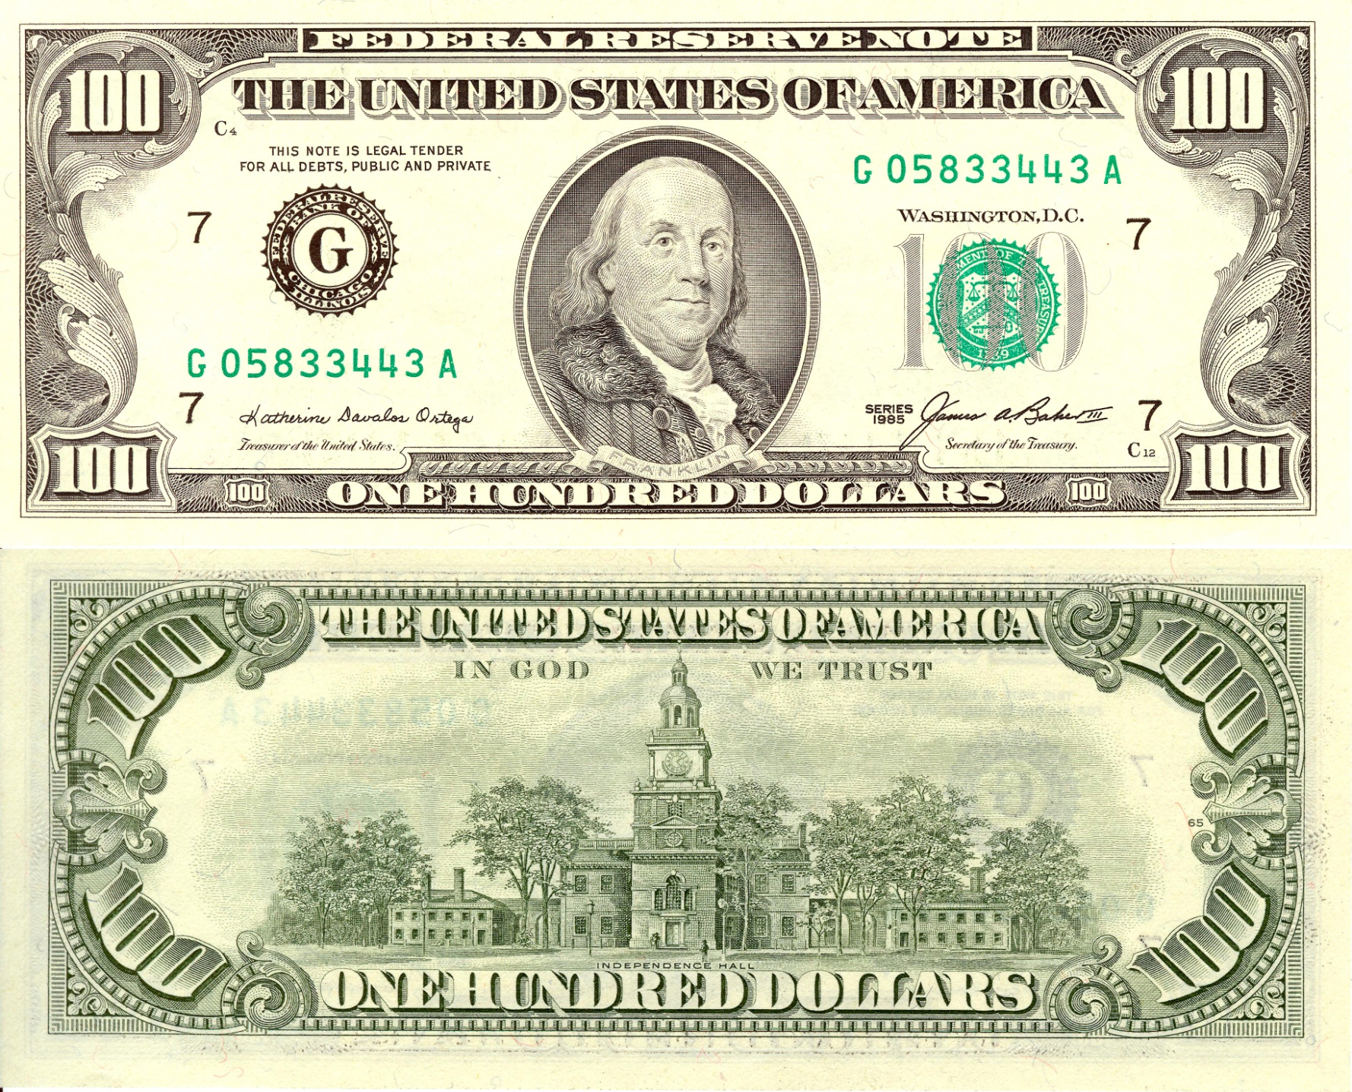

Slide 33
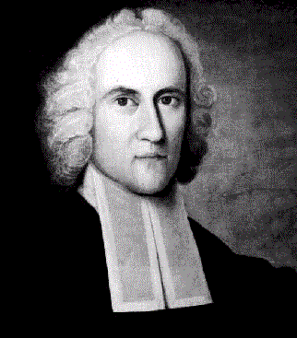
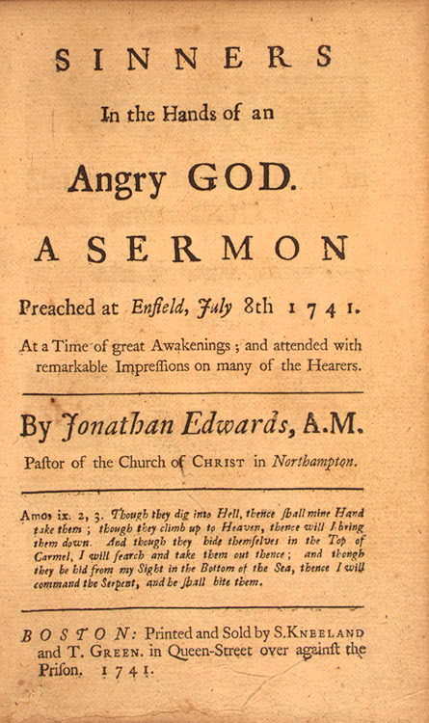
The Great Awakening (1730s – 1740s)
Religious zeal lessened
Calvinist beliefs weakened
Began in Mass under pastor Jonathan Edwards
No salvation through good works
Complete dependence on God’s grace
“Sinners in the Hands of an Angry God”
Hell was “paved with the skulls of unbaptized children”

Slide 34
The Great Awakening (1730s – 1740s)
George Whitefield
Tours county preaching message at revival meetings
“saved”
Inspires revival movement
Ministers divided
Old Lights – skeptical of emotionalism and theatrics of revivalists
New Lights – Awakening revitalized American religion
Congregationalists split

Slide 35
Effects of Awakening
Undermined old clergy
Increases number and competitiveness of denominations
New wave of missionary work with Indians and slaves
“new light” colleges
Princeton, Brown, Rutgers, Dartmouth
First spontaneous mass movement of American people ---Creates sense of united America

