Slide 1
The Southern Colonies
The Carolina’s & Georgia

Slide 2
North Carolina
Farmers from Virginia established small, self-sufficient tobacco farms.
The region lacked good harbors which led to fewer large plantations.

Slide 3
South Carolina
With a warm climate and access to good ports, South Carolina’s plantation economy grew.
South Carolina became known for its large RICE plantations.

Slide 4
Georgia
Founded in 1732 Georgia was the last of the British colonies.
First colonists arrive in 1733 and settle along the Savannah River on Yamacraw Bluff.
Reasons for establishment:
Charity
Economics
Defense

Slide 5
The Middle Colonies
New York, New Jersey, Delaware & Pennsylvania

Slide 6
The Middle Colonies

Slide 7
Middle Colonies
Immigrants were attracted to the available land and a more tolerant religious atmosphere of the Middle Colonies.
This was in contrast to the New England Colonies, whose populations increased mainly through birthrate.

Slide 9
New York = New Amsterdam
New York was settled by the Dutch, who called it New Amsterdam
In 1664, the British conquered the colony from the Dutch and renamed it New York.

Slide 10
New York
NY became a center of trade & commerce (located on the Hudson River).
With members of various British & Dutch churches, New York tolerated different religions.

Slide 11
New Jersey
New Jersey enticed settlement with generous land offers and allowed for religious freedom and an assembly.

Slide 12
William Penn & Pennsylvania
William Penn was a Quaker and a champion for democracy and religious freedom.
He believed Pennsylvania was “The Holy Experiment” and wanted the colony to provide a refuge for Quakers and other persecuted people.
Penn advertised his colony in Europe to gain new settlers.

Slide 13
William Penn & Pennsylvania
His beliefs in treating people fairly extended to his business dealings with the Native Americans.
Pennsylvania territory grew through land purchases instead of wars and fighting for control of the territory.

Slide 14
Delaware
Originally part of Pennsylvania, Delaware was granted it’s own assembly by William Penn in 1702.

Slide 15
The Settlement of New England

Slide 17
New England
Many of the New England settlers were Puritans escaping from religious persecution in England.
The region’s northern location and poor farmland meant that its winters were cold and difficult.

Slide 18
Pilgrims
What is the difference between the Pilgrims & the Puritans?
Make a chart on your paper!!

Slide 19
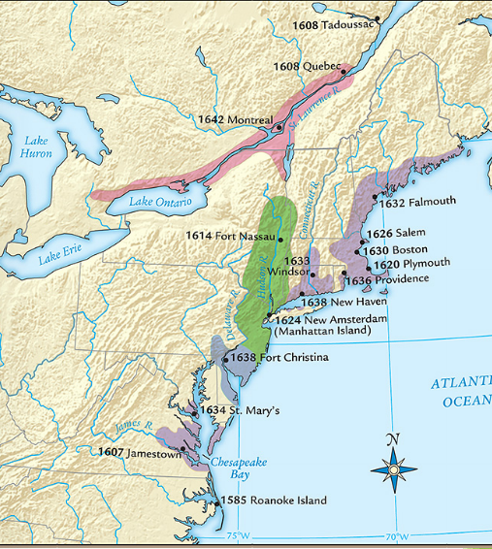
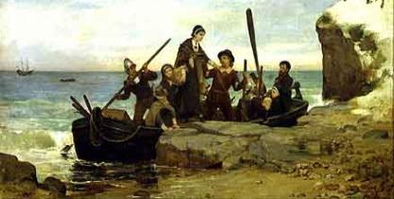
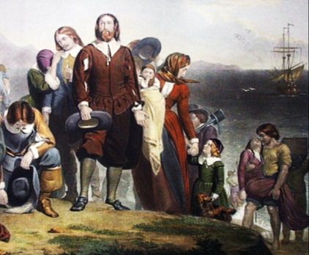
The Separatists became “Pilgrims” when they formed a joint-stock company, gained a charter,
& created the Plymouth colony in America

Slide 20
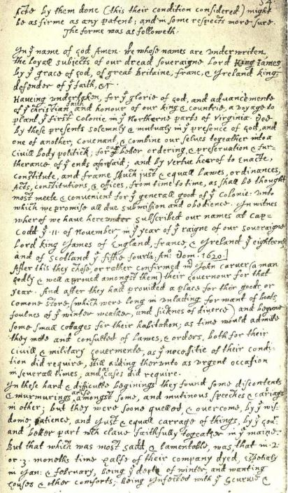
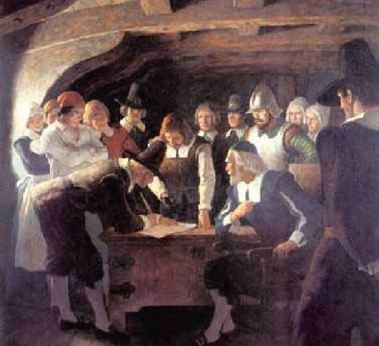
Before landing in America, the Pilgrims created the Mayflower Compact agreeing to work together as a “civil body politick”…
…The Mayflower Compact was the first example of self-government in America

Slide 21
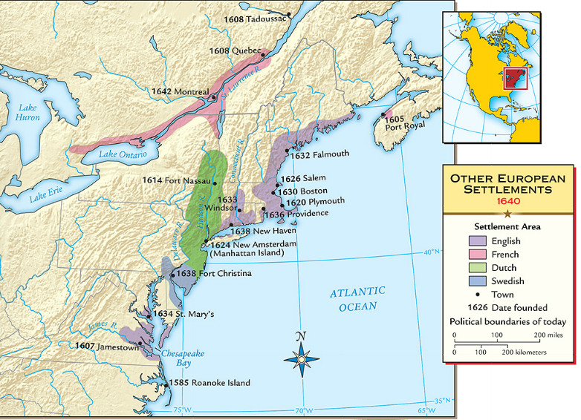
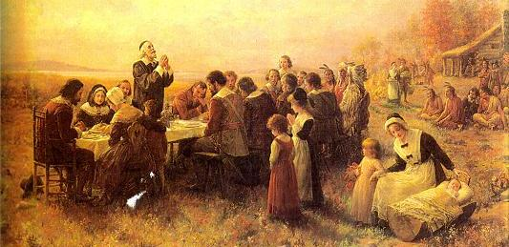
When the Pilgrims founded Plymouth in 1620, they faced disease & hunger
The Pilgrims received help from local natives like Squanto & Massasoit…
…and celebrated the first Thanksgiving to honor the local Indians

Slide 22
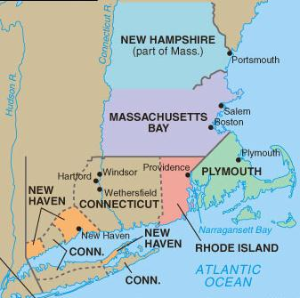
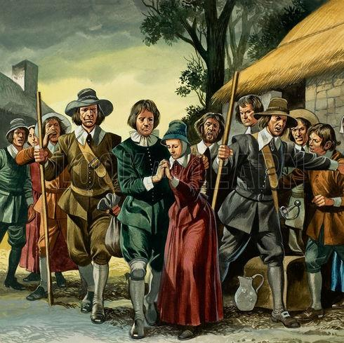
When the Separatist Pilgrims came to America, the Puritans remained within the Church of England
But when the Catholic King Charles I came to power, Puritans felt the time was right to leave Britain
In 1630, Puritans arrived in Boston & created the New England colony of Massachusetts

Slide 23
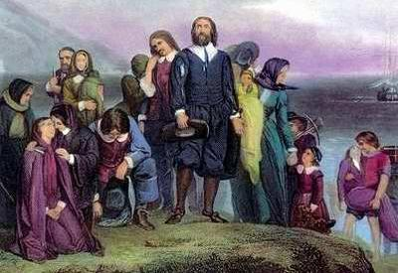
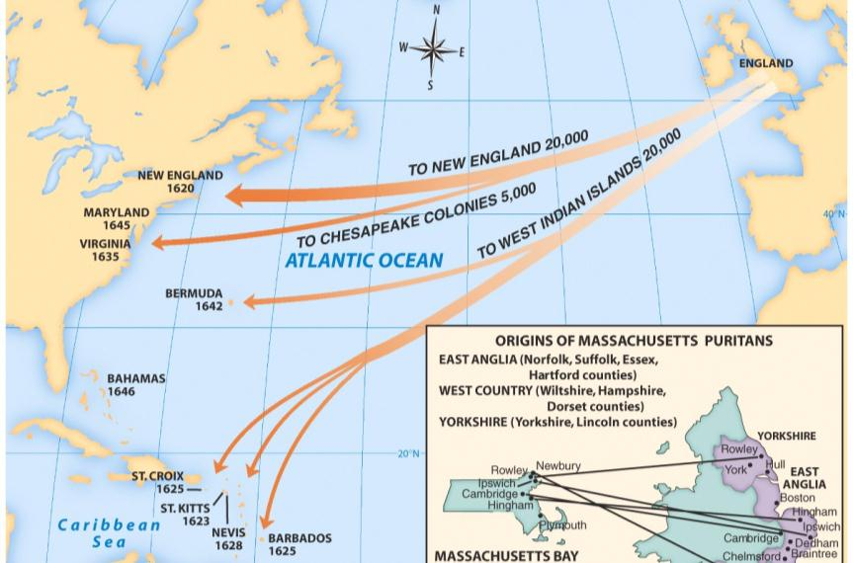
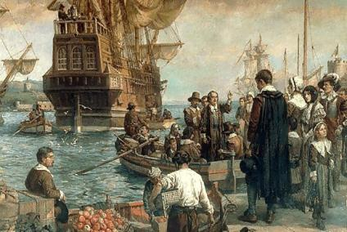
From 1630 to 1640, Puritan leader John Winthrop led 16,000 Puritans to the Massachusetts Bay colony as part of the “Great Migration”
John Winthrop wanted to build Boston as a “city on a hill” to be a model to other Christians

Slide 25
Religious Persecution
The Puritans who settled in Massachusetts wanted freedom to worship as they pleased.
However, they required those who settled in their colony to follow Puritan theology.

Slide 26
Religious Persecution
Puritan religious dissenters (people who didn’t follow their faith) were banished from the Massachusetts colony.
Two members banished from Puritan Massachusetts were Roger Williams (founded R.I.) & Anne Hutchinson.
Rhode Island, Pennsylvania, & New Hampshire were settled as havens of religious freedom from the Puritans.

Slide 27
Religious Tensions
Church membership was on a decline in Puritan Massachusetts. To fix this they passed the half-way covenant.
The half-way covenant provided partial church membership for the children and grandchildren of original Puritans, regardless of their conversion experience.
They hoped that partial church membership would get them more involved and eventually encourage them to become full members of the church.

Slide 28
New England Government
The Mayflower Compact was the first attempt at self government. (Massachusetts)
In New England, they established an elected legislature.
They held town meetings where tax paying citizens met to discuss and vote on issues.
True Puritan power rested in the church leaders.

Slide 29
Paranoia hits Salem, Mass.
Claiming that they were possessed by the devil, several girls accused the towns people in Salem of being witches.
This event became known as the Salem Witch Trials
Salem Witch Trials Video Clip

Slide 30
The Salem Witch Trials
In a series of court hearings, over 150 Massachusetts colonists accused of witchcraft were tried.
29 of whom were convicted, & 19 were hanged.
At least 6 more died in prison.

Slide 31
Salem
The Puritans had created a theocracy in which the church could rule in civil matters, even sentencing someone to death for violations of church beliefs.
The magistrates used several methods, none of which would stand up in a court of law today, to determine the guilt or innocence of someone who was accused of witchcraft.

Slide 32
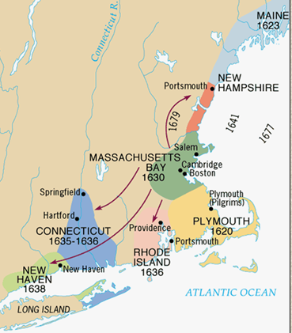
As the Massachusetts colony grew, it spawned four new colonies:
New Hampshire
Rhode Island
New Haven
Connecticut
Connecticut created the first written constitution in U.S. history called The Fundamental Orders of Connecticut

Slide 33
Relationship with Natives
At first relations were good.
A Treaty was signed between the Pilgrims and the Wampanoag Indians.
However, things will change…

Slide 34
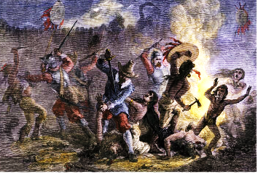
Relationship with Natives
As the New England colonies expanded into new lands, conflicts with Indians arose
The Pequot War in 1637 was the 1st major British-led attack on Indians & led to the death of 600 Indians

Slide 35
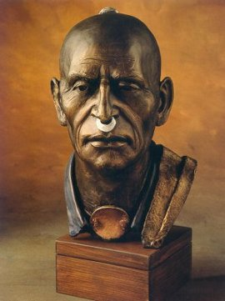
King Phillip’s War (1675-1676)
The only hope for Native Americans to resist white settlers encroachment on their land was to UNITE.
Metacom (King Phillip to white settlers) united the natives in his area and staged attacks on white settlements throughout New England.
Frontier settlers pushed back to Boston.

Slide 36
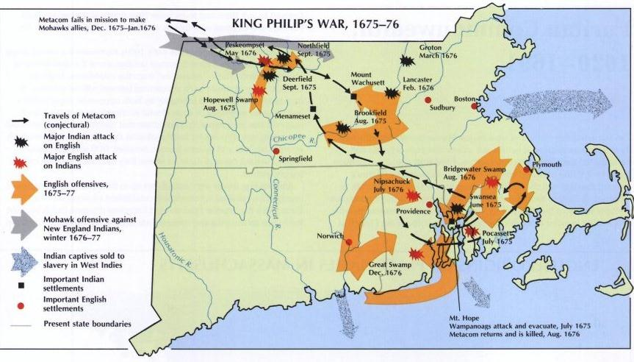
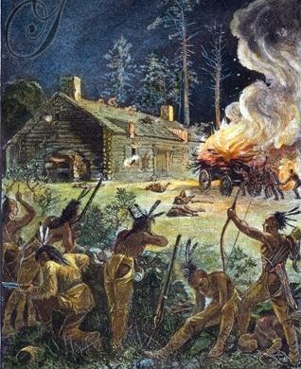
King Phillip’s War (1675-1676)

Slide 37
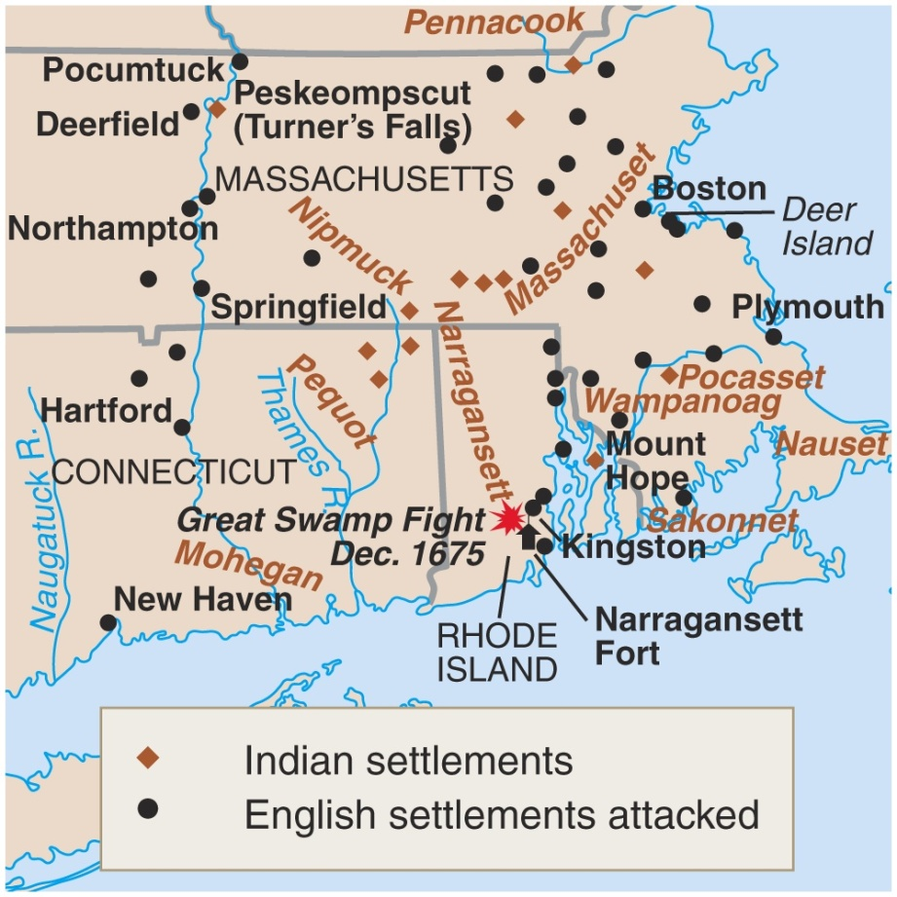
King Phillip’s War (1675-1676)
The war ended in failure for the natives.
Metacom beheaded
His son & wife were sold into slavery.
There was never a serious threat in New England again.

Slide 38
Dominion of New England

Slide 39
Dominion of New England
1686- created to:
1-to strengthen defense
2-regain control over America
Navigation Acts- colonists could only ship goods on British ships (limited trade)
Sir Edmund Andros- leader- not liked
Put restrictions on lifestyle of Puritans
Glorious Revolution put an end to his rule

Slide 40
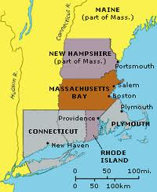
Dominion of New England
Massachusetts gained a new charter
All men can vote, not just church members
Moved Massachusetts towards democracy

Slide 41
Massachusetts Bay
Massachusetts Bay began as a proprietary colony controlled by the Massachusetts Bay Company.
The colony had disagreements with England, however, mainly due to the Puritan clergy refusing rights to other religious groups such as Anglicans, Quakers, and Catholics.
In 1691, Massachusetts was chartered as a royal colony—a colony whose governor is appointed by the monarch.
This combined the Plymouth & Massachusetts Bay Colonies

Slide 42
Geography, Transportation, & Economy

Slide 43
13 English Colonies
Though the colonies were all English, the backgrounds and motives of the people who settled them were diverse.
Regional differences in both climate and natural resources guaranteed that each section would have a distinct culture.
It is no surprise that New England—composed of Puritan refugees trying to farm on difficult soil—would develop differently than Virginia—a proprietary-turned-royal colony suited to growing crops.

Slide 45
Climate & Geography
The northern and southern climates and geography influenced the types of crops grown.
Depending on the crop, different levels of labor were required.
Southern plantations became more dependent on slavery to make a profit from their crops.

Slide 46
Agriculture

Slide 47
New England
In the early days of colonial North America, New England was considered the poorest region.
This was due mostly to the cold climate and rocky soil.
Highest life expectancy in the colonies (Smaller population)
Highest literacy rate

Slide 48
Middle Colonies
Economic development (Agriculture or trade) of the Middle Colonies depended upon the geography and climate of the colony.
Some middle colonies resembled Southern Colonies, some resembled New England

Slide 49
Venn Diagram
Create a Venn Diagram comparing and contrasting the New England Colonies to the Southern Colonies.

Slide 50
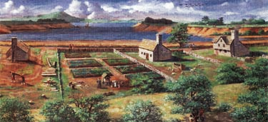
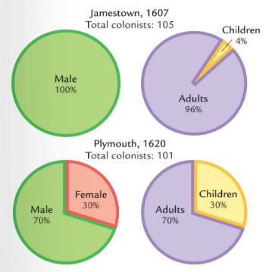
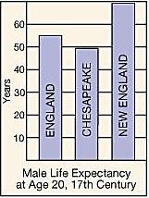
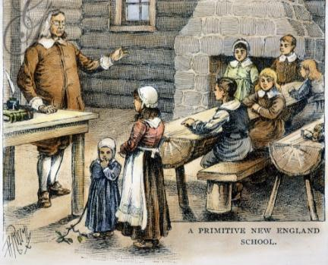
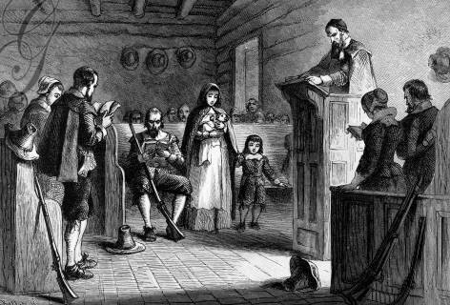
Quick discussion: Based on these images, how were the New England colonies different from Virginia?

Slide 51
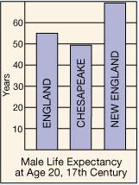
Massachusetts was a different colony from Virginia:
Puritans came to America for religious freedom
Puritan settlers usually came as families
Settlers sacrificed for the common good, built schools, & focused on subsistence farming
New England was a more healthy place to live than Virginia so colonists lived longer

