Slide 1
Chapter 10
Launching the New Ship of State

Slide 2
Growing Pains
1789 – New Constitution goes into affect
Population doubling every 20 years
90% rural, 5% west of the Appalachians
Vermont becomes 14th state in 1791
Followed by Kentucky, Tennessee, and Ohio
Westerners seen as crude, rough pioneers
America still heavily in debt
Paper money worthless
Other nations still doubted U.S. could succeed

Slide 3
Washington becomes President
Imposing figure
Famous hero of the Revolution
Respected by most
Wins election unanimously in Electoral College in 1789
Journey from Mt. Vernon to New York filled with cheering crowds
Establishes first “Cabinet”
Secretary of State – Thomas Jefferson
Secretary of the Treasury – Alexander Hamilton
Secretary of War – Henry Knox

Slide 4
Bill of Rights
States had ratified the Constitution based on a promise of a Bill of Rights
10 Amendments officially ratified in 1791
Judiciary Act of 1789
Creates federal court system
John Jay becomes first Chief Justice

Slide 5
Alexander Hamilton
Born in British West Indies
Loyalty to U.S. often questioned
Urged federal gov. to pay $54 million of debt at face value plus interest (“Funding at Par”)
Wanted federal gov. to assume $21.5 million from states
Debt not distributed evenly
Massachusetts has huge debt, Virginia doesn’t
Southern states see federal assumption of debt as unfair
Compromise worked out
District of Columbia will be built on Virginia land
Federal gov. will assume states’ debt

Slide 6
Customs Duties and Excise Taxes
Federal debt now at $75 million
Hamilton uses as an asset
The more people the U.S. owes money to, the more people will care about what happens to the U.S.
Hamilton proposes customs duties to pay debt
1789 – tariff of 8% on imports passed
Also will protect new industries
1791 – excise tax on whiskey passed
7 cents per gallon

Slide 7
The National Bank
Hamilton wants treasury to be a private institution
Modeled after Bank of England
Federal gov. as major stock holder
Circulate cash to stimulate business
Store excess money
Print money with value

Slide 8
The Battle for the Bank
Hamilton’s view
Constitution does not forbid a national bank
Bank is “necessary and proper”
Uses a loose interpretation of the “necessary and proper” clause, or elastic clause
Jefferson’s view
Constitution doesn’t say anything about bank, therefore Congress doesn’t have that power
According to 10th Amendment states could create banks
Constitution should be interpreted literally (Strict interpretation)

Slide 9
Bank Created
Hamilton wins
Bank of U.S. created by Congress and signed into law by Washington in 1791
20 year charter
Located in Philadelphia
Stock opened to public sale
Sold off in two hours

Slide 10
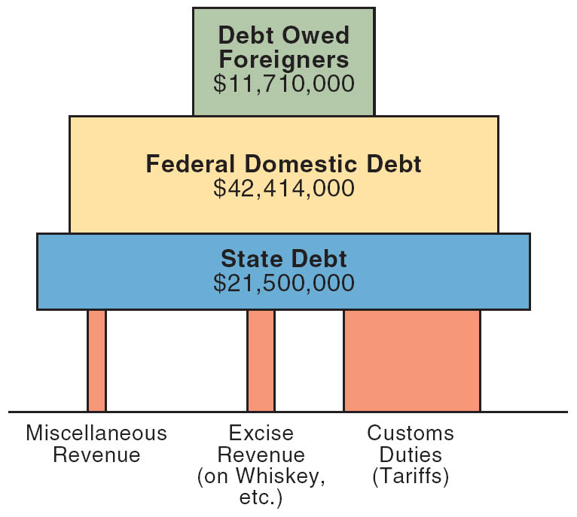
Hamilton’s Financial Structure Supported by Revenues
Copyright (c) Houghton Mifflin Company. All Rights Reserved.

Slide 11
The Whiskey Rebellion
1794 – poor farmers in Western Pennsylvania revolt against excise tax on whiskey
Liquor often used as money
Argued they were unfairly singled out
Calls of “taxation without representation”
Washington calls out army of 13000 troops
Rebels scatter
Proves gov. now strong enough to withstand internal threats

Slide 12
Political parties form
Anti-federalists argue that Hamilton’s policies encroach on states’ rights
Personal rivalry between Hamilton and Jefferson evolves into first political parties
Will become Federalists and Democratic-Republicans

Slide 13
The French Revolution
Americans initially overjoyed
Overthrow of king, proclamation of republic
After revolution becomes radical support in America cools
Federalists view French revolutionaries as dangerous mob
America becomes embroiled in international conflict

Slide 14
Maintaining Neutrality
Jefferson and Democratic-Republicans call for joining war on side of France
Hamilton wants to enter war on side of British to gain economic advantage
Washington knows country not strong enough to fight in 1793
Issues Neutrality Proclamation
Orders Americans to be impartial
Members of both political parties furious

Slide 15
Citizen Genet (1793)
French Representative to U.S.
Lands in Charleston, travels to Philly
Cheered by crowds of Jeffersonians
Believes Neutrality Proclamation doesn’t reflect desires of Americans as a whole
Begins funding American privateers to capture British ships, and planning an invasion of Spanish Florida
Expelled from country
America continues to sell food to French islands in Caribbean
France angered at U.S. non-intervention, but never officially called on U.S. to honor alliance of 1778

Slide 16
Relations with Britain
Still maintained forts on U.S. territory
Supplying Indians with weapons
Discovered after signing of Treaty of Greenville (1795)
Indians cede vast tracts of land in Ohio after defeat by “Mad Anthony” Wayne at Battle of Fallen Timbers
American neutrality ignored
British seize around 300 ships
Sailors impressed into British army and navy
Jeffersonians call for war with Britain, or embargo
Washington knows this will destroy national economy

Slide 17
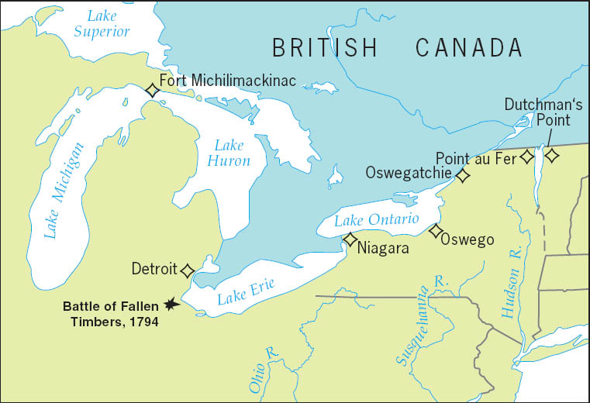
American Posts Held by the British After 1783
Despite the 1783 Treaty of Paris, the British government was reluctant to abandon its lucrative fur trade and maintained a chain of northern frontier posts.
Copyright (c) Houghton Mifflin Company. All Rights Reserved.

Slide 18
Jay’s Treaty (1794)
Washington sends John Jay to England to work out deal
Negotiations sabotaged by Hamilton
Results
Britain would repay money from shipping seizures and impressment (no agreement to stop practice)
America would pay off pre-Revolutionary War debt
Reaction
Southern farmers infuriated
Have to pay northern debt, while northern merchants paid by British
War avoided

Slide 19
Pinkney Treaty (1795)
Spain agrees to reopen Mississippi river
Allows use of disputed territory north of Florida
Favorable terms
Doesn’t want America becoming too friendly with Britain

Slide 20
Washington’s farewell address
Washington steps down after two terms
Establishes precedent that is followed until FDR
Farewell Address
Warns against political parties
Warns against permanent alliances

Slide 21
John Adams becomes 2nd President
Wins 71-68 against Jefferson, who becomes V.P.
Faces many problems
Hamilton plots with cabinet members against Adams
Jefferson, political rival, is VP
International relations with France at the brink of war

Slide 22
Undeclared War with France
France considers Jay’s Treaty a violation of the Franco-American Treaty of 1778
Begins seizing U.S. ships
XYZ Affair (1797-98)
Three envoys sent to France to meet with Talleyrand
French agents (X, Y, Z) demand 32 million florins plus $250000 just to speak to Talleyrand
Americans refuse to pay bribe, no agreement
Americans call for war with France
Adams, like Washington knows war could mean disaster
War not declared
Naval warfare rages for almost two years in the Atlantic
Over 80 French ships captured

Slide 23
Adams sacrifices
Talleyrand doesn’t want U.S. as enemy
Asks for second envoy, will be treated respectfully
Meet with Napoleon in 1800
New treaty signed
Ends 1778 alliance
Americans must pay French shippers claims
Adams keeps U.S. out of war
Loses popularity and chance at 2nd term

Slide 24
Alien and Sedition Acts (1798)
Federalists seek to weaken Democratic-Republicans and influence of Jefferson
Do not trust poor people
Alien Laws
Raised residence requirements from five to fourteen years in order to become citizen
Allowed President to deport aliens during peacetime and jail them during war
Sedition Act
Anyone impeding policies of gov. or defaming officials subject to fines and jail
Obviously unconstitutional, set to expire in 1801
Federalist majority in Congress and on Court would ensure law stood
Don’t want the law to be used against themselves
Matthew Lyon imprisoned for writing unfavorably about President Adams

Slide 25
Virginia (Madison) and Kentucky (Jefferson) Resolutions
Jefferson and Democratic Republicans afraid Federalists will continue to violate rights
Madison and Jefferson write legislation approved in 1798-99
“Compact Theory”
States had formed compact with federal gov.
States had right to nullify laws if contract with federal gov. violated
A.K.A. “States’ rights theory,” and “nullification”
Resolutions only adopted by Virginia and Kentucky
Federalists argue only Supreme Court can nullify laws
Adopted in 1803 due to Marbury v. Madison
Nobody wants secession, but argument is there
Will reappear in 1832 over tariffs, in 1850s over slavery, and eventually leads to Civil War

Slide 26
Federalists
Same people as Federalists before Constitution
Favor stronger government
Run by educated aristocrats
Most were merchants, manufacturers, and shippers
Pro-British
Wanted to increase foreign trade

Slide 27
Democratic-Republicans
Led by Jefferson
Appealed to common people
Wanted informed leaders
Weaker central gov.
Sovereignty of states
Mostly pro-French
Focus on paying off debt
Mostly farmers
Farming was ennobling
Kept people away from wickedness of cities
Slavery would prevent class of landless voters
Champions of free speech, individual liberties

