Slide 1
Essential Questions:
What sense of “colonial unity” existed in the British American colonies by the 18th Century?
Notes:
Lesson plan for August 28, 2007: Warm-up question, F&I War ppt notes, Salutary Neglect activity.

Slide 2
Moving from European Ways
Democratic forms of government
Each colony had a representative assembly elected by male voters
There were no political offices that could be dominated by a single aristocratic family
Religious toleration
All colonies permitted the practice of other religions (mostly Protestant), and Rhode Island and Pennsylvania offered religious asylum for the most

Slide 3
Rise of the American Press
Newspapers grew in number and popularity throughout 18th Century America
They were the primary form of method by which news spread throughout the colonies
Freedom of the Press???

Slide 4
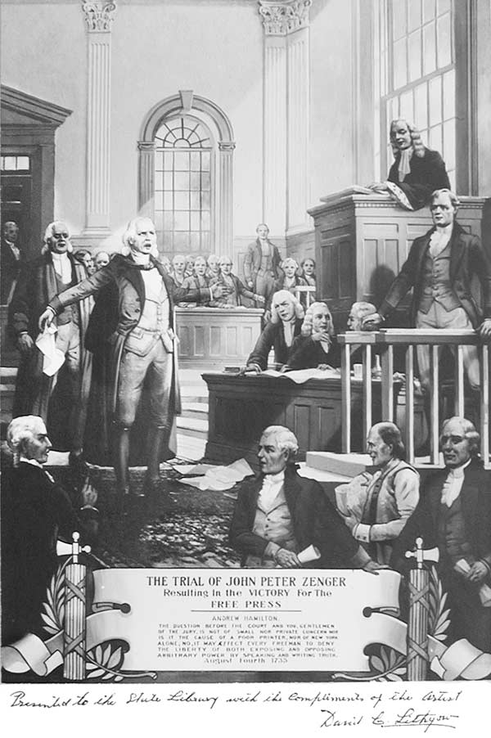
ZENGER TRIAL
Zenger decision was a landmark case which paved the way for the eventual freedom of the press.
Zenger Case, 1734-5: New York newspaper assailed corrupt local governor, charged with libel, defended by Andrew Hamilton

Slide 5
ZENGER TRIAL
John Peter Zenger, a New York publisher arrested and charged with libel against the colonial governor
Zenger’s lawyer argues that what he wrote was true, so it can’t be libel
English law says it doesn’t matter if it’s true or not
Jury acquits Zenger anyway → since it was the truth
Not total freedom of the press, but newspapers now took greater risks in criticism of political figures.

Slide 6
Chapter 6
The Duel for North America

Slide 7
Essential Questions:
How was 1763 (the end of the French and Indian War) a “turning point” in British-colonial relationships?
Notes:
Lesson plan for August 28, 2007: Warm-up question, F&I War ppt notes, Salutary Neglect activity.

Slide 8
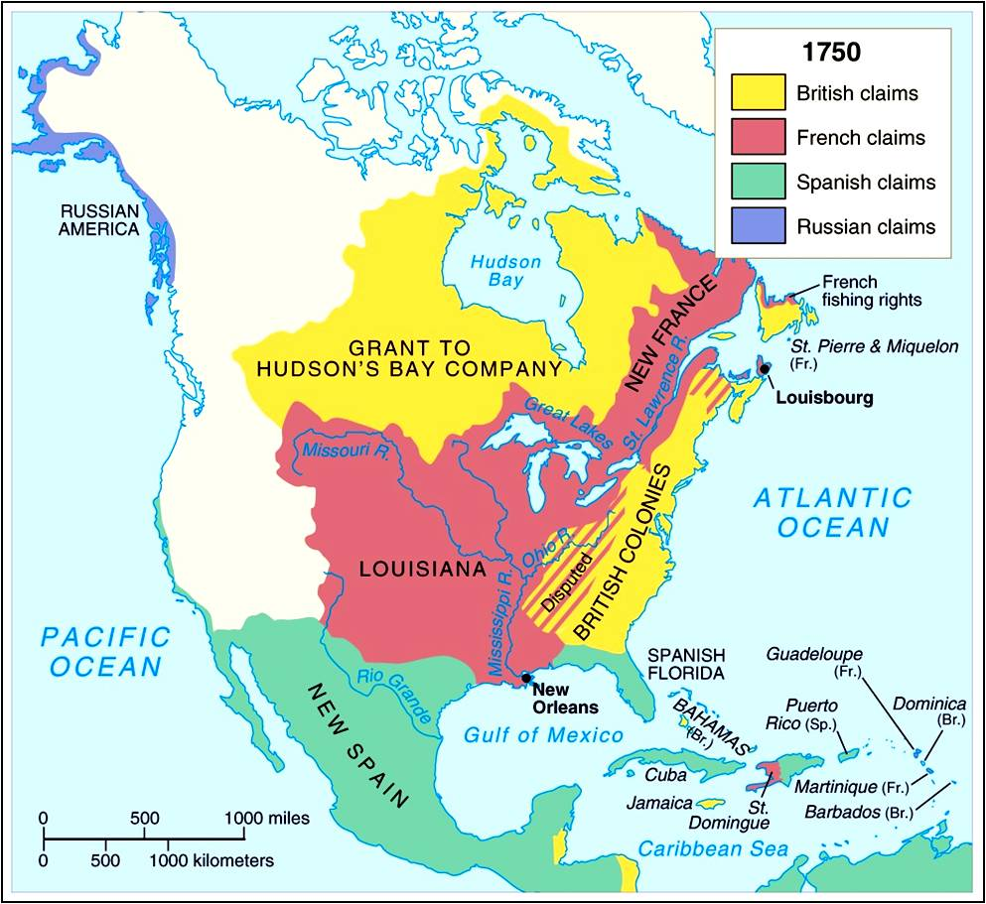

Slide 9
France
Involved in the colonization game late
Foreign wars
Religious civil wars
Similar to England
Edict of Nantes
Limited toleration of Protestants
Ends civil wars

Slide 10
New France (Canada)
Quebec
Established in 1608
Samuel de Champlain
Allies French with Huron in war against Iroquois
Limits access to Ohio Valley
Causes raids on French towns
Creates allies for British
King Louis XIV (1643 – 1715)
Takes active interest in colonies

Slide 11
Government in New France
Commercial companies fail
Colony taken over by king
No representatives
No trial by jury
Population Growth
60,000 by 1750
French peasants own land
Colony not open to protestants
French resources go to Caribbean

Slide 12
Expansion
Beaver Trade
Valued for warmth and appearance
Set up trade posts all over North America
Baton Rouge, Terre Haute, Des Moines
Consequences
Disease and alcohol decimate Indian populations
Beaver almost wiped out in parts of Canada

Slide 13
Missionaries
Jesuits
“save” the Indians
Many scalped or otherwise mutilated
Few converts
Excellent explorers and geographers

Slide 14
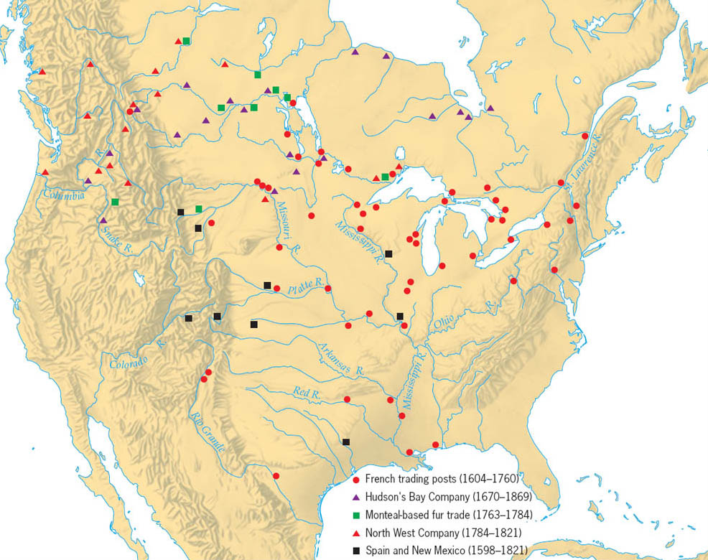
Copyright (c) Houghton Mifflin Company. All Rights Reserved.

Slide 15
Barbarians at the Gate
Antoine Cadillac
Founds fort Detroit
Keep English out of Ohio Valley
Robert de La Salle
Claims Mississippi delta for France
Louisiana
New Orleans (1718)
Illinois Country
Grain grown by the ton, shipped to New Orleans, then to Caribbean

Slide 16
French & English Mercantilist Wars

Slide 17
Clash of Em[ires
These regulations began with the Navigation Acts in 1660
The introduction of new English mercantilist policies changed its economic & military attitude towards the colonies:
Increase protective tariffs & create trade regulations so the colonies work for motherland
If that failed, go to war with economic rivals & get the colonists to fight too
The French & Indian War changed EVERYTHING between England & the colonies
New mercantilist policies after the French & Indian War led to colonial resentment & the American Revolution
Notes:
British Americans were increasingly drawn into European conflicts in the 18th Century with France & Spain

Slide 18
Clash of Empires
A series of European conflicts involving England & France spilled over into colonial North America:
King William’s War (1689-1697)
Queen Anne’s War (1702-1713)
War of Jenkins (1739-1748)
King George's War (1743-1748)
These wars were based on mercantilist competition & had little political significance…
Notes:
Queen Anne’s War was War of Spanish Succession; King George’s War was War of Austrian Succession
While the British colonies were militarily superior to New France, a lack of colonial unity & French alliances with Native Americans weakened colonial advantages

Slide 19
Clash of Empires
King William’s War (1689 – 1697)
Queen Anne’s War (1702-1713)
British vs. French and Indian allies
Neither empire sees America as worth fighting for
Guerrilla warfare
Spain allies with France
British win with capture of Port Royal in Acadia

Slide 20
Peace Treaty - 1713
British gain Acadia
Renamed Nova Scotia
Also Newfoundland, and Hudson Bay
Begins 20 years of peace
“salutary neglect”

Slide 21
War of Jenkin’s Ear (1739-1748)
Dispute with Spain over smuggling
British Captain Jenkins ear chopped off by Spanish revenue authorities in trade dispute
War declared in 1739
All fighting in Caribbean and Georgia
Oglethorpe holds Spanish off
War becomes part of War of Austrian Succession
Known as King George’s War
France allies with Spain
British capture Louisbourg at mouth of St. Lawrence River

Slide 22
Peace Treaty (1748)
Louisbourg give back to French
Outrages New Englanders
Felt betrayed
Could be base for further French aggression

Slide 23
Clash of Empires
A series of European conflicts involving England & France spilled over into colonial North America:
King William’s War (1689-1697)
Queen Anne’s War (1702-1713)
War of Jenkins (1739-1748)
King George's War (1743-1748)
These wars were based on mercantilist competition & had little political significance, but…
Notes:
Queen Anne’s War was War of Spanish Succession; King George’s War was War of Austrian Succession
While the British colonies were militarily superior to New France, a lack of colonial unity & French alliances with Native Americans weakened colonial advantages

Slide 24
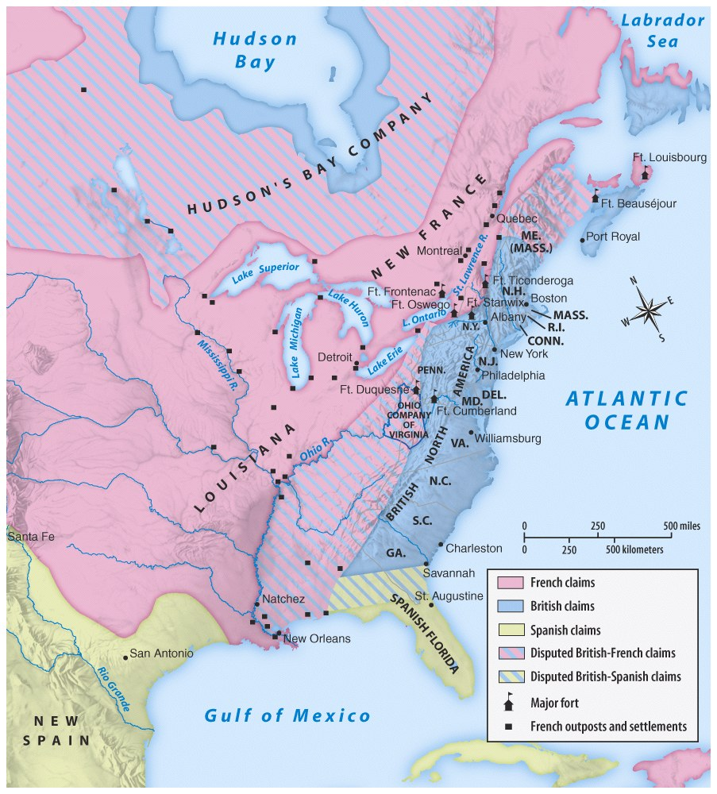
…these wars led to a land frenzy in the 1750s, among French & British colonists
Territorial disputes along the Ohio River sparked the French & Indian War

Slide 25
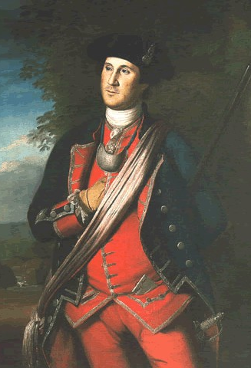
Turning Point: 1754
In 1754, VA governor sent 22 year old George Washington to protect an Ohio Company claim
Washington’s troops were forced to retreat from Fort Duquesne; This clash proved to be the beginning of the French & Indian War

Slide 26
George Washington starts a war
Ohio Country
Disputed between British and French
British flooding westward
Linked Canada to Louisiana
British colonists determined to own land
George Washington (21 year old surveyor)
1749 – Virginians gain “rights” to 500000 acres
French construct Fort Duquesne at head of Ohio River (Pittsburgh)
Sent to Ohio with 150 Virginia militiamen to secure claim
Fire on French troops 40 miles from Fort Duquesne

Slide 27
The Seven Years’ War
Washington constructs breastworks, Fort Necessity
Surrounded by French
Surrenders on July 4, 1754
Allowed to march back to VA
Nova Scotia
British worried French Canadians, Acadians, will revolt
4000 deported to Louisiana in 1755
Ancestors of Cajuns
Today nearly 1 million

Slide 28
Global War and Colonial Disunity
World War
Undeclared for two years
Widens into most widespread war in history
Europe, Caribbean, Philippines, Africa, India, all oceans
War in Europe
Britain and Prussia vs. France, Spain, Austria, Russia
Germans do most of the fighting, England pays gold
Most French troops wasted attacking Germany

Slide 29
Albany Congress
Colonist closest to the French respond more quickly
1754 – British government calls colonial congress to Albany, NY
7 colonies show up
Bribe Iroquois chiefs
Achieve colonial unity
Ben Franklin publishes cartoon

Slide 30
Ben Franklin
Undeclared leader of Albany Congress
Proposes Albany Plan of Union
Home rule for colonies
Congress of delegates from all 13 colonies
Powers
Raise military
War/peace with natives
Regulate trade in North America
Tax
Collect customs
Approved by delegates
Denied by colonial legislatures and British
Not enough independence/too much power given up

Slide 32
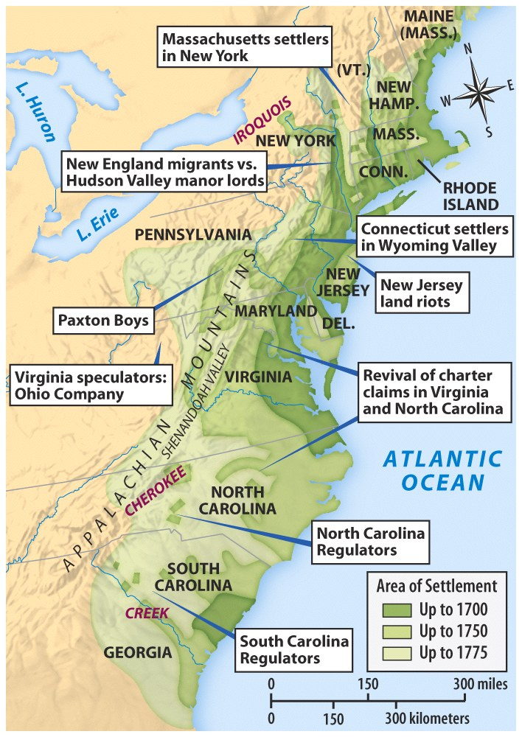
Westward Expansion & Land Conflicts, 1750-1775

Slide 33
Braddock’s Blundering
British defeats
Colonists lose opening battles of French and Indian War
General Braddock and 2000 troops sent to capture Fort Duquesne in 1775
60 year old European veteran
Routed by small French and Indian force
Indians surge across western frontier
People scalped as close as 80 miles from Philadelphia
Washington and 300 militiamen attempt to defend entire frontier

Slide 34
Invasion of Canada
1756 – British invade Canada
Attempt to attack multiple outposts simultaneously
Cut off French interior from St. Lawrence River

Slide 35
The French & Indian War
The war went bad for England from 1756 to 1758
In 1757, Prime Minister William Pitt took command of the military:
Used well-qualified generals
Had a “blank check” to fund the war in America, India, & Europe

Slide 36
William Pitt
1757 – Prime Minister of England
Attack Quebec/Montreal
1758 – British capture Louisbourg
James Wolfe
Chosen to command British troops
Daring attack on Quebec results in death
French defeated
In 1758, the tide of the war turned; England won by 1760

Slide 37
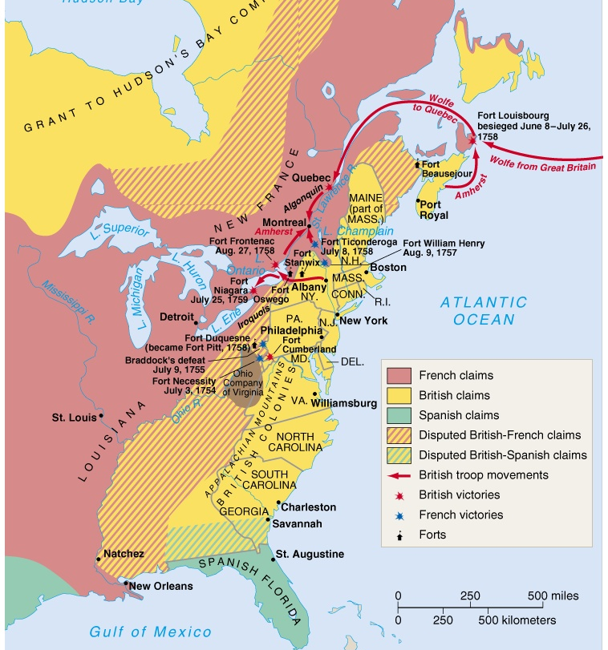
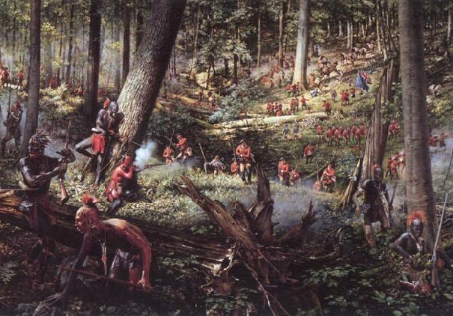
1758-1761 The Tide Turns for England
By 1761, Spain became an ally of France

Slide 38
The War ends
Montreal falls in 1760
Treaty of Paris (1763)
French lose all North American territory
Spain cedes Florida to British
Spain gets Louisiana territory west of Mississippi, and New Orleans
End of “salutary neglect” for colonists

Slide 39
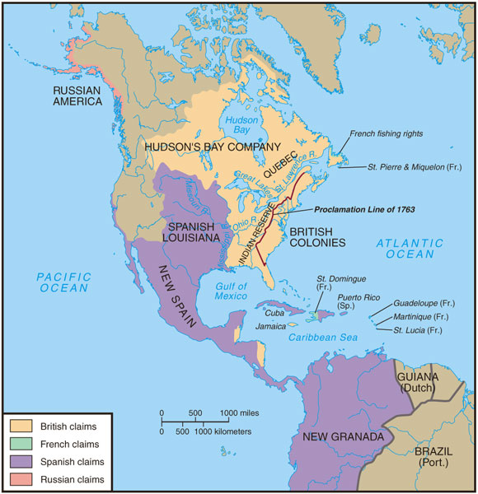
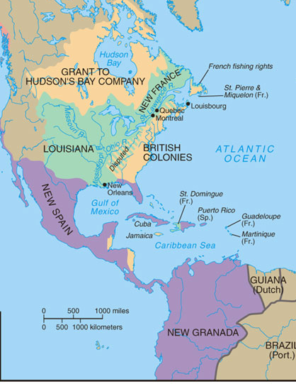
North America after 1763
America in 1750
America in 1763

Slide 40
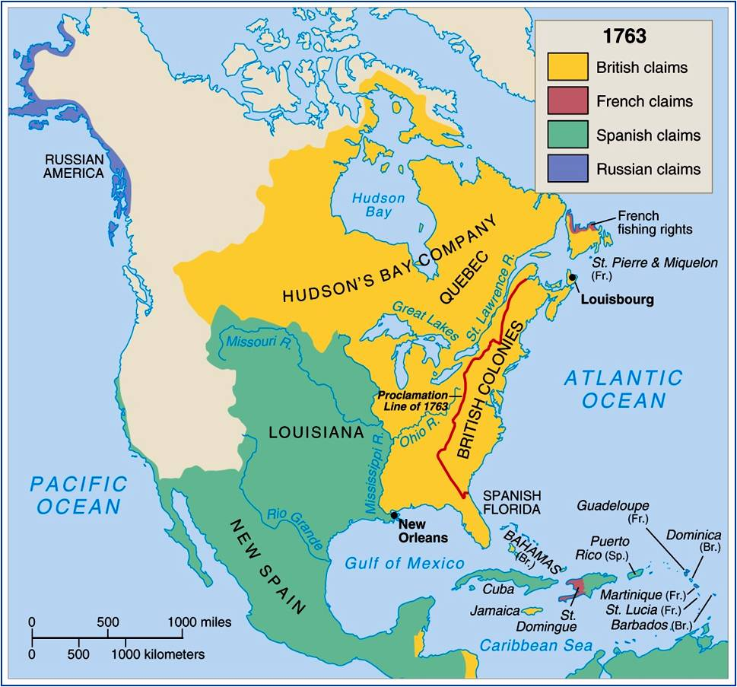

Slide 41
Restless Colonists
Colonial Militia
More confidence
Fought well using European tactics
Gained experience
20000 soldiers by end of war
Early defeats shatter the myth of British invincibility

Slide 42
Perceptions of the War
Colonial views:
Colonies could be very strong when they worked together
Newly gained frontier had land
Colonial commanders learned how to fight
English views:
Americans took forever to organize & balked at helping raise money for an expensive war to protect their own lands

Slide 43
Friction Arises
British show contempt for militia
Colonial militia not allowed to rise beyond captain
Contempt for colonists
“scum” from the “outhouses of civilization”
Colonists believed they are cutting edge of civilization
Deserve credit

Slide 44
Friction
Smuggling
Colonist smuggle goods to Caribbean
Keeps islands from starving during British blockade
British forbid all exports of supplies during last year of war
Lack of Troops
Colonist refuse to provide troops or money for campaign
Pitt offers reimbursement for service

Slide 45
Colonial Disunity
Caused by distance and geography
Religious conflict
Different nationalities
Different forms of government
Boundary disputes
Class differences

Slide 46
War’s Aftermath
Indians
French gone
Spanish influence reduced
Indians can no longer play Europeans against one another
Pontiac’s Rebellion
Chief Pontiac unites tribes in Ohio.
Overruns all but 3 forts
British distribute smallpox blankets
Post permanent troops on frontier
Colonists asked to pay bill

Slide 47
The West
Colonist eager to move west across Appalachians
Daniel Boone leads pioneers into TN and KY
Proclamation of 1763
Prohibited settlement west of Appalachians on Native American land
Needed time to work out Indian problem
How will colonists react?

Slide 48
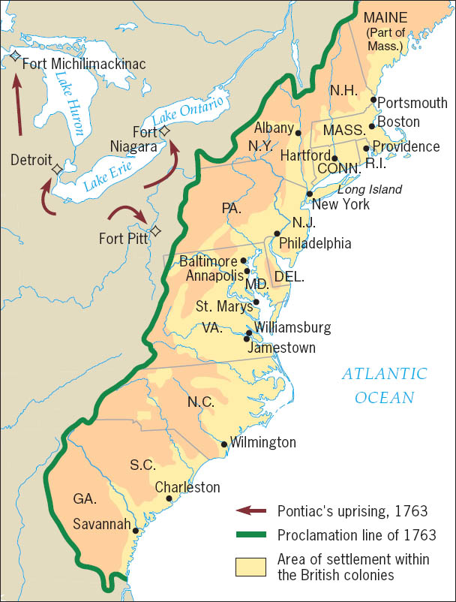
Copyright (c) Houghton Mifflin Company. All Rights Reserved.

Slide 49
Tensions Mount
No barriers to westward expansion of colonies
Colonists eager to conquer new lands
Beginnings of “manifest destiny”
British confident due to recent victories and land acquisitions
Annoyed with uppity colonists

