Slide 1
The Rise of Mass Democracy 1824-1840
Chapter 13 – The American Pageant

Slide 2
How did the election of 1824 forever change politics in America?

Slide 3
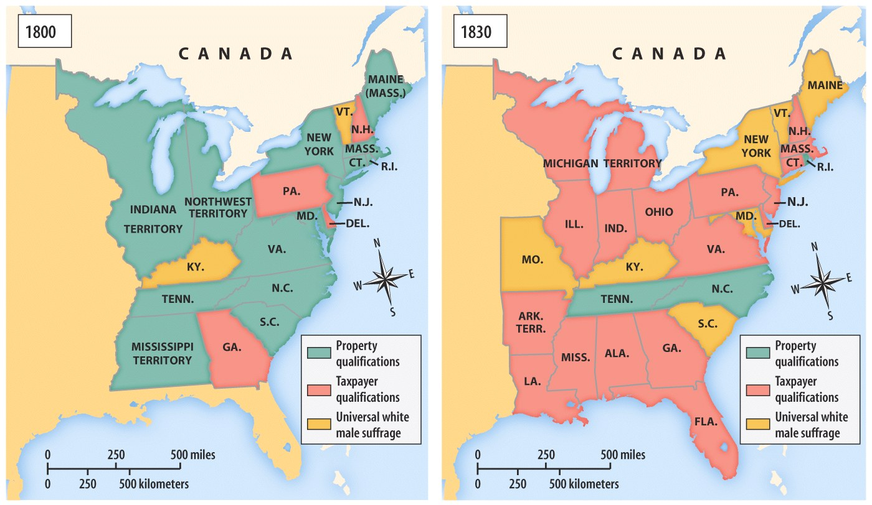
Voting Requirements in the Early 19c

Slide 4
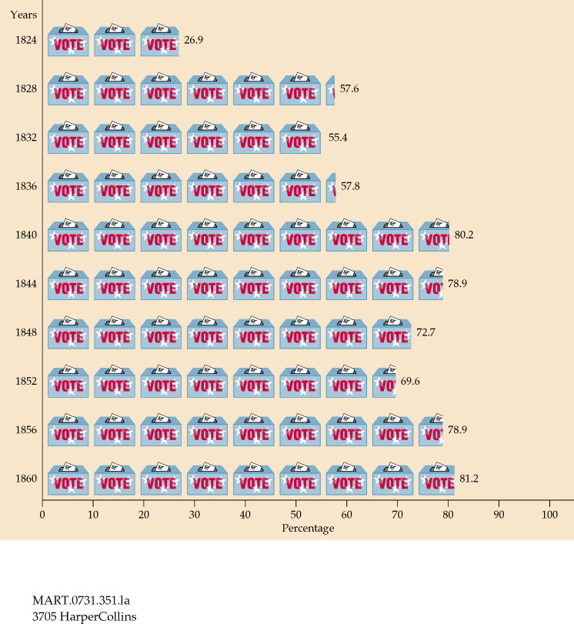
Voter Turnout: 1820 - 1860

Slide 5
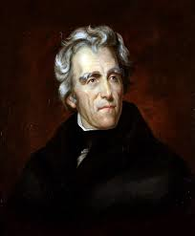
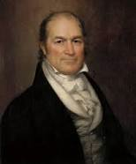
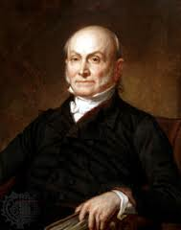
1824 – “Corrupt Bargain”
Universal white male suffrage
James Monroe, completed his 2nd term in office
Election of 1824
Andrew Jackson (Tenn.), Henry Clay (Kentucky), William H. Crawford (Georgia), John Q. Adams (Mass.)
All running as Republicans
Regional favorites
Andrew Jackson Henry Clay William H. Crawford John Q. Adams

Slide 6
Election of 1824
http://www.270towin.com/1824_Election/

Slide 7
Election of 1824
Candidates | Electoral Vote | Popular Vote | Popular Percentage
Jackson | 99 | 153,544 | 42.16%
Adams | 84 | 108,740 | 31.89%
Crawford | 41 | 46,618 | 12.95%
Clay | 37 | 47,136 | 12.99%
Who won the Popular Vote? The electoral vote?
Who won the election?

Slide 8
1824 – “Corrupt Bargain”
Jackson wins popular votes and electoral vote
Adams 2nd, Crawford 3rd
No majority in Electoral College
There were 261 electoral votes cast.
What is a majority?
This is where the 12th Amendment comes in.
A-15

Slide 9
1824 – “Corrupt Bargain”
- 12 Amendment – top three voted on in House
Winner of simple majority wins presidency
\
Who are the top three candidates?
Candidates | Electoral Vote | Popular Vote | Popular Percentage
Jackson | 99 | 153,544 | 42.16%
Adams | 84 | 108,740 | 31.89%
Crawford | 41 | 46,618 | 12.95%
Clay | 37 | 47,136 | 12.99%

Slide 10
Political Gamesmanship
Clay is eliminated, but is Speaker of the House
Crawford suffers paralytic stroke
Clay hates Jackson
Supports John Q. Adams
Clay rewarded with Secretary of State position
Traditionally “stepping stone” to presidency
Jacksonians charge corruption
Will of the people subverted by career politicians
“Corrupt Bargain” hurts reputations of Adams and Clay

Slide 11
John Q. Adams
Not very popular. Seen as out of touch with the people
Did not remove previous appointments
Urges construction of roads, canals, proposes national university and observatory
Mixed support
Attempts to curb over-speculation of land
Disliked by westerners
Attempts to deal fairly with Cherokee
Georgia resists

Slide 12
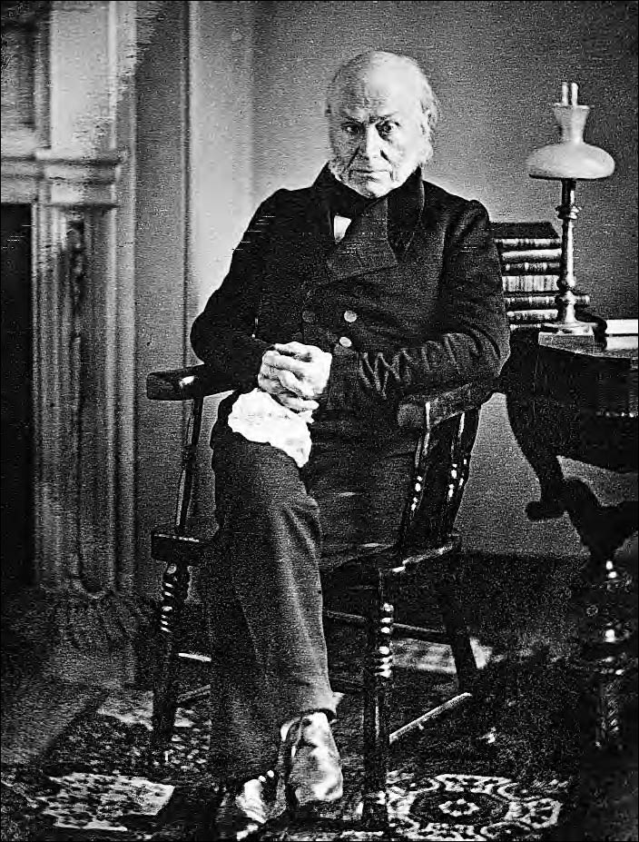
President John Quincy Adams (1767–1848), Daguerreotype by Phillip Haas, 1843
Adams wrote in his diary in June 1819, nearly six years before becoming president, “I am a man of reserved, cold, austere, and forbidding manners: my political adversaries say, a gloomy misanthropist, and my personal enemies an unsocial savage.”
Metropolitan Museum of Art. Gift of I.N. Phelps Stokes, Edward S. Hawes, Alice Mary Hawes

Slide 13
Jackson in 1828
Jacksonians ask “Should the people rule?”
Bring “corrupt bargain” back into spotlight
Public opinion turns against J.Q. Adams
Adams too honorable to attack Jackson
Supporters, not so much
Jackson’s mother a prostitute
Jackson an adulterer
Married wife, Rachel, thinking she was divorced
Rachel dies after election
Jackson blames attackers
Attack Adams as wasteful spender
Cite billiard table and chess set, purchased with own money

Slide 14
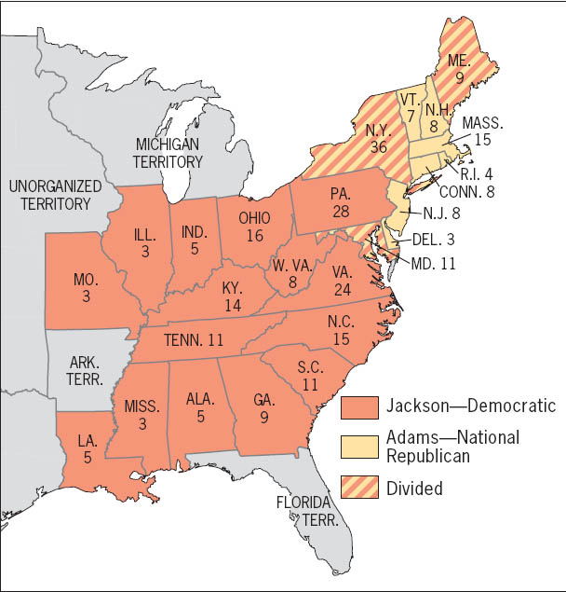
Presidential Election of 1828 (with electoral vote by state)
Jackson swept the South and West, whereas Adams retained the old Federalist stronghold of the Northeast. Yet Jackson’s inroads in the Northeast were decisive. He won 20 of New York’s electoral votes and all 28 of Pennsylvania’s. If those votes had gone the other way, Adams would have been victorious--by a margin of one vote.
Copyright (c) Houghton Mifflin Company. All Rights Reserved.

Slide 15
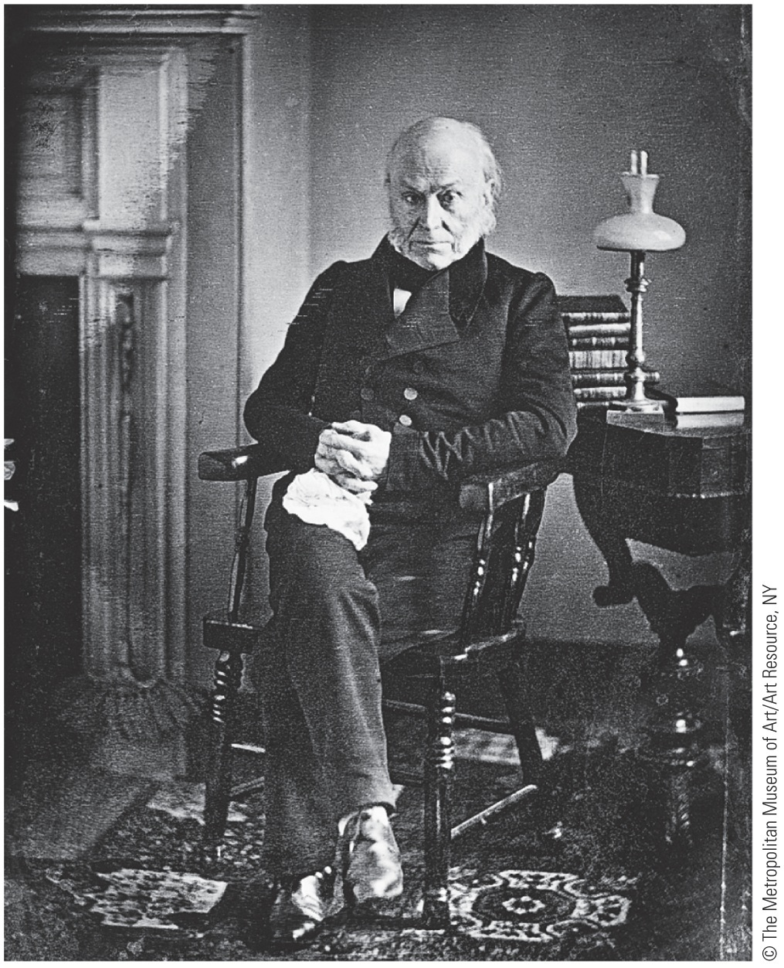
Who was Jackson? How can we describe him?
Primary Sources

Slide 16
“Old Hickory”
Jackson personifies West
Rough, jack of all trades
Survived malaria, dysentery, tuberculosis, and lead poisoning from bullets lodged in his body
Born in backwoods Carolina
Orphaned, not very literate
Violent temper
Involved in many duels, fights, stabbings
Called “Old Hickory” by troops because of toughness

Slide 17
Jackson continued
Became a judge, then congressman in Tennessee
Western aristocrat
Owned many slaves at his mansion and plantation, the Hermitage (near Nashville)
Anti-federalist
Believed federal gov. only for privileged
Also believed federal gov. held power over states

Slide 18
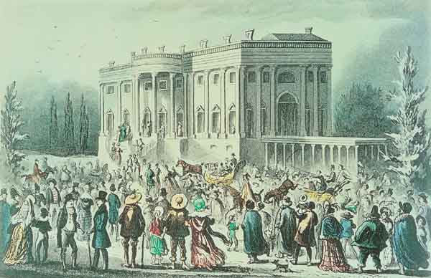
Jackson as President
Allowed commoners into White House on inauguration
Property damage and chaos
Dubbed “King Mob” by conservative opponents

Slide 19
The Spoils System
Jackson rewards supporters with good positions
Values loyalty over experience
Wants to replace aging bureaucrats with younger people
Ends up replacing 1/5 of gov. workers
Denies capable people chance to contribute
Largest donators to party awarded most lucrative jobs
Samuel Swartwout – appointed customs collector for New York
Steals over 1 million from gov.
Spoils system will prevail for next 50 years

Slide 20
“Tariff of Abominations”
Problem for Adams and now for Jackson:
Tariffs protected industry against competition from European manufactured goods
They also increased prices for all Americans
Invited retaliatory tariffs on American agricultural exports abroad
Middle states had long supported protectionist tariffs:
Webster abandoned free trade to back higher tariffs
Why would a New Englander, such as Daniel Webster, back these higher tariffs?

Slide 21
“Tariff of Abominations”
1824 – Congress increases tariff from 23 – 37%
Wool manufacturers demand higher rate
Tariff of 1828 – Election Year
Jacksonians attempt to raise tariff to 45%
Hope this will drive prices so high, even New England will come out against
Plan backfires
Law passes
Southerners, led by John C. Calhoun brand tariff as “Tariff of Abominations”

Slide 23
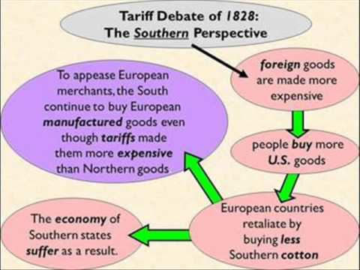

Slide 25
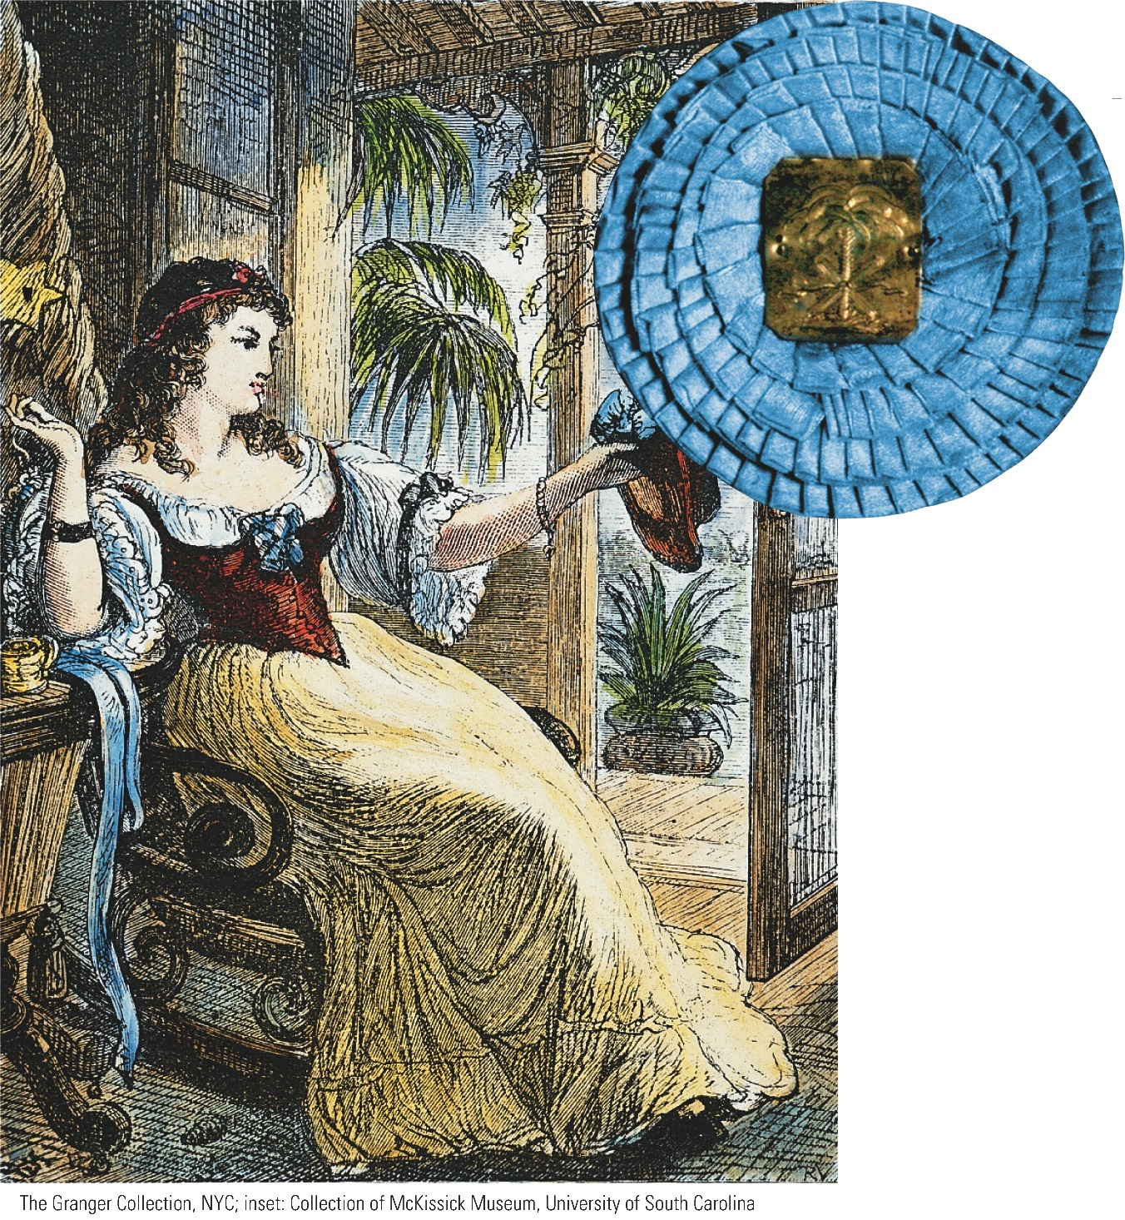
South Carolina Belle Sewing Palmetto Cockade The
“Tariff of Abominations” of 1828 drove many people in
South Carolina—the “Palmetto State”—to flirt with secession.
Anti-tariff protesters wore palmetto blossoms, real or sewn from fabric, to symbolize their defiance of the federal law.
The blue cockade indicated support for the ordinance of nullification.
The Granger Collection, NYC; inset: Collection of McKissick Museum, University of South Carolina
p256
Notes:
South Carolina Belle Sewing Palmetto Cockade The
“Tariff of Abominations” of 1828 drove many people in
South Carolina—the “Palmetto State”—to flirt with
secession. Anti-tariff protesters wore palmetto blossoms,
real or sewn from fabric, to symbolize their defiance of
the federal law. The blue cockade indicated support for
the ordinance of nullification.
The Granger Collection, NYC; inset: Collection of McKissick Museum, University of South Carolina

Slide 26
“Tariff of Abominations”
Deeper issues underlay southern outcry:
Growing anxiety about possible federal interference with slavery
Kindled by congressional debate on Missouri Compromise
Fanned by aborted slave rebellion in Charleston in 1822, led by free black Denmark Vesey
Cotton prices are falling
Tariffs raise cost for all southerners

Slide 27
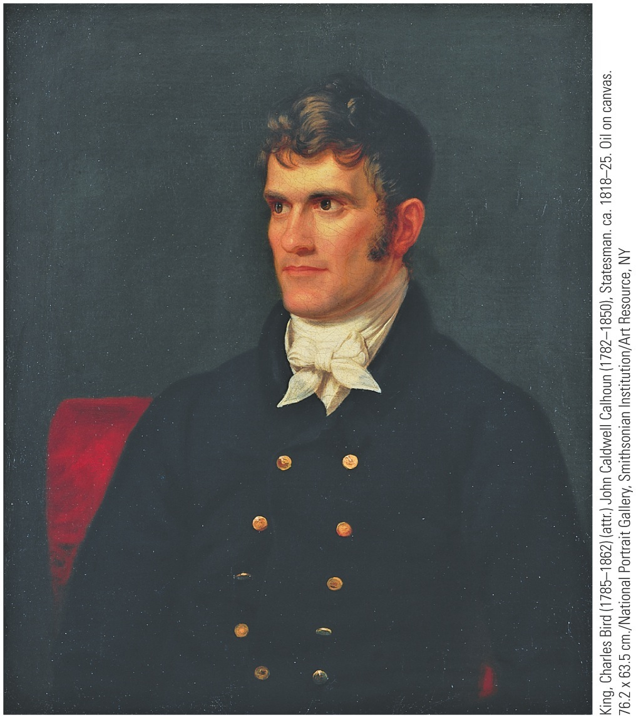
“The South Carolina Exposition”
A pamphlet Written by John C. Calhoun in 1828
Denounces tariff
Calls for nullification
Expects support of Jackson, elected two weeks earlier
1832 – Congress passes new tariff
Did away with worst of tariff of abominations
Lowers rate to 35%
South Carolina
Unionists voted out of office in 1832
Replaced by “nullies”

Slide 28
“Nullies”
Tariff of 1832 nullified by South Carolina
Threaten secession from Union if national gov’t tried to use force to collect money
Jackson angered, issues scathing proclamation
Governor Hayne issues counter-proclamation
On the brink of civil war
Henry Clay proposes Compromise Tariff of 1833
Tariff will be reduced by 10% over 8 years
25% by 1842
Fallout
Tariff of 1833 (Clay) passes
Congress passes Force Bill
Gives president authority to use army to collect tariffs, prevent nullification
Other southern states toy with nullification
S.C. repeals nullification ordinance

Slide 30
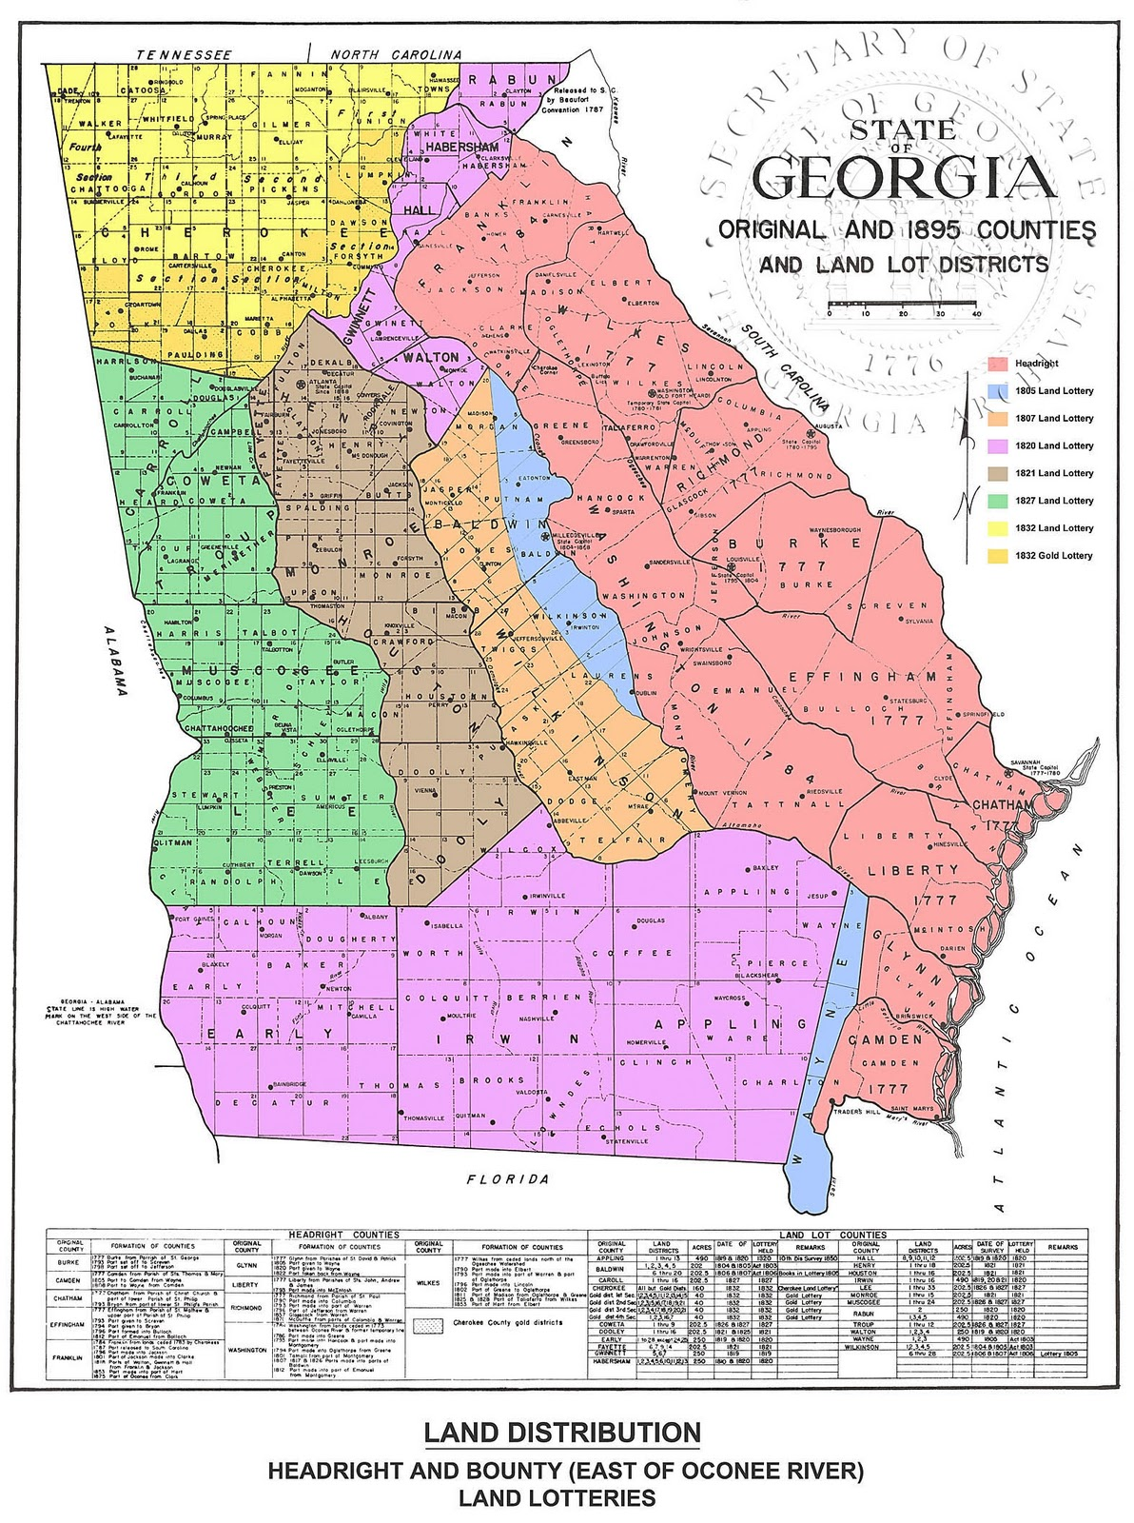
What does this map show us about the movement of people westward?

Slide 31
Indian Removal
Jacksonians committed to expansion west:
Meant confrontation with 125,000 Native Americans who lived east of Mississippi
Federal policy toward Indians varied:
1790s, U.S. Government recognized tribes as separate nations and agreed to acquire land only by formal treaty
Many white settlers broke treaties
Many other whites felt respect and admiration for Indians and believed they could be assimilated

Slide 32
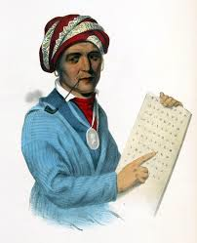
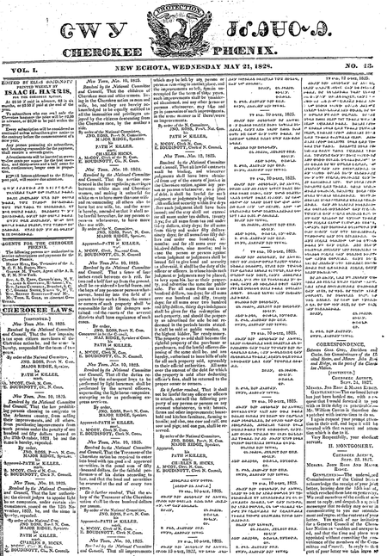
Indian Removal
Indians become stranded as states expand
People try to Christianize Indians
Some tribes resist
“Five Civilized Tribes” – Cherokees, Creeks, Choctaws, Chickasaws, and Seminoles
Cherokees
Attempt to adopt American culture
Settled agriculture, alphabet, legal code in 1808, constitution in 1827

Slide 34
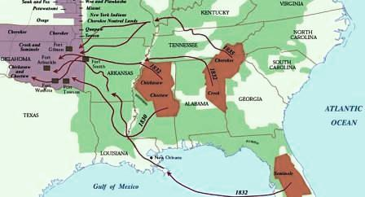
Indian Removal Act
Congress passes Indian Removal Act in 1830
Set aside land west of the Mississippi River as Indian Territory (present day Oklahoma)

Slide 35
The Cherokee Sue:
First Court Case:
In 1831 the Cherokee sue the state of Georgia arguing that the State of Georgia has no right to take their land.
The court rules that the Cherokee Nation are not citizens of the United States and have no right to use in Court.
Worcester v. Georgia
In 1832 the Cherokee sue again claiming that they are U.S. citizens and should have the power to sue.
Chief John Marshall of the U.S. Supreme court says that the land belonged to the Cherokee and their law, not Georgia.
The Cherokee had WON!

Slide 36
The President Responds:
President Andrew Jackson refuses to enforce the decision.
He said:
“John Marshall had rendered his ‘decision’; now let him enforce it.”

Slide 37
Trail of Tears
Summer of 1838 Cherokee are removed from Georgia.
Indian resistance in Black Hawk War (1832) crushed.
Black Hawk was a Sauk leader
1835-42 – Seminole in Florida wage guerrilla warfare in Florida until Chief Osceola captured
Thousands die on “Trail of Tears”

Slide 38
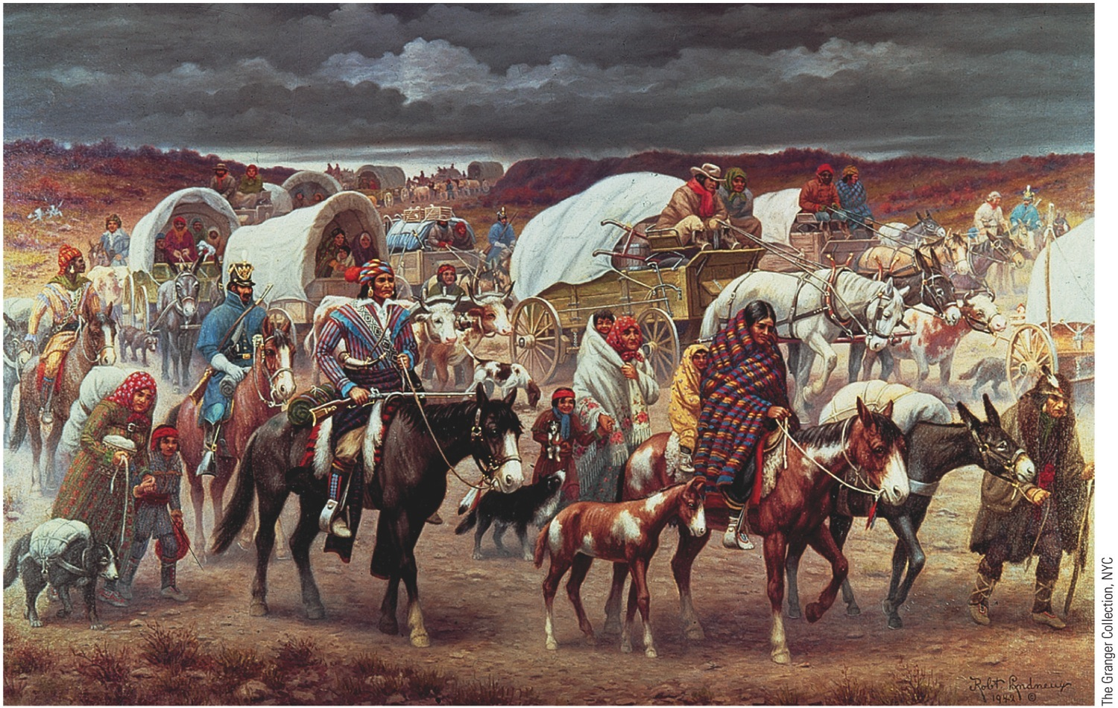
p259
Notes:
The “Trail of Tears” In the fall and winter of 1838–1839, the U.S. Army forcibly
removed about fifteen thousand Cherokees, some of them in manacles, from their
ancestral homelands in the southeastern United States and marched them to Indian
Territory (present-day Oklahoma). Freezing weather and inadequate food supplies
led to unspeakable suffering. The escorting troops refused to slow the forced march
so that the ill could recover, and some four thousand Cherokees died on the 116-day
journey.

Slide 39
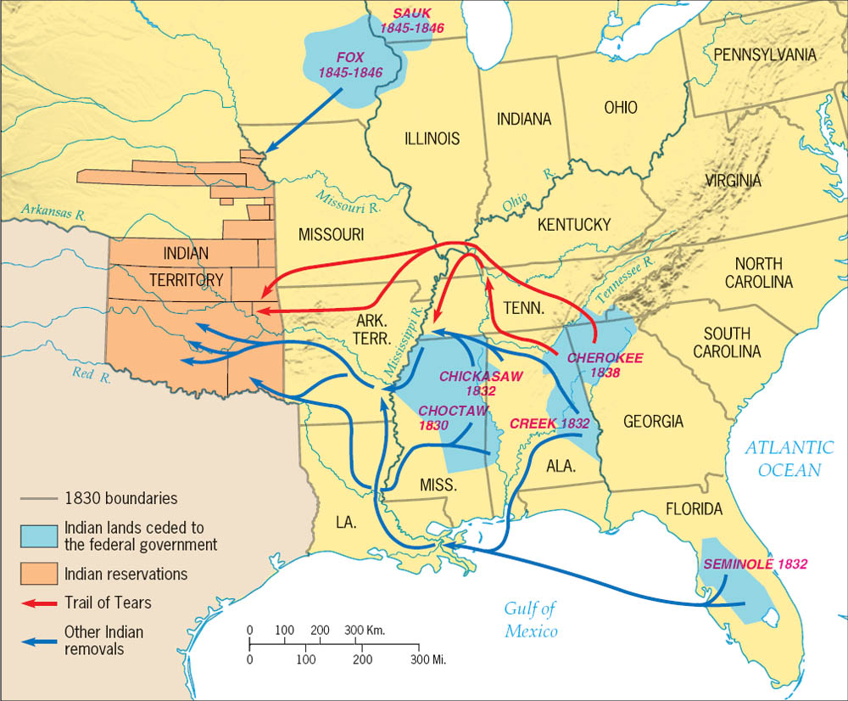
Copyright (c) Houghton Mifflin Company. All Rights Reserved.

Slide 40
Gov’t policies toward the N.A.’s
Bureau of Indian Affairs created in 1836
Deal with Indians
Energy devoted to “civilizing” and Christianizing the Indians.
Native American boarding schools started
In 1878, the Society for Propagating the Gospel among the Indians was founded.
The federal government appropriated $20,000 to promote literacy, agriculture, and vocational instruction among Indians.

Slide 41
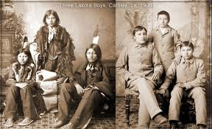

Slide 44
The Bank War
Jackson hates the Bank of the U.S.
Tool for wealthy to get richer
Only mints “hard money” (gold & silver coins)
Westerners want paper money
Paper money is printed by private banks
Causes inflation & rate fluctuated based on health of bank and amount of money printed
See banking system as way to keep common man down
Nicholas Biddle – leads BUS
Cracks down on “Wildcat” banks
Western banks issuing unstable currency and lenient credit
Corruption
Biddle lends U.S. funds to friends
Issues bribes

Slide 45
BUS
Bank is financially sound
Reduces bank failures
Promotes economic expansion
Safe depository for Washington funds
1832 – Clay attempts to damage Jackson
Proposes bill re-chartering BUS , four years early
He did this because it was an election year
Believed Jackson would alienate followers if bill signed
Would lose support of east if bill vetoed
If he signed it, would alienate western followers

Slide 46
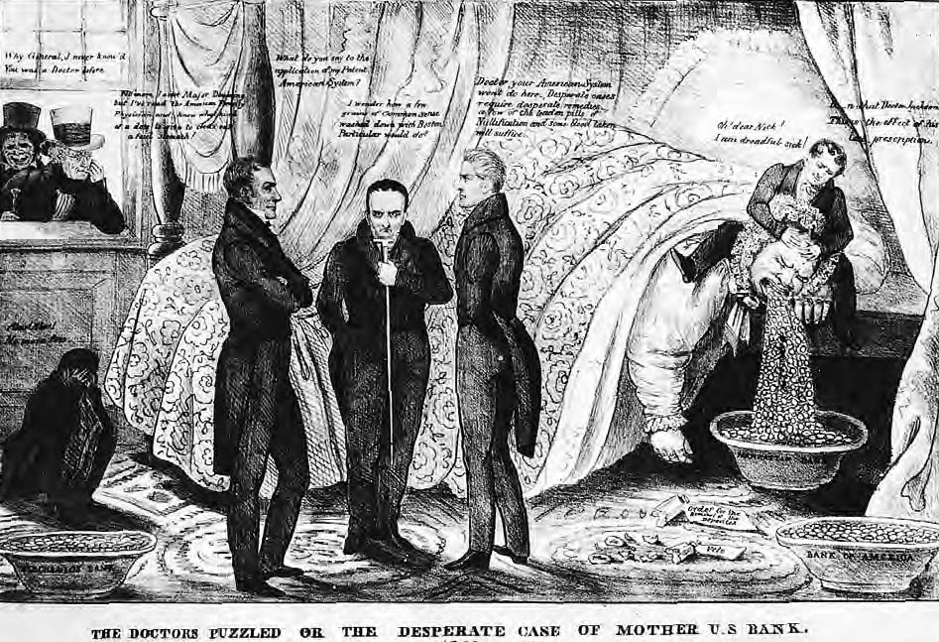
In Mother Bank’s Sick Room
Pro-bank men Henry Clay, Daniel Webster, and John Calhoun consult on the grave illness that is causing Mother Bank to cough up her deposits. While Nicholas Biddle, president of the Bank of the United States, ministers to the patient, U.S. president Andrew Jackson looks on with pleasure.
Brown Brothers

Slide 47
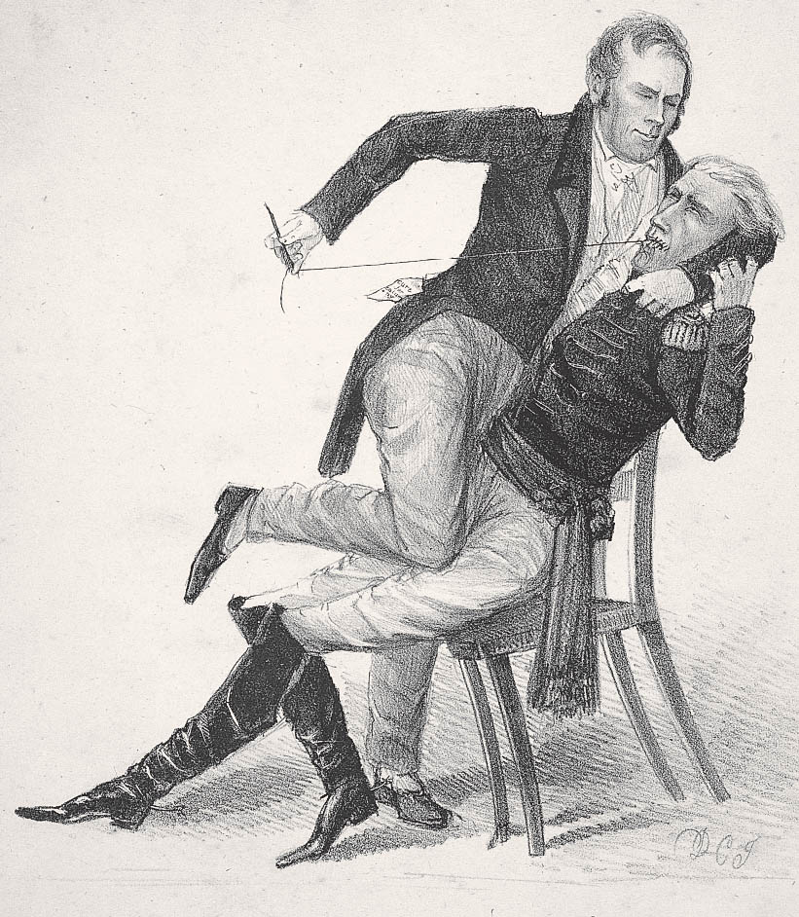
Symptoms of a Locked Jaw
An outraged and outmaneuvered Henry Clay vainly tries to “muzzle” Andrew Jackson after Jackson’s stinging message vetoing the bill to recharter the Bank of the United States.
Tennessee Historical Society

Slide 48
Election of 1832
Jackson vetoes re-charter bill
Condemned as unconstitutional
John Marshall had ruled bank was constitutional in McCulloch v. Maryland (1819)
Anti-American
Veto increases power of president
Supreme Court ignored again
Politically aligns west against east

Slide 49
Election of 1832
Clay and Jackson were candidates again
Jackson immensely popular
Attacked by Clay as dueling, gambling, etc.
Anti-Masonic Party
Opposed Masonic Order
Against Jackson, a Mason
Supported by many churches
Splits opposition to Jackson

Slide 50
Election of 1832
First national conventions held
Clay has more money, and support of the press
Jackson wins easily on backs of popular vote
Popular vote was 687,502 to 530,189.
Electoral count was 219 to 49.

Slide 51
The Death of the BUS
Jackson withdraws federal funds from BUS
With no money, bank can’t operate
Biddle calls for unnecessary loans
Creates mini economic panic
1836 – BUS out of funds
Only source of sure credit in US now gone
West falls into recession as wildcat banks fail

Slide 52
Birth of the Whigs
Modern two-party system begins to emerge
Opponents of Jackson
Despise iron-fisted nature
“King Andrew”
Whigs
Disliked Jackson
Supported American System and internal improvement

Slide 53
Election of 1836
Jackson too old to run
Martin van Buren picked as successor
Whigs disorganized
Offer popular candidate from every section of country
Hoping to force election into House
Plan fails
Van Buren wins

Slide 54
Troubles for Van Buren
1st President born in America
Support from only some Democrats
No widespread popularity
Inherits depression caused by death of BUS
Rebellion in Canada in 1837

Slide 55
Panic of 1837
“Wildcat banks” issue too many loans
Land overspeculation
Specie Circular
Debts can only be paid in specie (gold and silver)
Wheat crops fail due to Hessian fly
British bank failures in 1836

Slide 56
Response
Hundreds of banks fail
Including Jackson’s pet banks
Whigs propose expansion of bank credit, higher tariffs, and subsidies for improvements
Van Buren proposes “Divorce Bill”
Separates bank from government (independent treasury)
Money stored in vaults in large cities
Safe but unavailable
Passed in 1840
Repealed by Whigs 1841
Reenacted in 1846 under Polk
Eventually leads to creation of Federal Reserve System

Slide 58
Bellwork:
Grab an American Pageant textbook from the bookshelf.
Take out your notebook.
What do you know about Texas’ fight for independence from Mexico and it’s eventual annexation into the United States?

Slide 59
Problems in Texas
1823 – Stephen Austin makes agreement with Mexico to bring 300 families to Texas
Must become citizens
Must become Catholic
No slavery
Stipulations mostly ignored

Slide 60
Precursors to Rebellion
Texans led by Sam Houston
1830 – Mexico frees slaves, bans slavery in Texas
Angers Texans
1833 – Stephen Austin goes to Mexico City
Jailed for 8 months
1835 – Santa Anna raises army to suppress Texas
1836 – Texas declares independence

Slide 61
The Lone Star Rebellion
Mexicans slaughter Texans at Alamo and Goliad
Increases popular support for rebellion in Texas
Sam Houston marches army east for 37 days
Hoping to lengthen Santa Anna’s supply lines
Attacks Mexicans during siesta hour
Santa Anna captured, forced to sign treaty
Texas Independence – 1836
Republic of Texas created
Santa Anna repudiates treaty
Extorted under duress

Slide 62
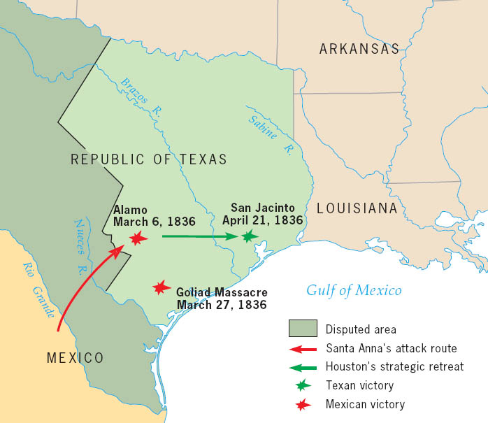
The Texas Revolution, 1836
General Houston’s strategy was to retreat and use defense in depth. His line of supply from the United States was shortened as Santa Anna’s lengthened. The Mexicans were forced to bring up supplies by land because the Texas navy controlled the sea. This force consisted of only four small ships, but it was big enough to do the job.
Copyright (c) Houghton Mifflin Company. All Rights Reserved.

Slide 63
Ramifications
Texas supported by U.S.
Independence recognized by Jackson on last day in office
Texans want annexation by U.S.
Slavery issue prevents this
Predicament
Texas expects attack by Santa Anna

Slide 64
Election of 1840
Whigs nominate William Henry Harrison and John Tyler
Slogan “Tippecanoe and Tyler too”
Attacked by democrats as poor old farmer from log cabin with hard cider
Appeals to westerners
Plays into hands of Whigs
Van Buren loses – protest against economic hard times
Harrison in office for 30 days
Dies of pneumonia

Slide 65
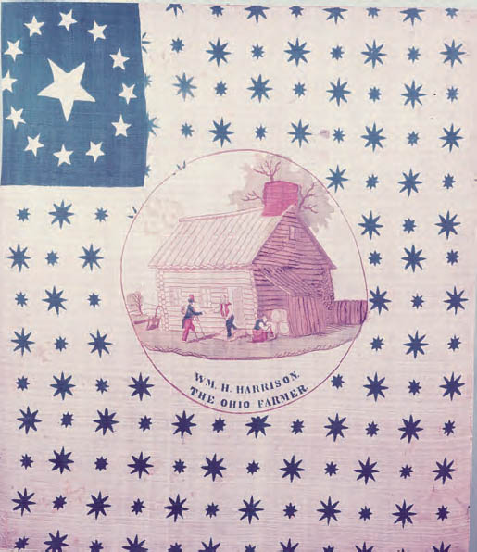
Campaign Flag for William Henry Harrison, 1840
As the two-party system came into its own by 1840, presidential elections became more public contests. Lively political campaigns used banners, posters, and flags to whip up voters’ support. Although General Harrison was hardly a simple log cabin-living Ohioan, the Whigs disseminated this logo to persuade the voters that the Virginia-born gentleman was really a homespun Western farmer.
Collection of The New-York Historical Society

Slide 66
The sea change in politics
Politicians have to appease and appeal to masses
Men with humble origins more likely to be elected
Western military heroes become popular politicians
Andrew Jackson, Davy Crocket, William Henry Harrison
Jacksonian Democrats argue governing to be done by people
Attacked as “coonskin congressmen” and “bipeds of the forest”

Slide 67
The new Two-Party System
Democrats
Liberty of the individual
States’ rights
Federal restraint in social and economic affairs
Poorer people, humble origins
Mostly Southern, western
Whigs
Harmony of society and value of community
No appeals to self-interest fostering conflict
Renew national bank, tariffs, internal improvements, public schools, moral reform
Aristocratic and wealthy
Mostly Eastern
Both parties claim to represent “the people”
Membership in both parties widely varied

