Slide 1
Chapter 11
The Triumphs and Travails of Jeffersonian Republic

Slide 2
Election Campaign of 1800
Federalists no longer have popular support
Alien and Sedition Acts create enemies
Damaged due to lack of declaration of war with France
Collected taxes, built navy, but no war
Jefferson attacked by Federalists
Accused of robbing widow of trust fund, fathering children with slaves, and being an atheist

Slide 3
“Revolution of 1800”
Jefferson wins same number of votes as Aaron Burr
Tied election must be decided in House of Representatives
House is dominated by “lame-duck” Federalists
Hate Jefferson, dislike Burr
Alexander Hamilton and John Adams persuade members to support Jefferson
Jefferson wins Presidency
Burr seen as “unprincipled” by Hamilton
Will lead to Hamilton’s death in duel with Burr
Power changes from Federalist to Democratic-Republican peacefully (peaceful Revolution of 1800)
Proves that new system can succeed
Elections based on popular support

Slide 4
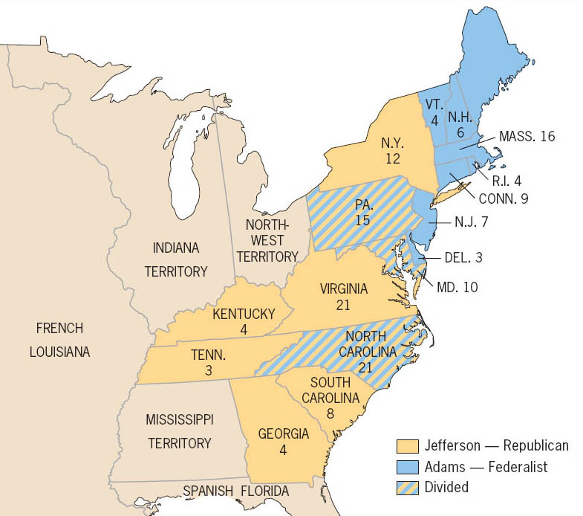

Slide 5
Responsibility and Moderation
Inaugurated March 4, 1801 in Washington
Declares all Americans are Federalists and Republicans
Pledges friendship with all nations, and alliances with none
Does not recognize rank at state dinners
Refuses to dress as member of upper class
Sends messages to Congress by way of clerk
Refuses to dismiss Federalist officials
Angers many party members

Slide 6
Restraint
Jefferson pardons violators of Sedition Act
1802 – new naturalization laws signed
Years needed to become a citizen dropped from 14 to 5
Excise tax repealed, but tariffs upheld
Andrew Gallatin – Secretary of Treasury
Manages to balance budget and reduce debt

Slide 7
The Judiciary
Judiciary Act of 1801 creates many new federal judge positions
Packed with Federalists
Chief Justice John Marshall
Federalist
Marbury v. Madison (1803) – establishes power of judicial review
1804 – Jefferson tries to have Samuel Chase (a Supreme Court Justice) impeached
Vote falls short in Senate

Slide 8
Military Affairs
Jefferson fears large military
Cuts militia to 2500 men
Barbary Pirates of North Africa continue to capture U.S. merchant ships
1801 – Pasha of Tripoli declares war (1st Barbary War)
Four years of fierce fighting between U.S. Navy/Marines and Tripoli
Peace signed in 1805 for $60000
Essentially buying captured U.S. sailors out of slavery
Referred to as ransom, not tribute

Slide 9
Louisiana
1800 – Napoleon convinces King of Spain to secretly cede Louisiana Territory to France
Dreams of creating North American Empire
Will use agricultural produce to feed Haiti and other Caribbean possessions
1802 – Spain withdraws right of deposit from New Orleans
Cuts off western farmers from access to New Orleans
Farmers threaten to march/capture New Orleans

Slide 10
Louisiana Purchase
1803 – Jefferson sends Madison to buy New Orleans, and as much western land as possible for $10 million
Napoleon offers to sell entire Louisiana Territory for $15 million
Haitian Revolution
War with Britain
Purchase finalized on April 30, 1803

Slide 11
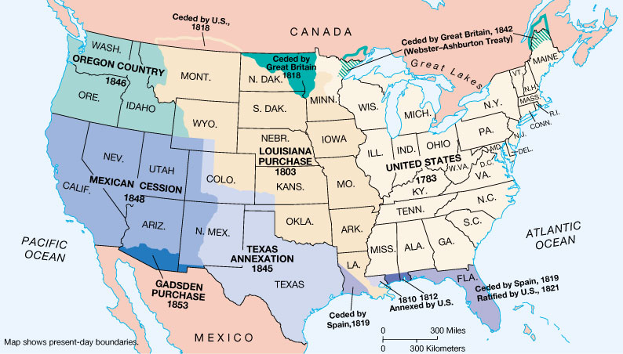
Territorial Growth to 1853

Slide 12
Constitutional Dilemma
Constitution says nothing about purchasing land
Jefferson adopts loose interpretation
Deal too good to pass up
Federalists argue for strict interpretation
New land will mean more farmers, new states, and further weakening of Federalist power
Parties flip-flop positions based on practicality
Senate approves purchase treaty quickly, doubling size of United States
3 cents per acre

Slide 13
Louisiana Continued
Purchase creates precedent for purchasing land
1804 – William Clark and Meriwether Lewis sent to explore territory
Sacajawea – Shoshoni woman, interpreter
2.5 year expedition maps territory, reaches Pacific in Oregon
Establishes U.S. claims in region
Fails to find water route to Pacific
1805-06 – Zebulon Pike explores headwaters of Mississippi, and explores Southwest portion of Territory

Slide 14
Federalist Desperation
Federalists attempt to convince Burr to help with plot to get New England and New York to secede
Burr kills Hamilton in duel
1806 – Burr arrested for treason
Louisiana Purchase causes increased loyalty in west
Increased patriotism
Beginnings of Manifest Destiny

Slide 15
Neutrality
Jefferson wins 1804 election easily
Britain and France at war
Hurts U.S. trade
1806 – Parliament issues Orders of Council
French controlled ports closed to foreign shipping by blockade
Ships must first go to British ports
Napoleon orders seizure of all ships entering British ports
Impressment
6000 Americans from 1808-11
Chesapeake incident (1807)
U.S. frigate Chesapeake attacked by British Frigate Leopard when commander refuses to turn over “deserters”
3 Americans killed, 18 wounded
Jefferson maintains neutrality

Slide 16
Embargo
Jefferson believes only way to avoid war is to shut down shipping
Believes Britain and France rely on American goods
Knows U.S. military is still weak
1807 – Embargo Act passed
Forbids export of all goods from United States
New England merchants hurt more than France or Britain
Southern and Western farmers hurt by mountains of unexported goods
Smuggling becomes rampant by 1808

Slide 17
The Non-Intercourse Act
Embargo Act repealed on March 1, 1809
Three days before Jefferson leaves office
Non-Intercourse Act passed
Reopens trade with all nations except France and Britain
Still hurts U.S. trade
Main partners are France and Britain
Smuggling continues until 1812

Slide 18
Failure
Embargo and Non-Intercourse Acts fail
Embargo not enforced long enough, or tightly enough to succeed
Jefferson admitted a Navy and war would have lost less money
Parliament suspends Orders of Council two days before America declares war in 1812
British underestimated
Federalist Party regains some power
Some factories reopened
Promotes industrialization

Slide 20
Madison
Madison wins election of 1808
1810 – Macon’s Bill No. 2 adopted
Promises restoration of trade with France/Britain if either drops commercial restrictions
Napoleon announces restrictions lifted in August 1810
Madison declares France available for trade
Napoleon reneges, draws America into European conflict

Slide 21
Power Changes in Congress
1811 – young politicians sweep away older generation
Henry Clay of Kentucky appointed Speaker of the House
Western politicians cry out against Indian threat on the frontier. Known as “War Hawks”
Want to force Indians off land
Also calls for war with Britain
British were helping Indians

Slide 22
Relations with the Indians
Tecumseh and the Prophet
Create confederation of Indians to oppose America
No ceding land unless all Indians agree
Nov. 7, 1811 – William Henry Harrison attacks Tecumseh at Tippecanoe
The Prophet killed, camp burned
1813 – Battle of the Thames
Tecumseh killed by Harrison
Dreams of Indian Confederation die
March 27, 1814 – Battle of Horseshoe Bend
Andrew Jackson crushes Creek Indians
Entire area east of Mississippi now open for settlement

Slide 23
To War
“War Hawks” think only way to end Indian threat is to wipe out Canada
War declared against Britain in 1812 by vote of 79-49 in House and 19-13 in Senate
Reasons for war
Freedom of the seas
No impressment, right to trade with all nations
Possibility of land
Possibly conquest of Canada or Florida
Indian issues
British had been selling Indians weapons

Slide 24
Division at home
New England/Federalists – oppose war
Had always been pro-British
Conquest of Canada would lead to more agrarian society
Beginnings of sectionalism
North against war
West and South for war

