Slide 1
Chapter 23, 24, and 25
The Gilded Age
Part 3

Slide 2
European Immigration
Up until the 1880s most European immigrants came from Northern and Western Europe (Ireland, England, Germany). Many of these “looked” like Americans, and had similar religious and cultural backgrounds
Beginning in the late 1880s, a change began to occur in the origin of immigrants. These “new” immigrants began arriving from eastern and southern Europe (Italy, Greece, Poland, Russia).

Slide 3
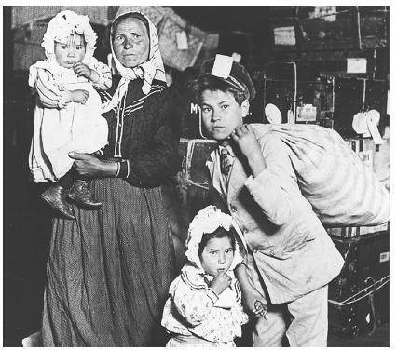
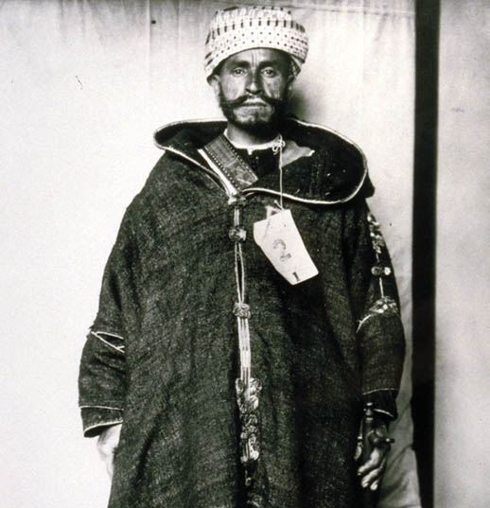
The “New” Immigrants
Many of these new immigrants didn’t speak English, came from non democratic governments, had differing religions, and didn’t “look” American.

Slide 4
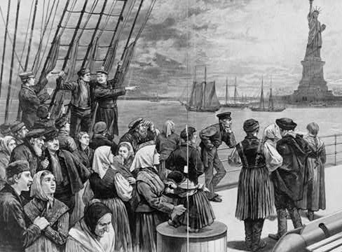
The “New” Immigrants
These new immigrants often settled together in ethnic ghettos within the inner east coast cities (Little Italy), and worked in low paying factory jobs
This new wave of
immigrants caused the
emergence of nativism:
an extreme dislike of
immigrants
Why would these new
immigrants want to settle
together in cities?

Slide 5
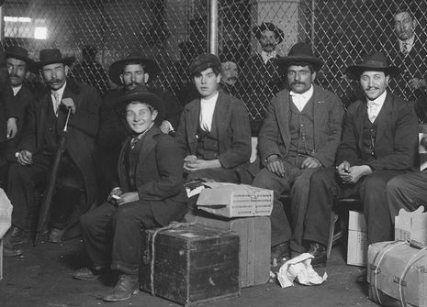
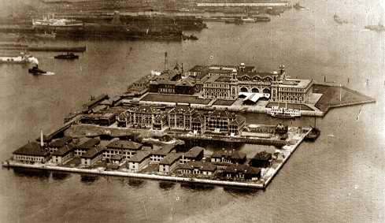
Ellis Island
To deal with the large # of people arriving in the country, the federal government opened Ellis Island in 1892.
Ellis Island (NY) was the entry point for many European immigrants

Slide 6
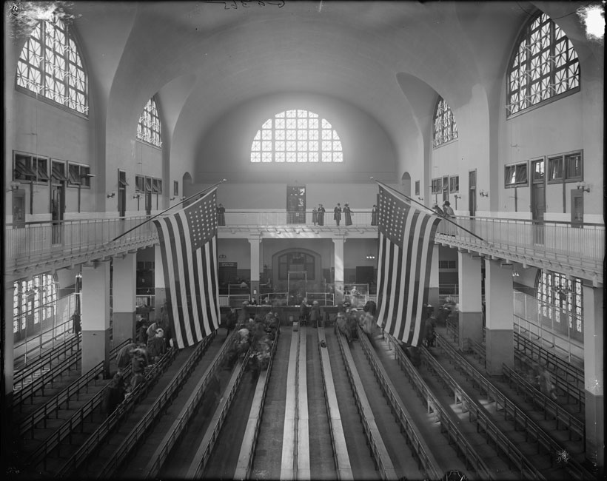
Ellis Island
Immigrants had to pass medical, mental, and legal exams and have at least $25 in order to enter into the U.S.
Angel Island is opened off California’s coast.

Slide 7
The “New” Immigrants
Nativism often meant that foreign immigrants were the victims of violence and discrimination.
Eventually the government passes laws restricting immigration.
In the 1870’s cities like San Francisco began to resent the cheap labor that the Chinese immigrants offered and the fact that they had to compete with them for jobs.
Chinese Exclusion Act of 1882 – prohibited Chinese immigrants from legally coming to the United States.
Wasn’t repealed until 1943.

Slide 8
Reaction to Immigrants
Boss Tweed, Tammany Hall, Political Machines
Run lives of immigrants in large cities
“Social Gospel”
Walter Raushenbusch, Washington Gladden
Churches should address social issues through Christian charity
Jane Addams – “Settlement house”
Hull House in Chicago (1889)
Counseling, literacy training, child care, cultural activities for immigrants
Lillian Wald - Henry Street Settlement, NY
Become centers for women’s rights activism

Slide 9
Problems in the Cities
Whole families tended to work because wages were low and no one person could earn enough to support the whole family.
Women & children worked in mills and factories.
12 hours a day, six days a week
Women worked simple machines – no opportunity for advancement

Slide 10
Problems in the Cities
Child Labor became common practice.
Children as young as five worked
Loss of an education
Missed out on their childhood
Caught in the endless cycle of poverty
African Americans had little opportunities.
Many labor unions wouldn’t accept African American workers
Often feared losing their jobs

Slide 11
Problems in the Cities
Working Conditions = difficult
Work was monotonous
Long working hours
Low wages
Dangerous conditions
Sweatshops: Makeshift factories setup by private contractors in small apartments or unused buildings.
were hazardous
Poorly lit & poorly ventilated
unsafe,
little pay

Slide 12
Problems in the Cities
Urban slums: poor inner-city neighborhoods
Tenements: overcrowded apartments that housed several families of immigrants or poor laborers
Conditions in Slums:
Often these slums had open sewers
Rats & disease widespread
Air was dark & polluted with soot from coal-fired engines and boilers
Individual tenements
usually dark, poorly ventilated, and full of fire hazards.

Slide 13
Negative Effects
Trash piles up in streets
Drinking water polluted
Lack of sewage systems
Terrible air quality
“Dumbell” tenements
Airshaft through the building for clean air
1920 – America more urban than rural

Slide 14
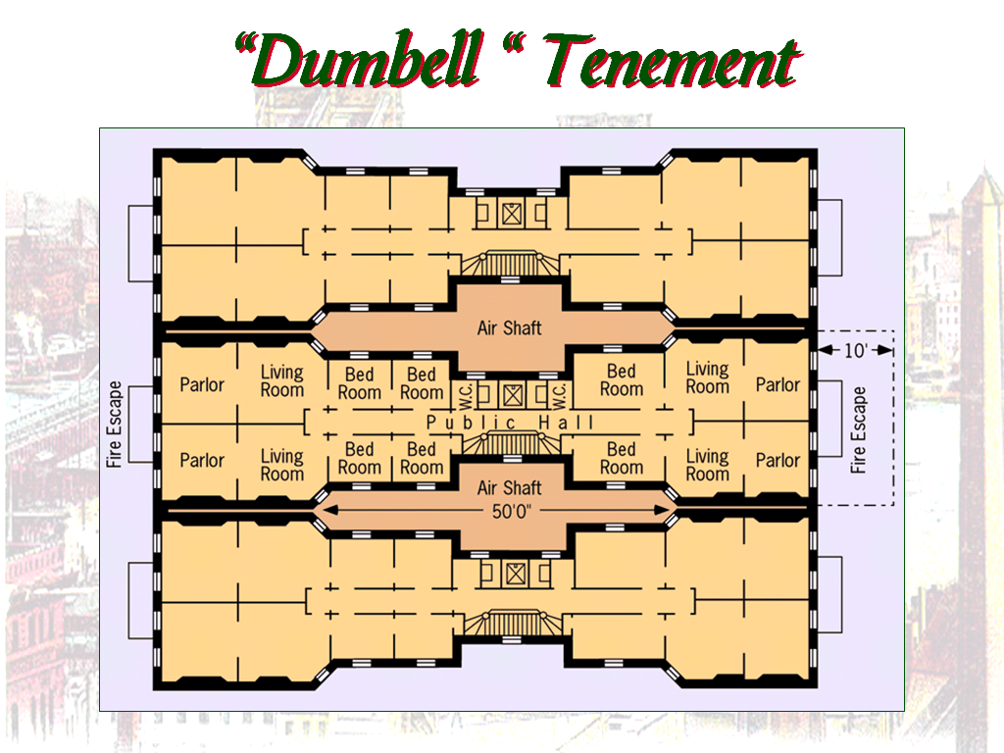
Jacob Riis’ “How the Other Half Lives” (1890) exposed the poverty of the urban poor

Slide 15
Statue of Liberty
Statue of Liberty donated by France in 1886
“Give me your tired, your poor;
Your huddled masses yearning to breathe free,
The wretched refuse of your teeming shore.
Send these, the homeless, tempest-tost to me.
I lift my lamp beside the golden door!”
From The New Colossus by emma lazarus, 1883
\

