Slide 1
Chapter 23, 24, and 25
The Gilded Age

Slide 2
The “Bloody Shirt” Elects Grant
1868 Election
Ulysses S. Grant – Republican
No political experience
People support him because people looked at hi as having been a good general.
Republicans energetically nominated him by “Waving the bloody shirt.”
Horatio Seymour – Democrat
Disorganized campaign, critical of reconstruction
Seymour doesn’t support “greenbacks”

Slide 3
The “Bloody Shirt” Elects Grant
Republicans:
Freed from Union party coalition of war days
Nominated Grant for presidency in 1868
Platform called for continued Reconstruction of South
Grant “Let us have peace”
Democrats:
In their nominating convention, denounced military Reconstruction but could agree on little else

Slide 4
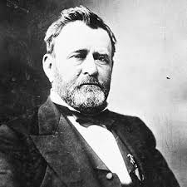
The “Bloody Shirt” Elects Grant
Grant wins by narrow margin
Leads to tightly run political parties, narrow margins of victory
Grant received 3,013,421 to 2,706,829 popular votes:
- Ballots of three still- unreconstructed southern states (Mississippi, Texas, Virginia) not counted at all

Slide 5
Era of Good Stealings
Corruption rampant during late 19th Century
Railroads, stock prices, corrupt judges, issues with the Senate
Two notorious financial millionaire partners:
“Jubilee” Jim Fisk and Jay Gould
Attempt to corner gold market in 1869
Buy up all gold, raise prices
Try to convince Grant and brother-in-law to support

Slide 6
Boss Tweed and Tammany Hall
“Boss” Tweed – Democrat
Tammany Hall – Political Machine in NYC
Bribery, graft, rigged elections
Helped Irish Immigrants in exchange for votes/jobs
Attacked by Thomas Nast through political cartoons
Prosecuted by NY attorney Samuel J. Tilden
Runs for president in 1876 vs. Rutherford B. Hayes
Tweed died behind bars

Slide 7
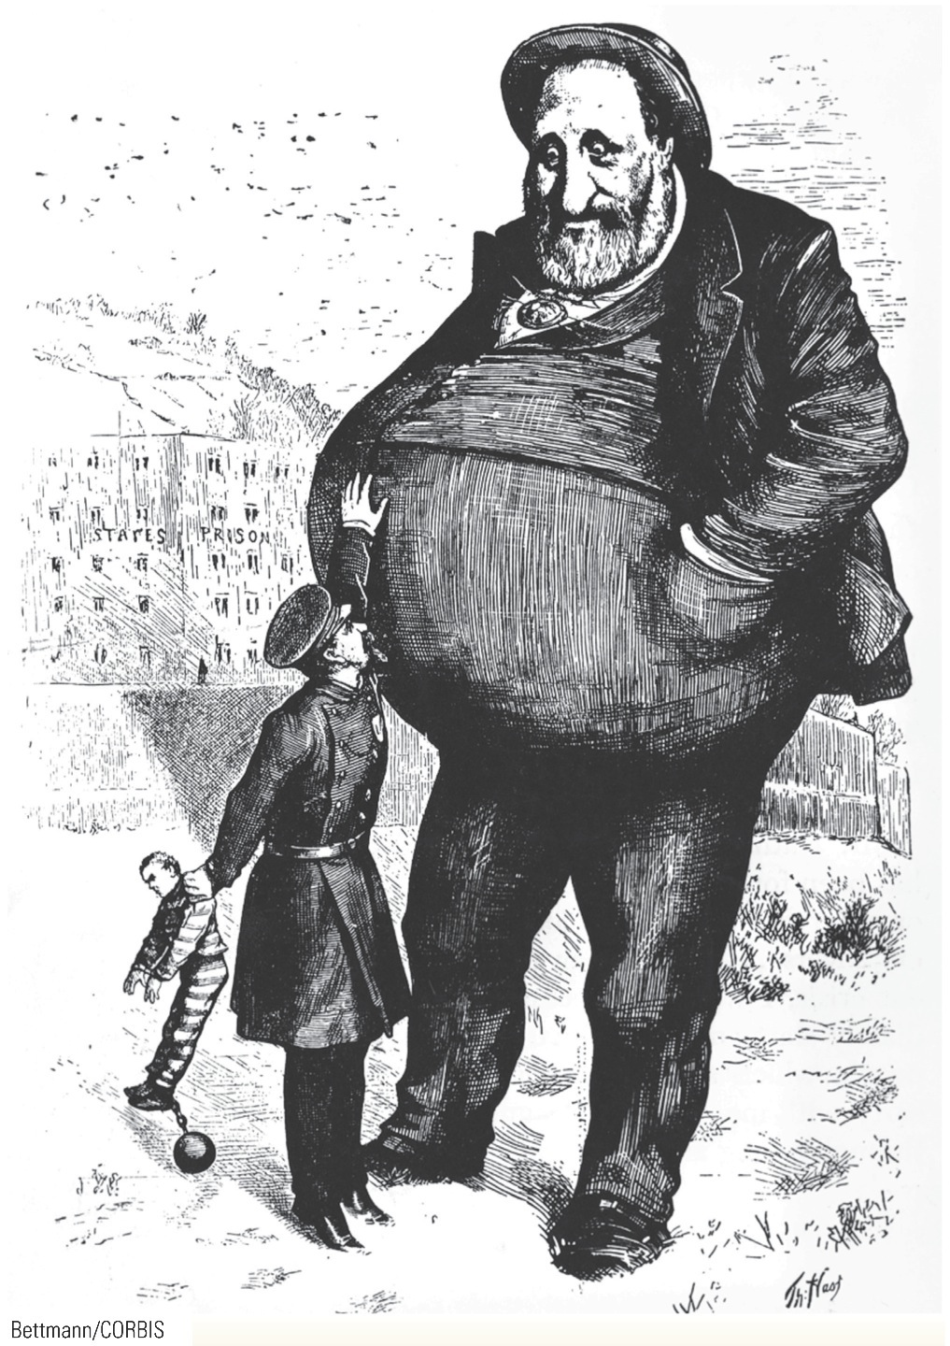
p489
Notes:
Can the Law Reach Him? 1872 Cartoonist Thomas Nast
attacked “Boss” Tweed in a series of cartoons like this one
that appeared in Harper’s Weekly in 1872. Here Nast depicts
the corrupt Tweed as a powerful giant, towering over a
puny law force. Bettmann/CORBIS

Slide 8
Carnival of Corruption
Grant unaware or incompetent when faced with corruption
In-laws obtain government “jobs”
Credit Mobilier Scandal
Directors of Union Pacific Railroad create fake company (Credit Mobilier Construction Company) in charge of railroad construction
Get paid twice by federal gov.
Stock/bribes given to Congressman
New York Sun breaks story during 1872 election campaign
Vice-president had even accepted payments from them

Slide 9
Carnival of Corruption
Grant unaware or incompetent when faced with corruption
Whiskey Ring
Whiskey tax revenue stolen by officials
Grants own private secretary was involved
William Belknap, Secretary of War
Secretary of War William Belknap (1876) forced to resign after pocketing bribes from suppliers to Indian reservations

Slide 10
Liberal Republican Revolt of 72
Liberal Republican Party started to clean up corruption
Horace Greeley, editor of New York Tribune nominated
Also endorsed by Democrats due to stance on South
Particularly nasty campaign
Greeley dubbed atheist, communist, free-lover, vegetarian, co-signor to Davis’ bail bond
Grant accused of being drunken swindler
Grant wins
Republicans in Congress take limited action
Amnesty for former Confederates in South
Reduction of tariffs
Attempts to clean up Grant administration

Slide 11
Panic of 1873
Over spending by railroads and factories. Growth outpaces market sustainability
Same causes as other panics :
Over-speculation/Easy Credit
As businesses go under banks fail
Blacks especially hard hit
Last to be hired, first laid off
Freedman’s Savings and Trust Co.
$7 million in savings lost

Slide 12
Continuing Panic
Debtors demand “greenbacks” to cause inflation
Easier to pay off debts
Called “soft money” or “cheap money” policy
Also want silver coinage
Bankers and wealthy favor “hard money”
Unfair to raise inflation to pay back debts since money not as valuable
Grant vetoes greenbacks
Resumption Act passed
Lower greenback circulation
Redeem paper money at face value after 1879

Slide 13
Continuing Panic
Debtors looked for relief in silver
Demand for coinage of more silver was nothing more nor less than another scheme to promote inflation
Contraction
Amount of money in circulation decreases during 1870s
Value of dollar rises, few redeemed in 1879
Effect
Democrats win House in 1874
Greenback Labor Party started in 1878

Slide 14
Pallid Politics in the Gilded Age
“Gilded Age” – coined by Mark Twain
Times look good but problems just beneath the surface
Corruption, heated politics, shady business deals
Republicans gain support from North and West & African Americans in the South
Democrats gain support from South

Slide 15
Election of 1876
Republicans nominate Rutherford B. Hayes
Democrats nominate Samuel Tilden
Wins 184 electoral votes, 1 short of victory
20 votes up for grabs due to questions
Congress can’t decide whether House or Senate should count votes
Electoral Count Act sets up commission to end crisis
15 men from House, Senate, and Supreme Court
8 Republicans, 7 Democrats
Democrats filibuster Republican efforts

Slide 16
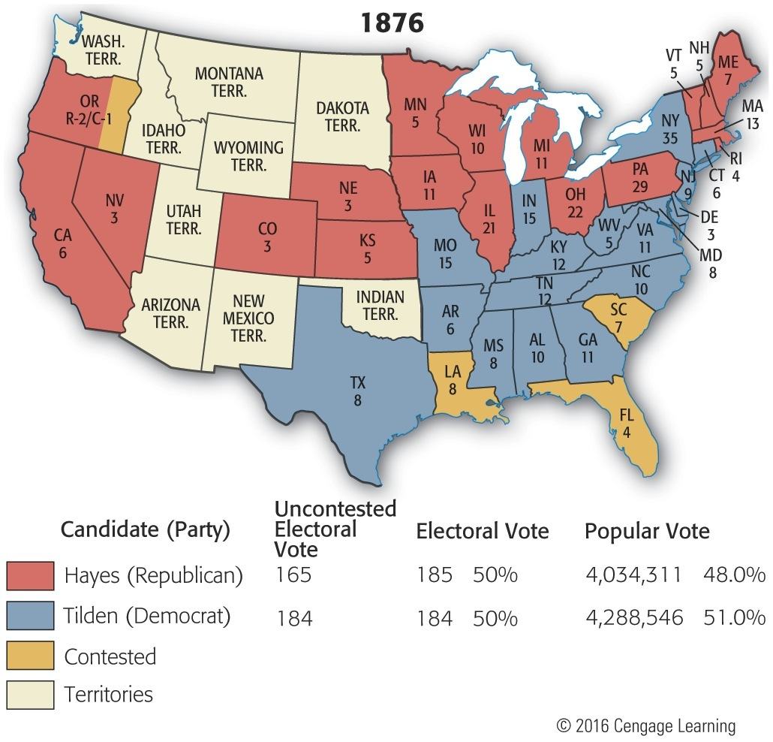
Map 23-1 p494
Notes:
Map 23.1 Hayes-Tilden Disputed Election of 1876
(with electoral vote by state) Nineteen of the twenty
disputed votes composed the total electoral count of
Louisiana, South Carolina, and Florida. The twentieth was
one of Oregon’s three votes, cast by an elector who turned
out to be ineligible because he was a federal officeholder
(a postmaster), contrary to the Constitution (see Art. II, Sec. I,
para. 2). © 2016 Cengage Learning

Slide 17
Compromise of 1877
The North/Republicans
Rutherford B. Hayes elected President
The South/Democrats
End of military occupation
Southern blacks no longer protected
Supreme Court already struck down much of CRA of 1875

Slide 18
The Birth of Jim Crow
Southerners use fraud and intimidation to weaken political power of blacks
Sharecropping/Tennant Farming
Farmed land they didn’t own, paid fees to landlord at harvest time, never able to escape debt
Segregation
States legalize segregation through “Jim Crow” laws
Plessy v. Ferguson (1896)
Supreme Court rules “separate but equal” facilities legal
Violation of laws leads to stiff penalties
Lynching reaches record levels as whites “enforce” laws themselves

Slide 19
Railroad Strike of 1877
4 largest railroads cut employee wages by 10%
Workers strike
Hayes calls in federal troops
Strike broken, workers return to work
Labor movement not yet strong, but growing

Slide 20
Ethnic Conflict
Competition among immigrants for low paying jobs
Chinese vs. Irish in San Francisco
Denis Kearney
“rice eater” vs. “beef eater”
Irish gangs seek vengeance on Chinese
Congress passes Chinese Exclusion Act in 1882
No immigration from China to America
First restrictive immigration law

Slide 21
Election of 1880
Republicans
James Garfield with Chester A. Arthur
Dark horse candidate from Ohio
Democrats
Winfield Scott Hancock
Union hero of Gettysburg
Garfield wins

Slide 22
Chester A. Arthur
Garfield assassinated Sept. 1881
Charles J. Guiteau, Stalwart
He was shot at a Washington train station and died 11 weeks later of his injuries.
Arthur becomes president
Reform-minded
Pendleton Act passed
Civil Service Reform, merit based system ends patronage
Civil Service Commission
Awards jobs based on performance
Only affects 10% of federal jobs
Sets tone for further reform

Slide 23
Election of 1884
James G. Blaine – Republican
Mugwumps
Reform-minded Republicans jump ship to the Democrats
Grover Cleveland – Democrat
Subject of mud-slinging over affair and 8 year old child

Slide 24
“Old Grover”
First Democratic President since Buchanan in 56 (28 years)
Supports laissez-faire capitalism
Appoints former Confederates to cabinet
Man of principle
Wants to continue civil service reform
¾ of all federal employees fired, half replaced by Democrats
Struggles over military pensions

Slide 25
Cleveland and Tariffs
Budget surplus
Cleveland doesn’t believe gov. should take in more than it needs
Solutions
Increase spending, or cut taxes
Cleveland asks Congress to lower Tariff
Businesses side with Republicans
Election of 1888, Tariff is primary issue
Harrison wins close race

Slide 26
The Billion Dollar Congress
Republicans eager to assert power
Thomas “Czar” Reed – Speaker of the House
Runs House as dictatorship
US Government spends $1 billion
Pensions given liberally to veterans
Silver purchased
McKinley Tariff (1890)
48%, highest peacetime rate ever
Benefits business leaders, angers farmers

Slide 27
Political Discontent
1892 – Populist Party (People’s Party)
Rooted in the Farmers’ Alliance
Leader – Tom Watson
Inflation through “cheap money”
Paper and silver
Inflation
Graduated income tax
Government regulation
Railroads, telegraphs, telephones
Direct election of Senators
Initiative and referendum
Shorter working day
Immigration restrictions

Slide 28
Election of 1892
Democrats – Grover Cleveland
Republicans – Benjamin Harrison
Populist/Peoples – James B. Weaver
Populist Party wins 22 electoral votes in Western States
no support in South due to courting black vote
Election results in literacy tests, poll taxes, and “Grandfather clauses” in South
Cleveland wins

Slide 29
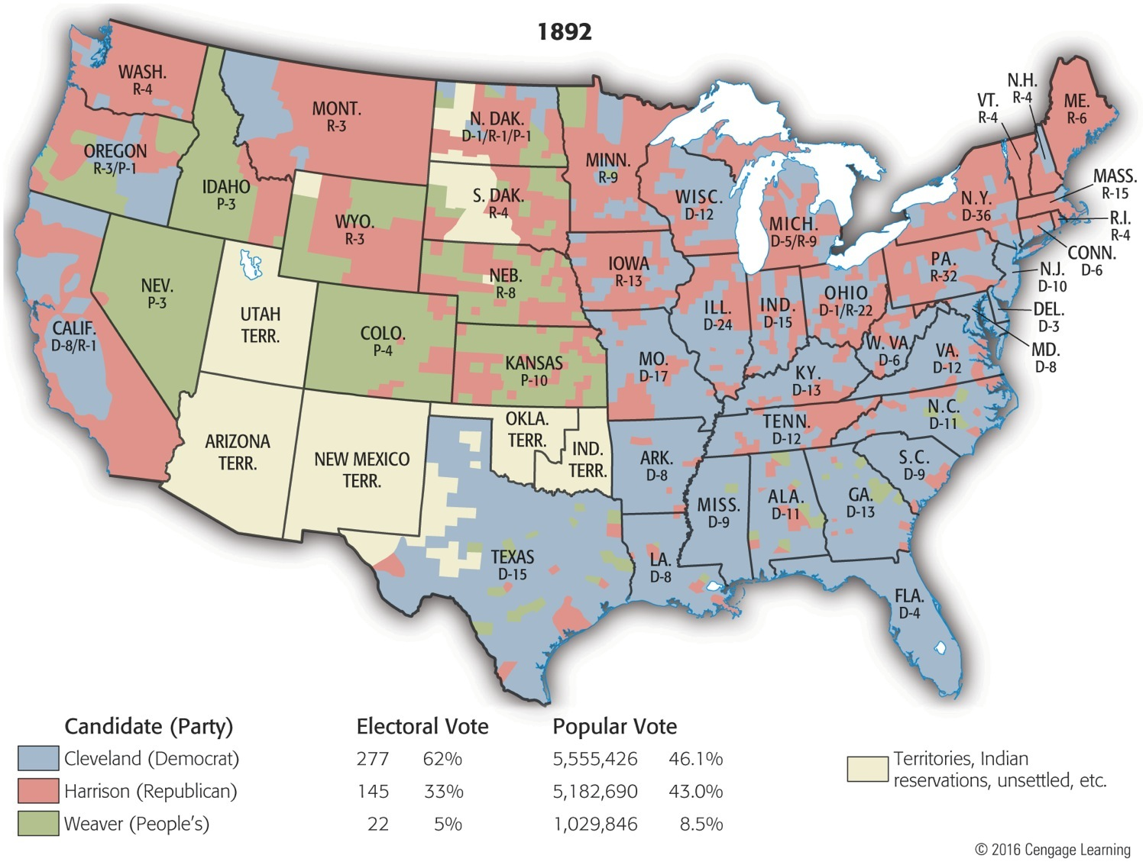
Map 23-3 p506
Notes:
Map 23.3 Presidential Election of 1892 (showing vote by county) Note the concentration
of Populist strength in the semiarid farming regions of the western half of the
country. (Compare this with Map 26.4, showing average annual precipitation with major
agricultural products as of 1900, on p. 587.) © 2016 Cengage Learning

Slide 30
The Drumbeat of Discontent
Homestead Strike (1892):
At Andrew Carnegie's Homestead steel plant, near Pittsburgh, officials called in 300 armed Pinkerton detectives to crush strike by steelworkers over pay cuts
Strikers forced Pinkerton assailants to surrender after vicious battle that left 10 dead and 60 wounded
After troops entered, union broken

Slide 31
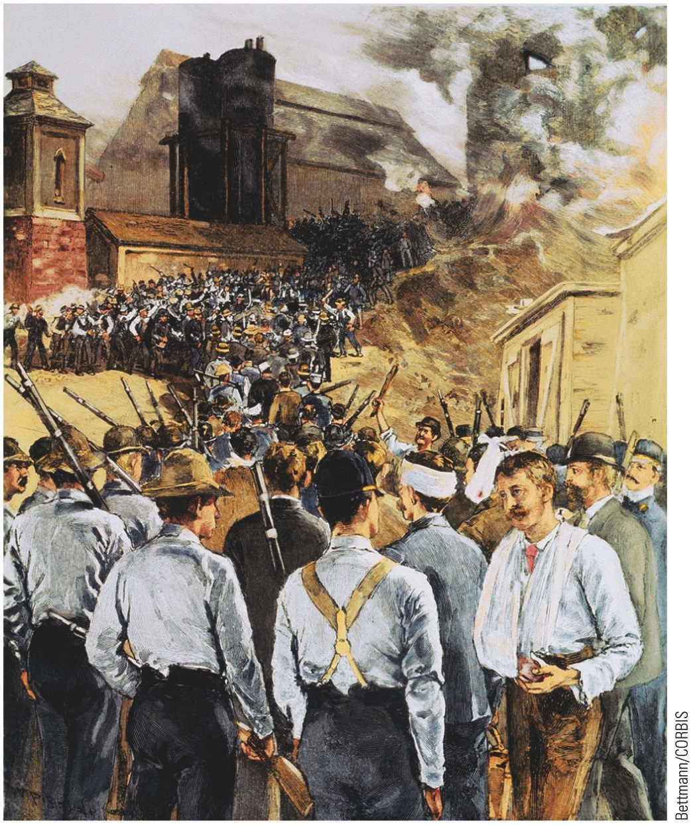
p505
Notes:
The Homestead Strike, 1892 Three hundred armed
Pinkerton detectives floated on barges down the Monongahela
River to the site of the Carnegie steel plant at
Homestead, Pennsylvania. Met by a defiant and disciplined
force of strikers, they were compelled to surrender.
Here the Pinkerton men are shown disembarking from
their barges after their capitulation, while the jeering
strikers ashore exult in their victory.

Slide 32
Depression of 1893
8000 businesses go bankrupt in 6 months
Cleveland faced with budget deficit
Gold supply running out
Sherman Silver Purchase Act 1890
Gov buys silver purchased with printed paper money
Paper money can be turned in for gold
Gold supply dips below $100 million
Congress debates repealing Silver Purchase Act
30 year old William Jennings Bryan becomes spokesman for “cheap money”
Sherman Act repealed
Exchange continues
Reserves fall to $41 million
J.P. Morgan lends gov. $65 million

Slide 33
Backlash
Cleveland’s dealings with Morgan seen as underhanded.
Wilson-Gorman Tariff
Almost no change to McKinley Tariff
2% income tax on income over $4000 struck down by Supreme Court
Gives impression that Gov. is controlled by wealthy
Republicans begin to benefit

Slide 36
Election of 1896
Leading Republican candidate William McKinley:
Sponsored tariff bill of 1890
Creditable Civil War record
Hailed from potent state of Ohio
Long years of honorable service in Congress
As a presidential candidate, McKinley the creature of fellow Ohioan, businessman Marcus Alonzo Hanna:
Coveted role of president maker
Wholehearted Hamiltonian, Hanna believed prime function of government was to aid business
Became personification of big industry in politics
Believed prosperity “trickled down” to laborer

Slide 37
Election of 1896
William McKinley/Mark Hanna – Republican
Pro-tariff, pro business, favored gold over silver
William Jennings Bryan – Democrat
Cross of Gold Speech
“You shall not press down upon the brow of labor this crown of thorns, you shall not crucify mankind upon a cross of gold.”
Gold/Silver Issue is #1 issue of campaign

Slide 38
Election of 1896
Campaign issues:
Hanna assumed it would be tariff
Bryan campaigned widely on behalf of free silver:
Bryan goes on speaking tour
36 speeches in one day (made nearly 600 speeches total)
Silver will save the poor

Slide 39
Election of 1986
Republicans:
McKinleyites amassed most formidable campaign chest thus far in U.S. history by fundraising from trusts and plutocrats:
At all levels—national, state, local—amounted to about $16 million
In contrast to $1 million Democrats raised
Bryanites accused Hanna of buying election and of floating McKinley to White House on tidal wave of mud, money, and “dirty tricks” (use of strong-arm fear tactics by employers)

Slide 40
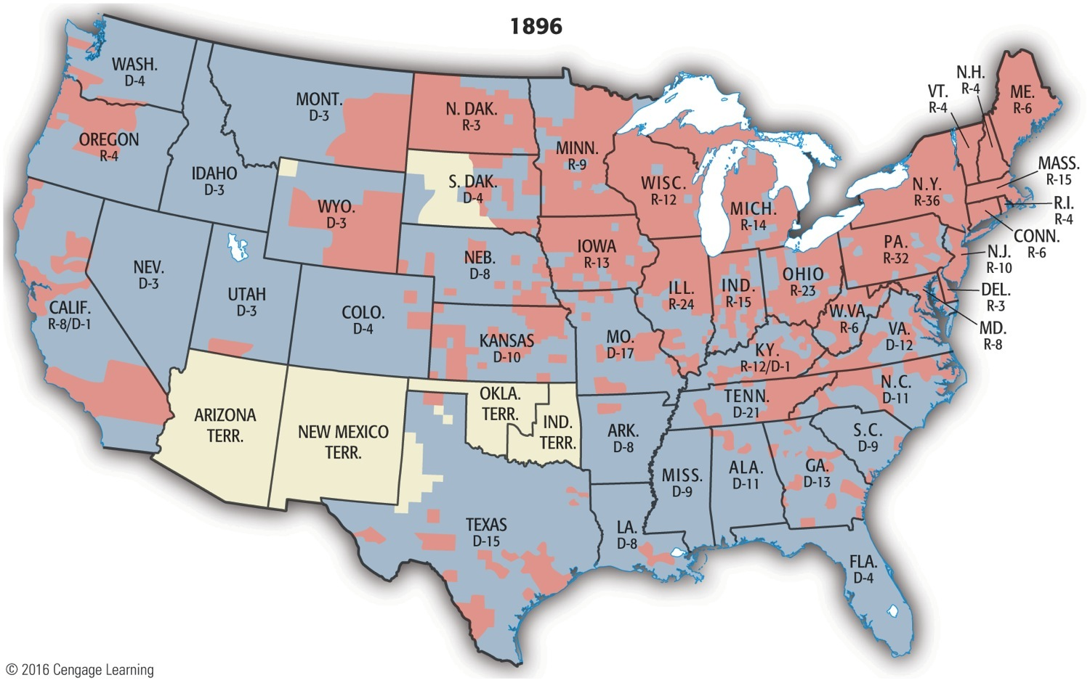
Map 26-6 p602
Notes:
Map 26.6 Presidential Election of 1896 (with electoral vote by state) This election
tolled the death knell of the Gilded Age political party system, with its razor-close elections,
strong party loyalties, and high voter turnouts. Bryan’s sweep of the southern states
and strong showing in the West gave him only 176 electoral votes to McKinley’s 271 from
the more populous North and East. For years after 1896, Republicans predominated, and
citizens showed a declining interest in joining parties and voting. © 2016 Cengage Learning

Slide 41
Election of 1896
McKinley wins election
Gold becomes currency standard
Victory of industrial, conservative, and middle class values over working class

Slide 42
Gold vs. Silver & Class Conflicts
Free-silver election of 1896 perhaps most significant political turning point since Lincoln's victories in 1860 and 1864:
Despite Bryan's strength in South and West:
Results vividly demonstrated his lack of appeal to the unmortgaged farmer and the eastern urban laborer
Many wage earners in East voted for their jobs and full dinner pails—
threatened by free silver, free trade, fireless factories
Living on a fixed wage, factory workers had no reason to favor inflation, which was heart of Bryanites's program

Slide 43
Gold vs. Silver & Class Conflicts
Bryan-McKinley battle heralded advent of new era in American politics:
Underprivileged many against privileged few,
Of indebted backcountry against city,
Of agrarians against industrialists,
Of Main Street against Wall Street,
Of the nobodies against the somebodies
Outcome a resounding win for big business, big cities, middle-class values, and financial conservatism
1896 = last effort to win entirely by farming vote

Slide 44
Gold vs. Silver & Class Conflicts
Grand Old Party's smashing victory of 1896:
Heralded a Republican grip on White House for next 16 years
McKinley's election imparted new character to political system with fourth party system:
Diminishing voter participation in elections
Weakening of party organizations
Money question and civil-service reform faded as issues
Replaced by concern for industrial regulation and welfare of labor
Contrast with “third party system” (1860-1896) of high voter turnouts and close contests between Democrats and Republicans

Slide 45
McKinley years
Dingley Tariff Bill
Raises tariff to 46.5%
Gold Standard Act (1900)
Paper money tradable for gold
Stabilizes value of currency
Gold rush in Alaska, worldwide increase in gold production
Sense of stability leads to economic growth

Slide 46
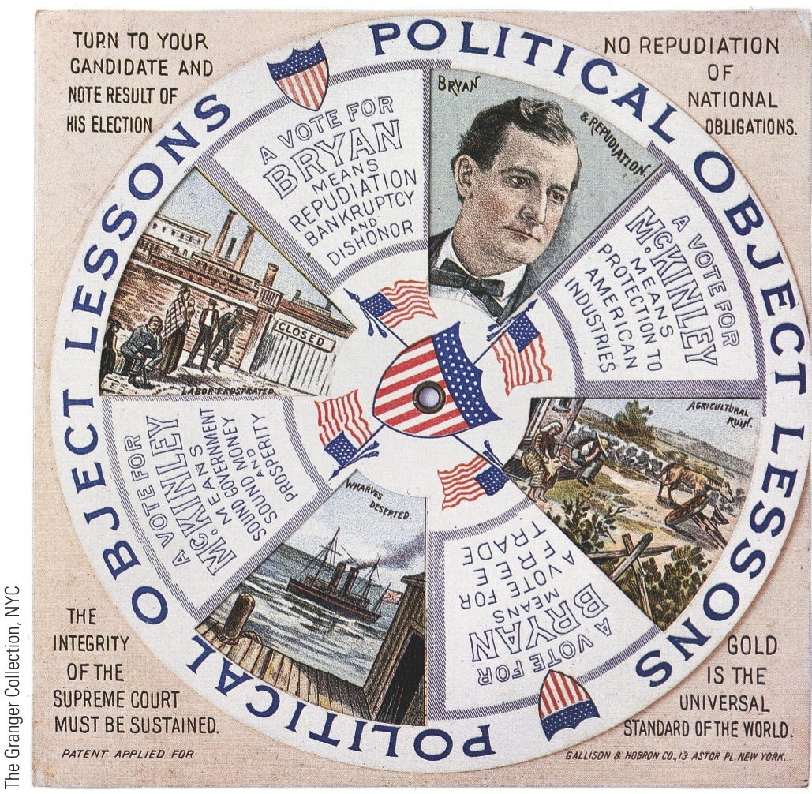
p603
Notes:
Campaign Gimcracks, 1896 These mechanical cards predicted Republican prosperity with
McKinley and economic ruin with Bryan.

Slide 47
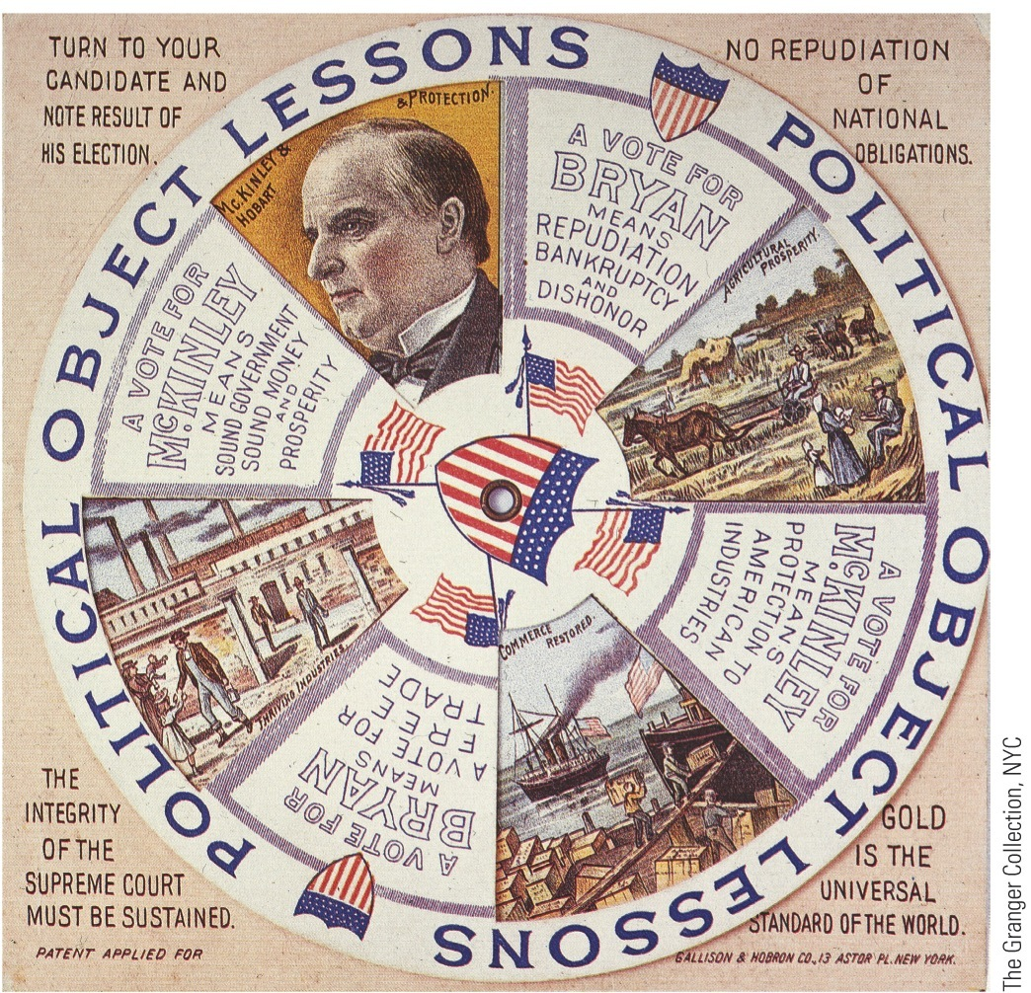
p603
Notes:
Campaign Gimcracks, 1896 These mechanical cards predicted Republican prosperity with
McKinley and economic ruin with Bryan.

Slide 48
Wizard of Oz Theory
Wizard of Oz

Slide 50
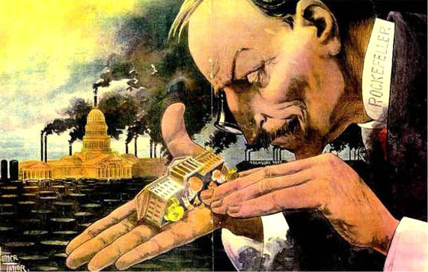

Slide 51
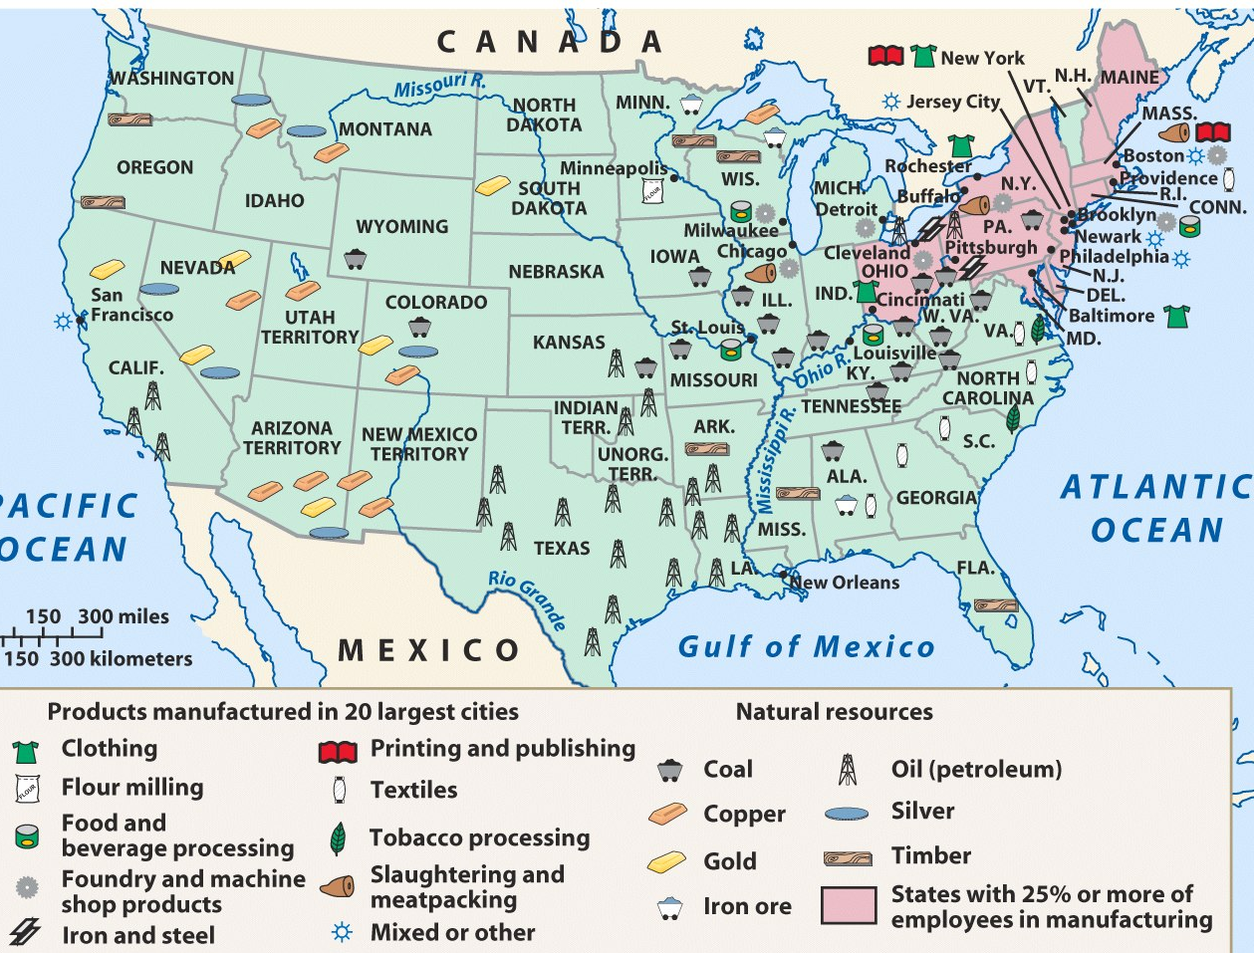
The Second Industrial Revolution was fueled by 3 industries: railroads, steel, & oil

Slide 52
Gilded Age Industrialization
During the Gilded Age, American businesses were transformed:
Massive corporations replaced small, family businesses
New technology, transportation, marketing, labor relations, & efficient mass-production
By 1900, the U.S. was the most industrialized country in the world

Slide 53
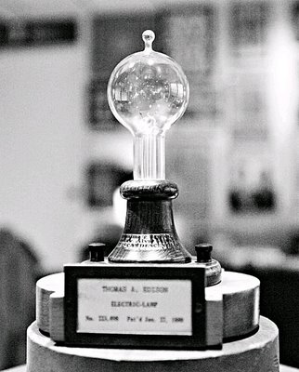
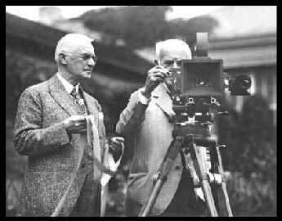
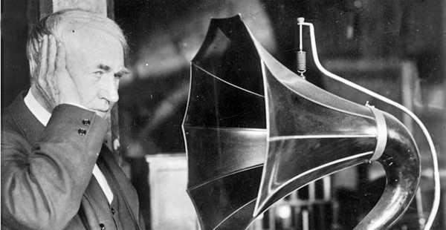
New Inventions
A number of inventions helped the United States progress as an industrialized nation during the late 1800’s and early 1900’s.

Slide 54
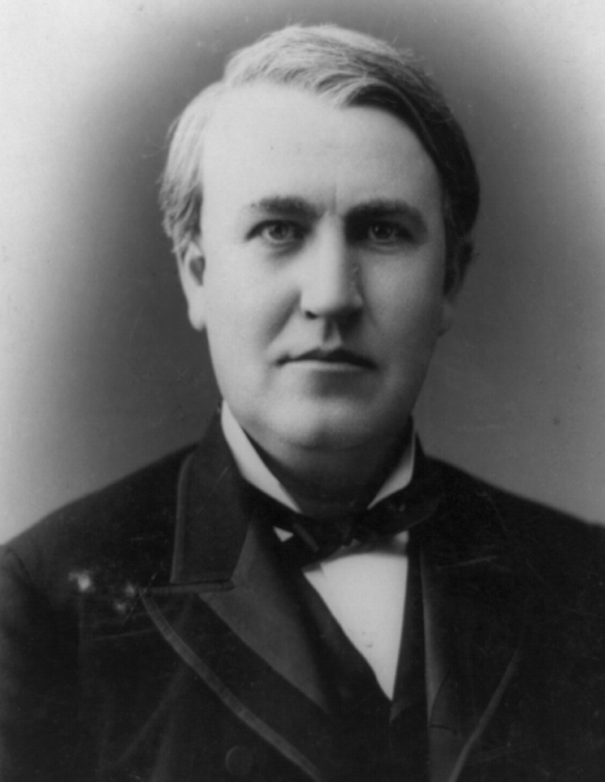
Thomas Edison
1808 – received a patent for the incandescent light bulb
Credited with inventing the phonograph & a machine o capture motion pictures.
Created a research lab in Menlo Park, New Jersey to develop and perfect his inventions.
How would these inventions have an impact on society?

Slide 55
Thomas Edison
He came up with the idea of central power companies that provided electrical power to large numbers of customers.
His electric company effectively supplied electricity to New York City by 1882.
His episode of the Men who Built America was outstanding!
How would these inventions have an impact on society?

Slide 56
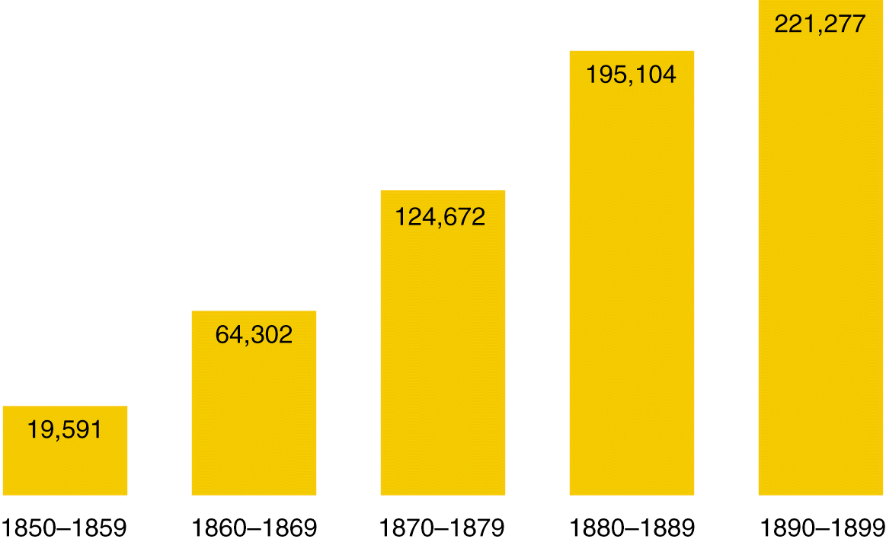
Patents Issued (1850-1899)

Slide 57
The Railroads
1865 – 35000 miles, 1900 – 192000 miles
More acreage than size of Texas given to railroads by Congress
Increases railroad profits
Transcontinental Railroad
In 1862, Lincoln signed the Pacific Railway Act
Union Pacific from Omaha
Central Pacific from California
Leland Stanford, bribe free, Chinese Labor
Completed in 1869 at Promontory Point, Utah
5 transcontinental routes by 1900

Slide 58
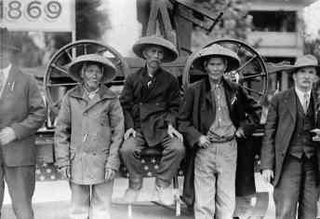
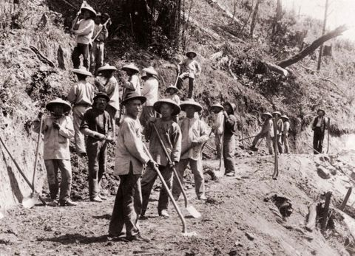
The Railroads
Much of the western portions of the railroad was built by Chinese laborers, specifically brought to the US to work on the railroad

Slide 59
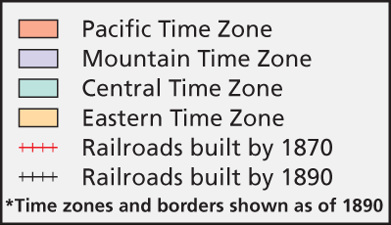
Railroads

Slide 60
American Monopolies
A few men got rich developing the railroad industry.
Because some of them were known to be crooked in their dealings, they collectively came to be called “robber barons”
Robber Barons – a name associated with wealthy entrepreneurs who wanted to eliminate competition and instead create a monopoly (or total control of an industry)

Slide 61
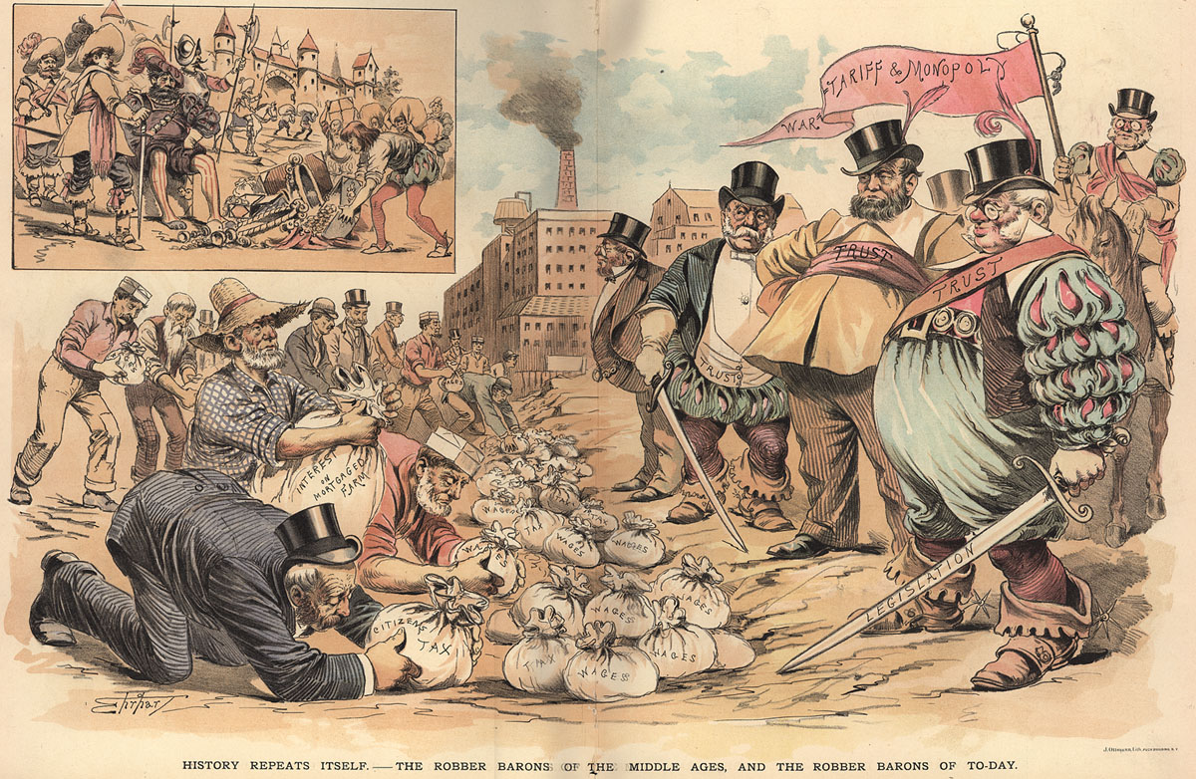
The “Robber Barons”
Notes:
The “Robber Barons” of the Past

Slide 62
Railroad Tycoons
Jay Gould
In 1874, he Purchased the Union Pacific railroad.
Began buying up smaller railroads west of the Mississippi River

Slide 63
Consolidation and Mechanization
Cornelius Vanderbilt
In 1869, he extended his New York Central railroad to reach Chicago, IL.
Travellers could go from NY to Chicago without transferring trains multiple times.
Results in cheaper fares, faster travel
Uses steel rails instead of iron
Standardized gauge
Westinghouse air brakes
Pullman Palace Cars
Telegraphs and signaling
Tragic accidents still common

Slide 64
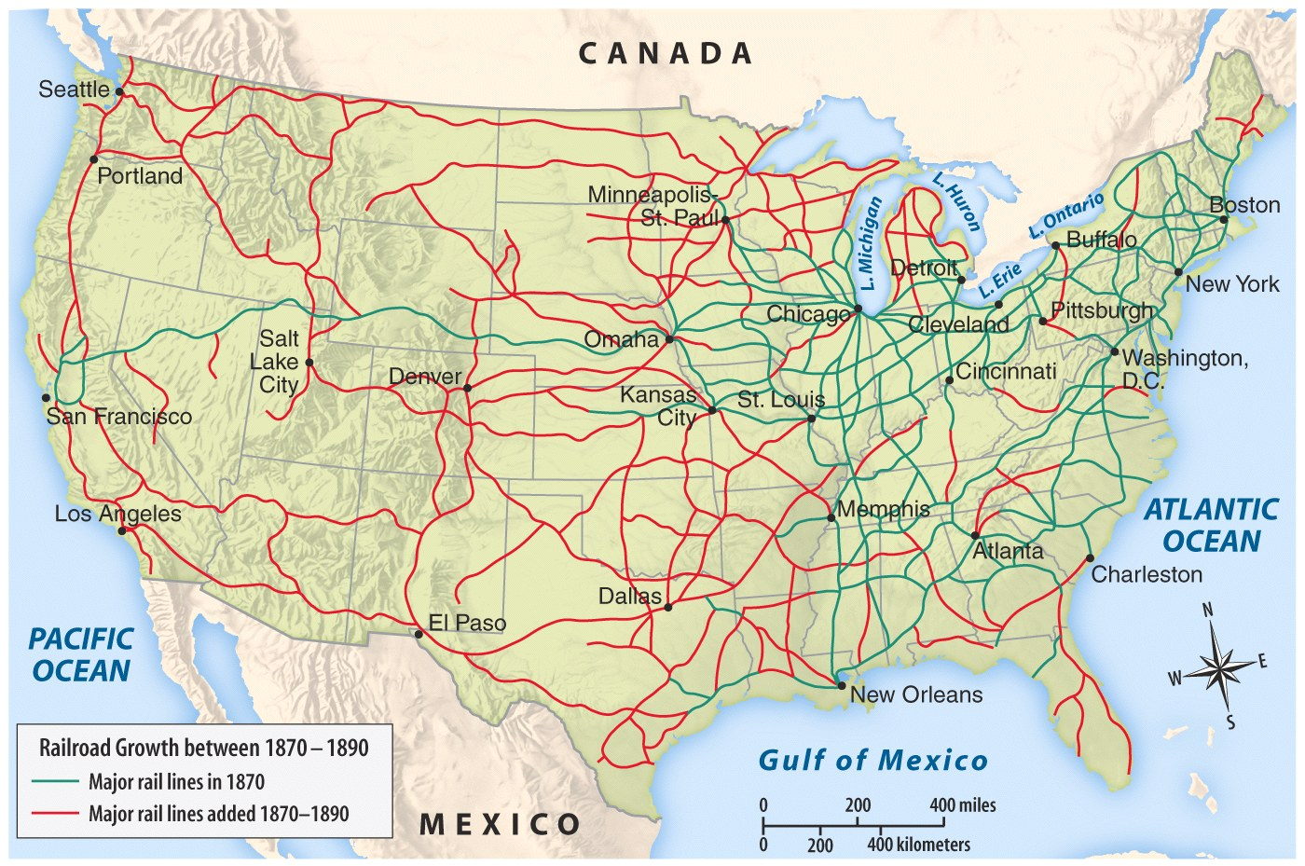
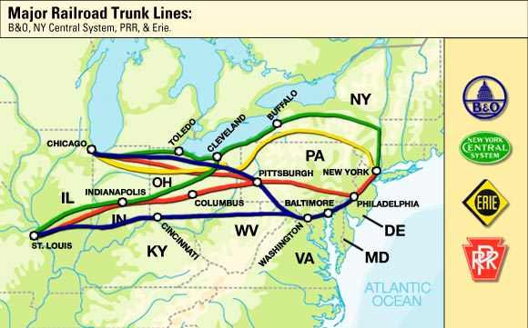
Notes:
3

Slide 65
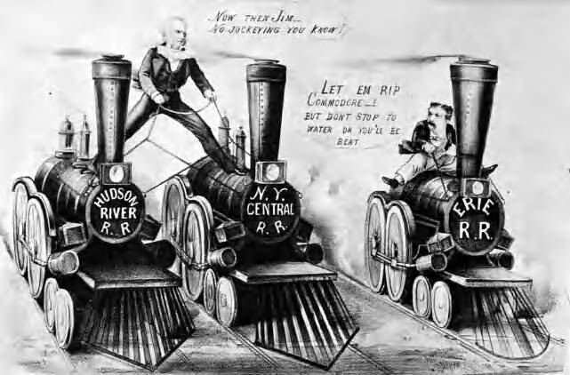
Cornelius “the Commodore” Vanderbilt was the most powerful figure in the railroad industry
Jim Fisk

Slide 66
Effects of the RR industry
The railroad was America’s 1st big business:
Railroads stimulated the coal, petroleum, & iron/steel industries
Large companies bought small railroads, standardized gauges & schedules, & pooled cars
Small lines in the east acted as tributaries to the 4 great trunk lines into the West
Faster settlement of the west
Buffalo wiped out on the planes
Time zones created
Notes:
3

Slide 67
Corruption in Rail
Credit Mobilier – already discussed
Jay Gould
Boom and bust railroad stocks
“stock watering” – talk up company causing stock prices to soar, sell quickly
“Kickbacks” – bribes to gov. officials and major customers
“pools” competitors agree to cooperate as one giant corporation
Rebates given to companies shipping more goods and goods over larger distances
Free passes given to press to ensure good publicity

Slide 68
Government Regulation
The Grange pushes for regulation during 1870s recessions
Wabash Case – Supreme Court rules only Congress can regulate interstate trade
Interstate Commerce Act (1887)
Outlaws rebates and pools
Requires open publication of rates
Bans higher rates for short hauls

Slide 69
Steel Industry
Andrew Carnegie
Rags to Riches story
Dominated the steel industry
Steel was used to make huge machines, products of industry, and railroad tracks.
Andrew Carnegie’s company made more steel than England
Vertical Integration
Buys businesses used in production of steel
Land with iron ore and coal, mines, ships & railroads, steel mills

Slide 70
Steel Industry
Andrew Carnegie
He sold his steel interests to a business J.P. Morgan for close to $500 million!
The sale made Carnegie the richest man in the world at the time.
He later commented that he should have asked for more money, to which Morgan casually replied “I’d have paid it.”
Carnegie will later become a philanthropist and give away a great deal of his wealth

Slide 71
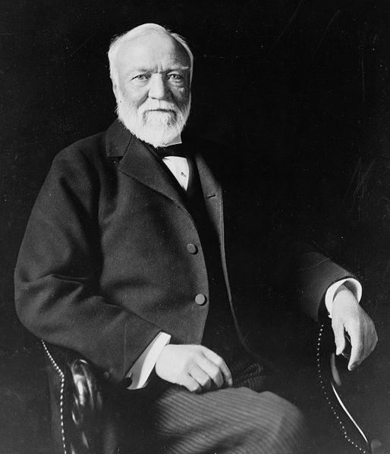
Andrew Carnegie was the great example of the “American Dream” & social mobility
Notes:
9
Henry Bessemer (& William Kelly) turned iron into steel in 1850s—process allowed for mass production of steel

Slide 72
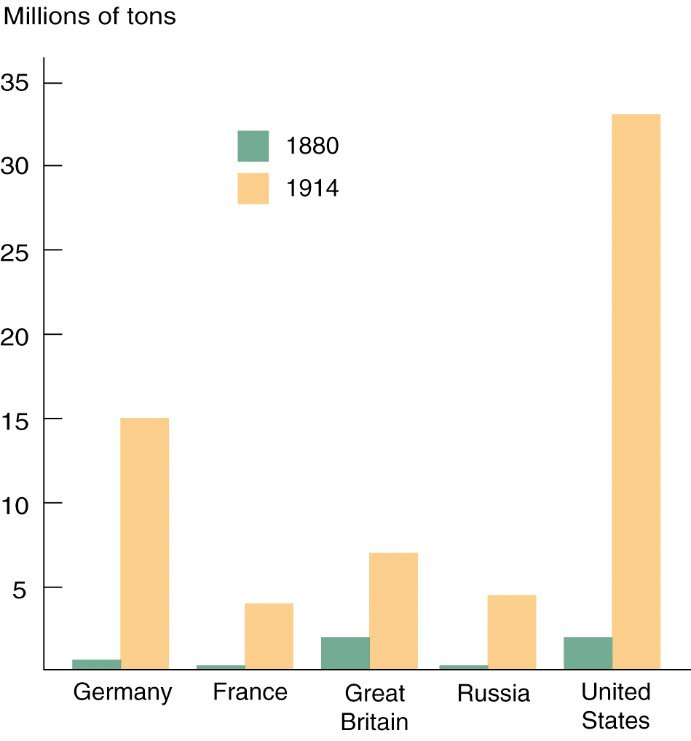
International Steel Production, 1880-1914
The U.S. was ideal for steel production because it had lots of coal, iron, & railroads

Slide 73
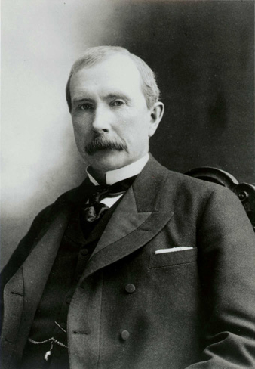
John D. Rockefeller
Founded Standard Oil Company in 1870
To remove competition, Standard Oil bought up oil refineries, so that by 1880 they owned 90% of the refineries in the US, forming a monopoly.
This was called Horizontal integration, the combining of firms in the same business into one large corporation.
Ex: Buying all of the smaller oil refineries

Slide 74
John D. Rockefeller
To avoid violating state laws against horizontal integration, Standard Oil formed a trust, a way of merging and controlling other companies
Standard Oil was the nation’s first trust
Rather than pay other producers to supply the material that he needed for his company, his company made what it needed itself.

Slide 75
John D. Rockefeller
Horizontal Integration is when many competing companies are bought up and turned into one large company
Standard Oil was broken up by the government in 1911 for being a monopoly
Rockefeller was also a philanthropist, supporting colleges such as Spelman

Slide 76
J.P. Morgan
Financier
Places his people on boards of struggling companies
Makes millions
Buys US Steel for close to $500 million in 1900
Quickly becomes world’s first billion dollar company

