Slide 1
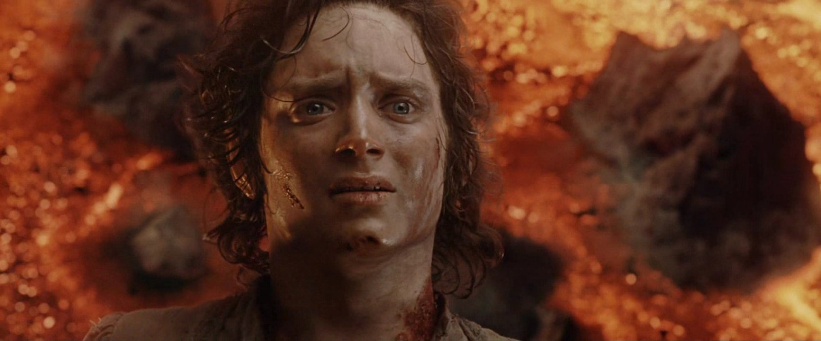
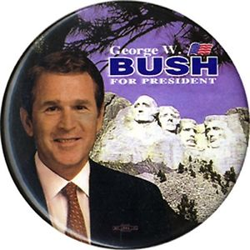
The Millennium and George W. Bush 2001 – 2009
“The action we take and the decisions we make in this decade will have consequences far into this century. If America shows weakness and uncertainty, the world will drift toward tragedy. That will not happen on my watch.” - George W. Bush

Slide 2
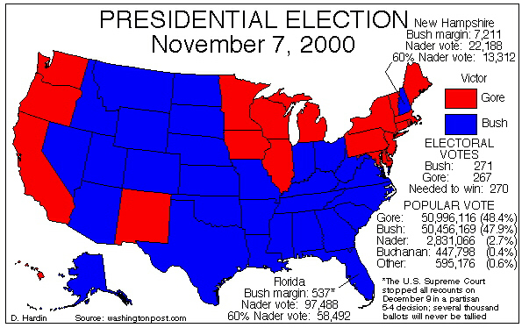
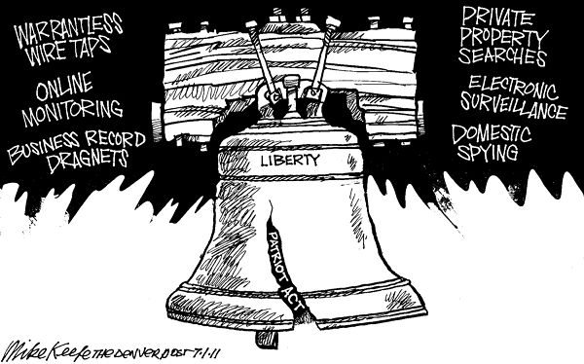
W. Bush – Domestic Activity
Elected with a VERY slim margin – led to a recount in Florida (which is where his brother was governor).
Led to a law suit (Bush v. Gore) – courts sided with Bush and he won the election.
Seen as a “good times” president who would continue the prosperity of the 90’s with little action – surrounded himself with his father’s advisors.
Then 9/11…leads to the creation of the Patriot Act – government can spy on the American people (listen to phone conversations, hack email, etc.) in the name of National Security.
Modern example of the limitation of civil liberties during a “time of war.”

Slide 3
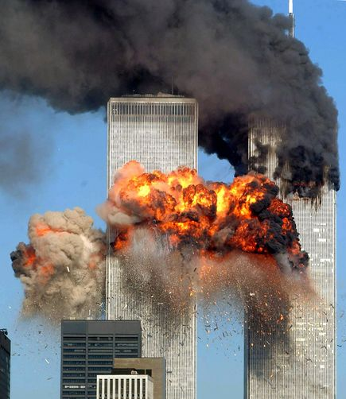
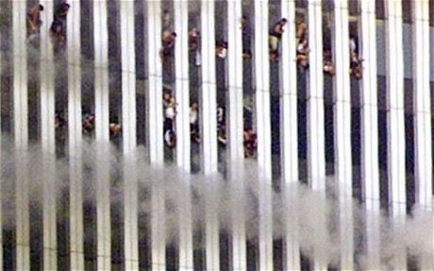
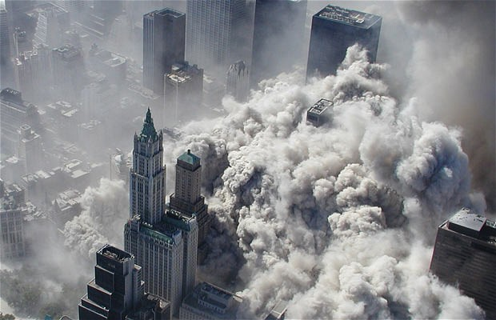
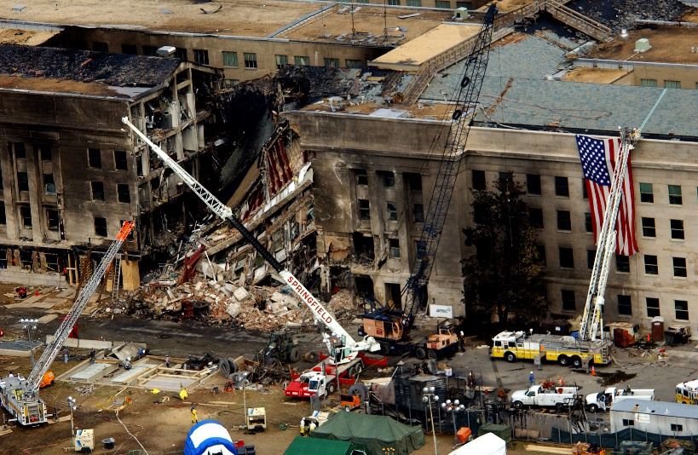
W. Bush – Foreign Events
Sept.11, 2001 (9/11) – four planes are high jacked and purposefully flown into the World Trade Center in NYC, the Pentagon in DC, and a failed attempt at the White House (crashed in PA).
3,000 people killed in total
Within a month, Al Qaeda was identified as the group who planned 9/11.
Intel linked Bin Laden to “the Taliban” in Afghanistan – a political group what supported fundamentalist Islam and were anti-western.
Remember the Mujahedeen (means Muslim Rebels)…fought the Soviets with our covert funding and CIA led assistance.
After the Soviet invasion of Afghanistan and no public assistance from the US - they evolved into the Taliban.
Created a new era in US History – the Age of Terrorism.

Slide 4
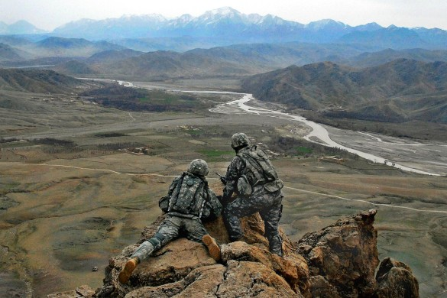
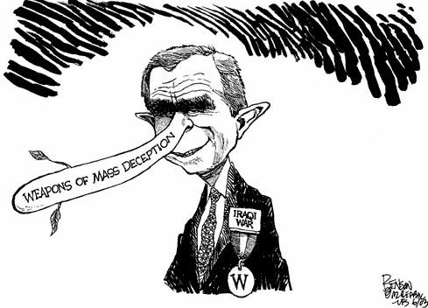
W. Bush – Afghanistan and Iraq Wars
Led to the almost immediate declaration of war with Afghanistan.
Becomes a “cat and mouse” type of war – The Taliban would set up a base in one area…the US would “clear” the area and then the Taliban would set up a new area of control.
Afghanistan is mountainous and harsh – no one has EVER conquered Afghanistan due to the terrain and the grit of its people (except the Mongols).
By 2002, new British intel of “Weapons of Mass Destruction” located in Iraq – also portrayed as an ally to Al Qaeda and a violent dictatorship under Saddam Hussein (remember…we put him there).
US declared war with 93% congressional support – the international legality of the war is questionable according to the UN international law.
Within the first few weeks, the US took the majority of Iraq - had a fight for certain strong holds – led to “insurgent” guerrilla warfare.
Many injuries due to IED’s and lots of PTSD from this war.
By 2010, it was proved that there was never any WMD’s in Iraq.

Slide 5
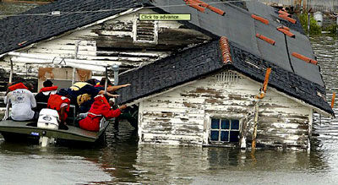
W. Bush –Hurricane Katrina
Led to evacuation and flooding of 80% of New Orleans
Highest storm surge and waves ever recorded on the American continent
Failure of the New Orleans levees
1800 people lose their lives / costliest Hurricane on record
Lack of and delayed response citizens stranded for days on rooftops and in attics
20,000 trapped in New Orleans Superdome – sweltering heat and unsanitary conditions
Bush Administration blamed by many for slow reaction

